Slide 1
Personal Hygiene
by: Yasmeen Ejjeh, Lana Al shafei, Yasmina Alam, Tina Bqaeen

Slide 2
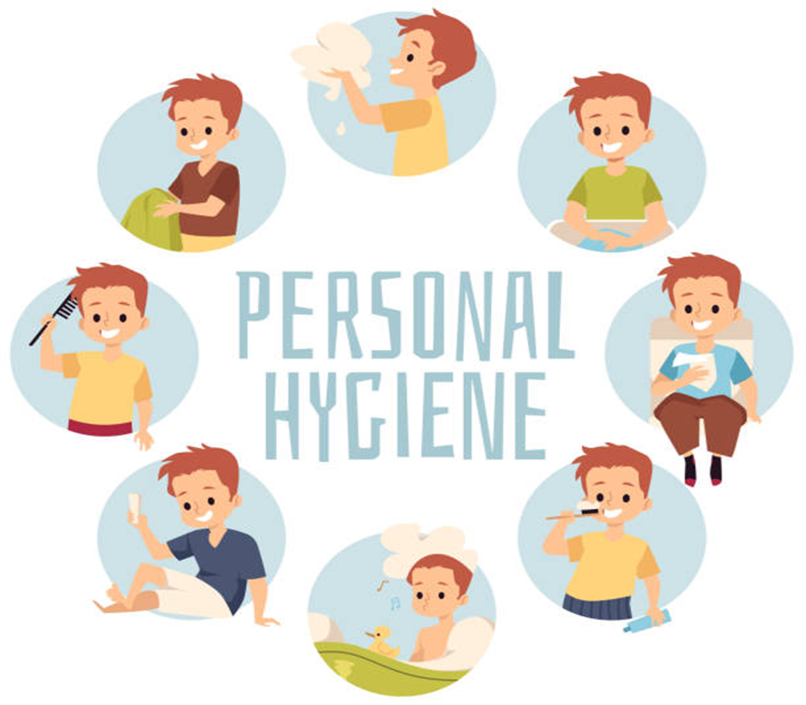
What is personal hygiene?
Personal Hygiene is how you care for your body. Everyday you come into contact with millions of outside germs and viruses. To prevent that you should maintain personal hygiene.

Slide 3
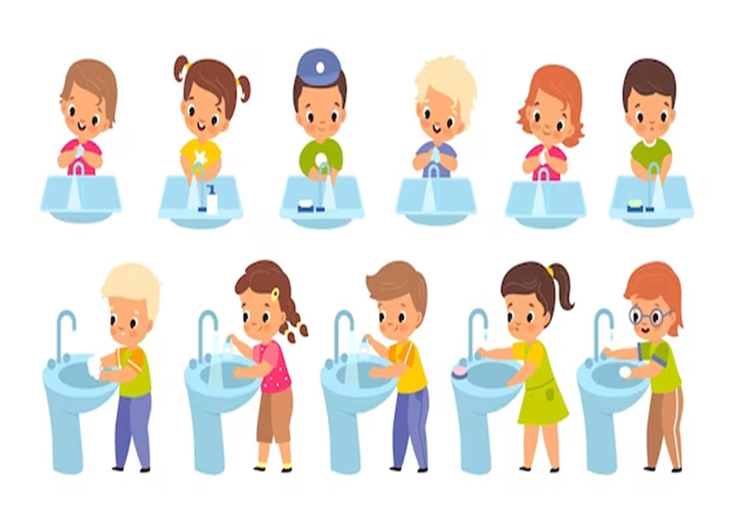
What are the different types of Personal Hygiene?
Hand Hygiene
Nail Hygiene
Hair Hygiene
Facial Hygiene
Oral Hygiene

Slide 4
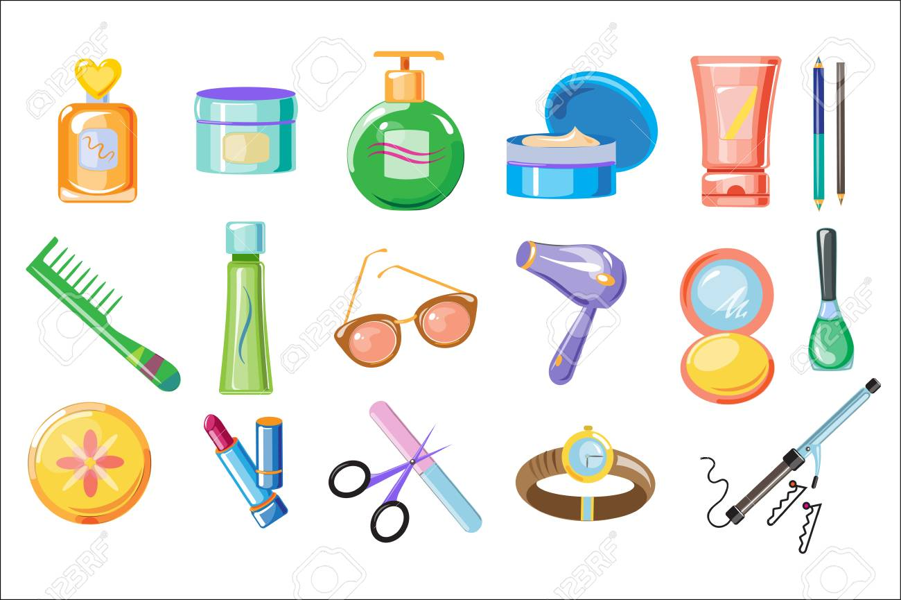
What are the best ways to maintain Personal Hygiene?
Some of the best ways to maintain personal hygiene are:
Washing your hands frequently
Brushing your teeth twice a day
Showering frequently
Keeping your nails clean
Washing your hair properly
When coughing and sneezing, cover your mouth and nose

Slide 5
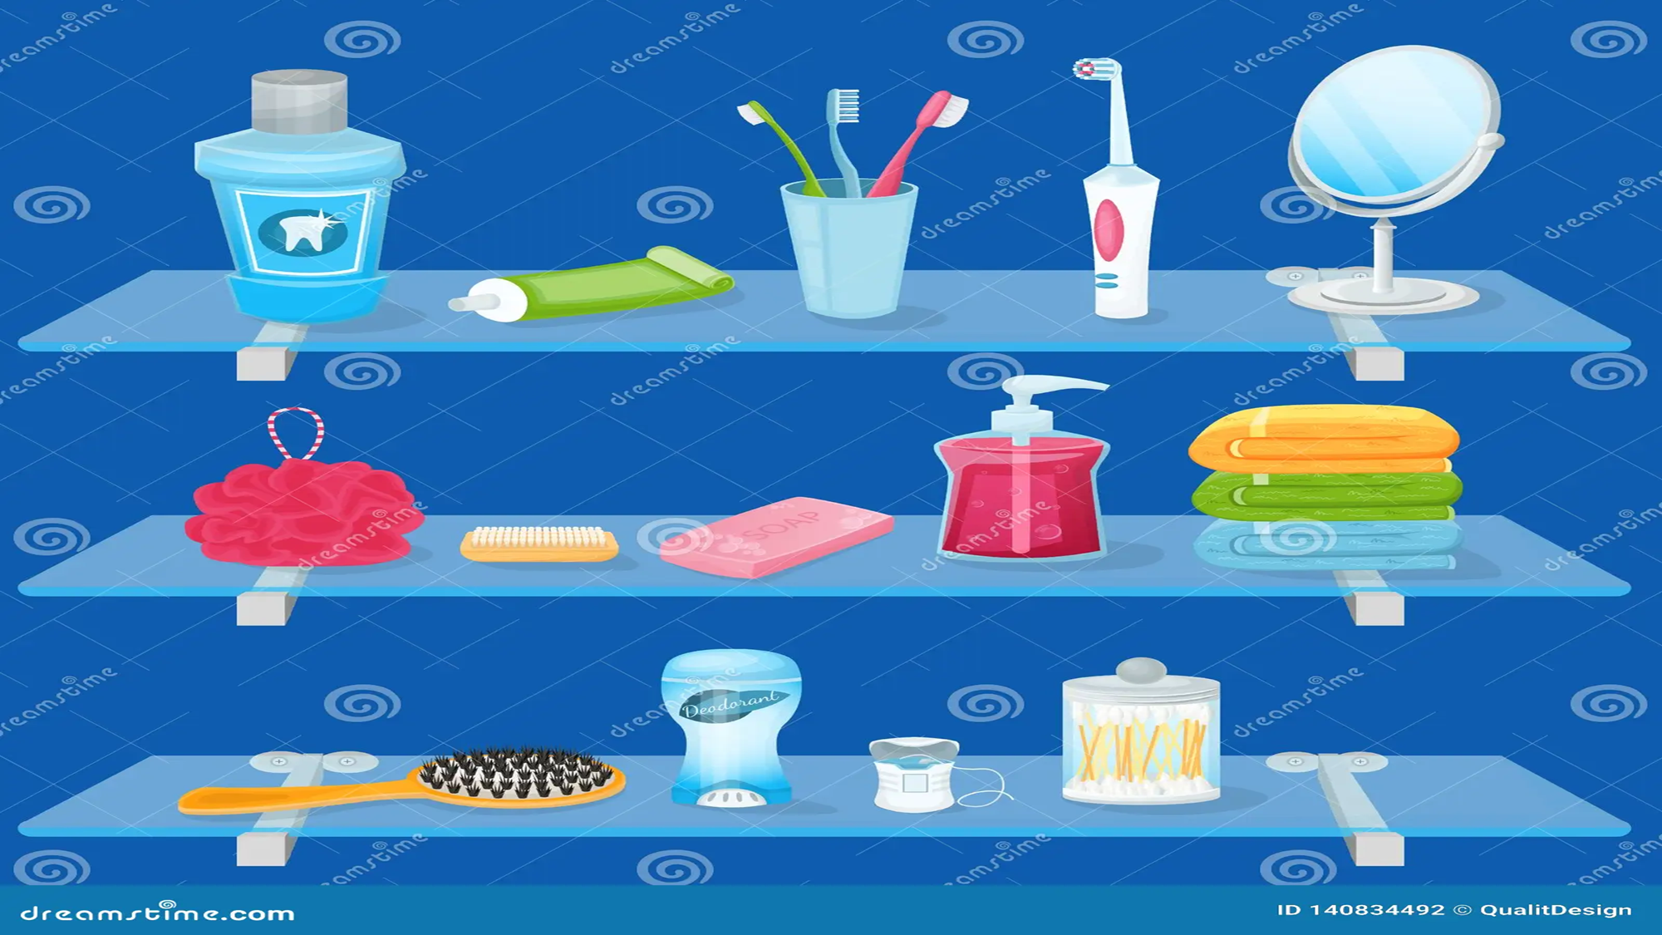
What is the most important part of Personal Hygiene?
The most crucial part of personal hygiene is washing your hands, it can prevent you from catching many diseases and viruses.

Slide 6
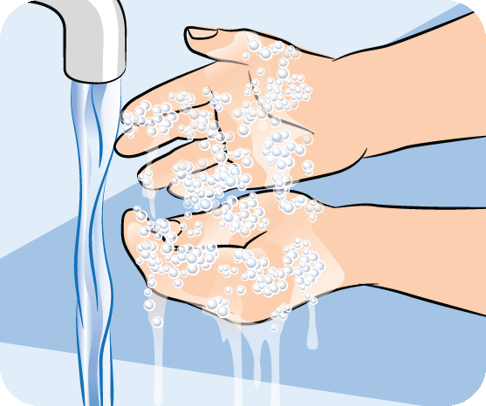
What are the effects of personal hygiene?
Maintaining personal hygiene will help you live a better life because it will prevent you from catching infectious diseases such as Covid-19, colds and the flues. If you are healthy and clean you fell good.

Slide 7
Cross checking data:
1. https://www.cdc.gov/hygiene/personal-hygiene/hands.html
“Hand washing is one of the best ways to protect yourself and your family from getting sick.”
2. https://www.healthdirect.gov.au/personal-hygiene
“Washing your hands often is a good way to stop the germs on your hands making you sick.”
3.https://www.betterhealth.vic.gov.au/health/conditionsandtreatments/handwashing-why-its-important
“Thorough hand washing with soap and water can protect you and others from a range of infectious diseases.”

Slide 8
Methodology
Our methodology was an interview with a pharmacist (medical professional) and based on his answers we made a game and a video:
Game: https://create.kahoot.it/share/personal-hygiene/f956dca8-8483-4e9a-bf54-48b3c517b791
Video:
https://app.animaker.com/editproject/tgNMuxsumiQgMoae?shareid=edit%7CtgNMuxsumiQgMoae

