Slide 1
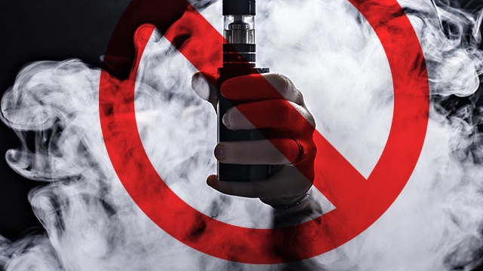
Vaping survey
Made by: Faris Ghawi, Michael Elwerr, Laith Khoury

Slide 2
What is vaping?
Vaping is the inhaling of a vapor created by an electronic cigarette or other vaping device.

Slide 3
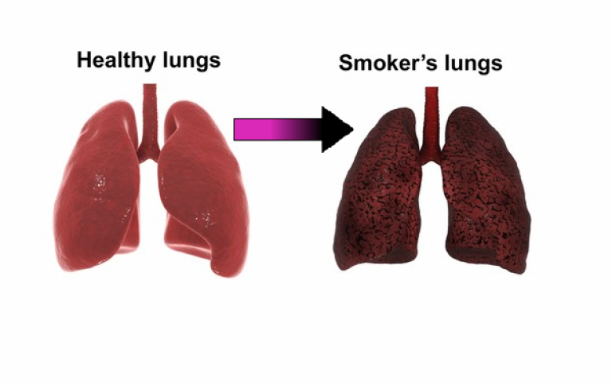
What are consequences of vaping?
addiction: E-cigarettes contain nicotine which is addictive
anxiety and depression: Nicotine makes anxiety and depression worse
becoming a smoker: People who vape are more likely to start smoking regular (tobacco)
exposure to cancer-causing chemicals: vapes contain many cancer causing chemicals
chronic bronchitis: Vaping causes bronchospasm and mucous production leading to the development of respiratory symptoms including chronic bronchitis
And more

Slide 4
What are the causes of vaping?
To quit smoking
To fit in with others
The belief that e-cigarettes are less harmful than other forms of tobacco, such as cigarettes
Because family or friends use them

Slide 5
How to quit vaping
Exercise:
Physical activity is a reliable way to crush a craving
Use a distraction:
Cravings will pass if you can give them a minute or two
Celebrate your accomplishments:
Experts say that recognizing and celebrating accomplishments when you’re quitting can boost resistance to stress and cravings

Slide 6
Survey for answering: https://docs.google.com/forms/d/e/1FAIpQLSfvIfMMC9bNCX9eFKhBupe8rQ6j2mhe5hEGyCoUVbZ6LmuolA/viewform?usp=sf_link
Survey responses:

Slide 7
Citations and cross checking :
https://www.hopkinsmedicine.org/health/wellness-and-prevention/5-truths-you-need-to-know-about-vaping
This can also be found in: Vaping Facts: 10 Vital Facts Vapers and Healthcare Professionals Must Know (smokingaddiction.org)
https://www.tobaccofreeco.org/know-the-facts/vape-myths-vs-facts/
This can also be found in: Vaping Myths and Facts (childrensmercy.org)
https://www.consumernotice.org/products/e-cigarettes/vaping-statistics/
This can also be found in: https://www.samaritas.org/About-Samaritas/News-Updates/vaping-statistics#:~:text=That%20number%20may%20not%20seem,an%20estimated%2086.1%20people%20worldwide.
https://kidshealth.org/en/teens/e-cigarettes.html
This can also be found in: https://my.clevelandclinic.org/health/treatments/21162-vaping

