Slide 1
6TH Grader’s
Personal Safety
By Raed, Awn, Omar and Sery

Slide 2
Introduction
We sent a survey to five 6th graders about their own personal safety, the following slides showcase the questions and responses of the survey.
The black numbers placed above each section of the pie-charts represent the number of people who voted on that particular side.
Survey: https://docs.google.com/forms/d/e/1FAIpQLSddZPEnaUbyHYVVlgkZ5CfzErV2pGWXf4aqkvvP04GNil2jig/viewform?usp=sf_link

Slide 3
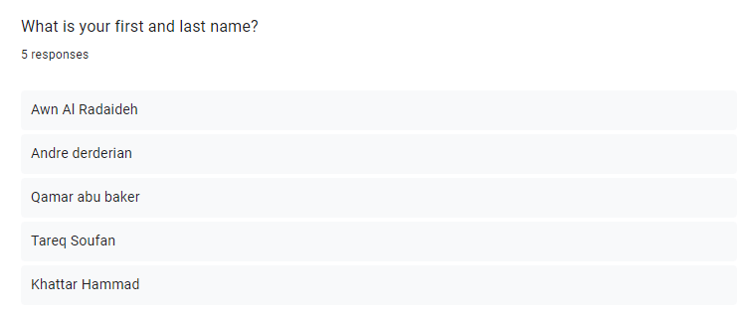
Question 1:

Slide 4
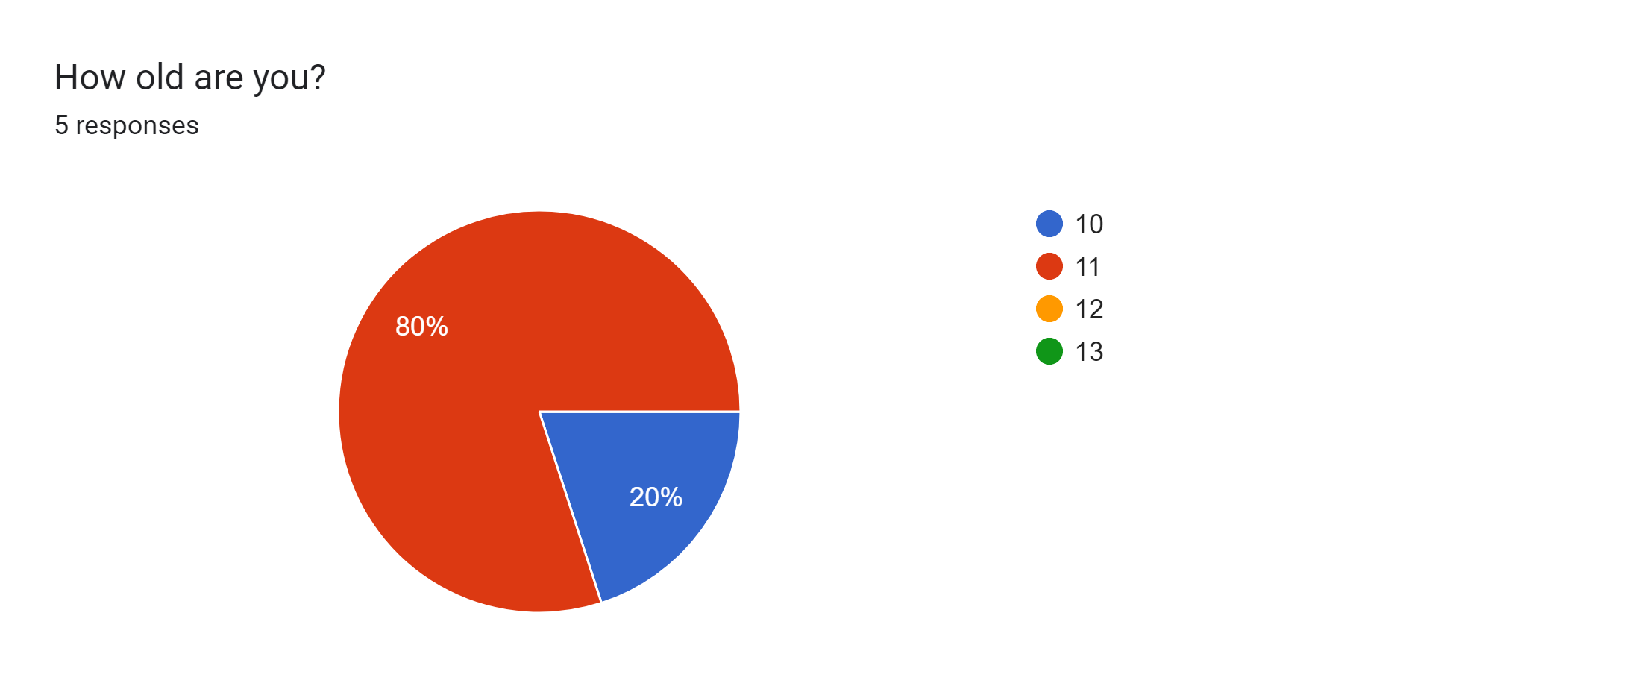
Question 2:
4
1

Slide 5
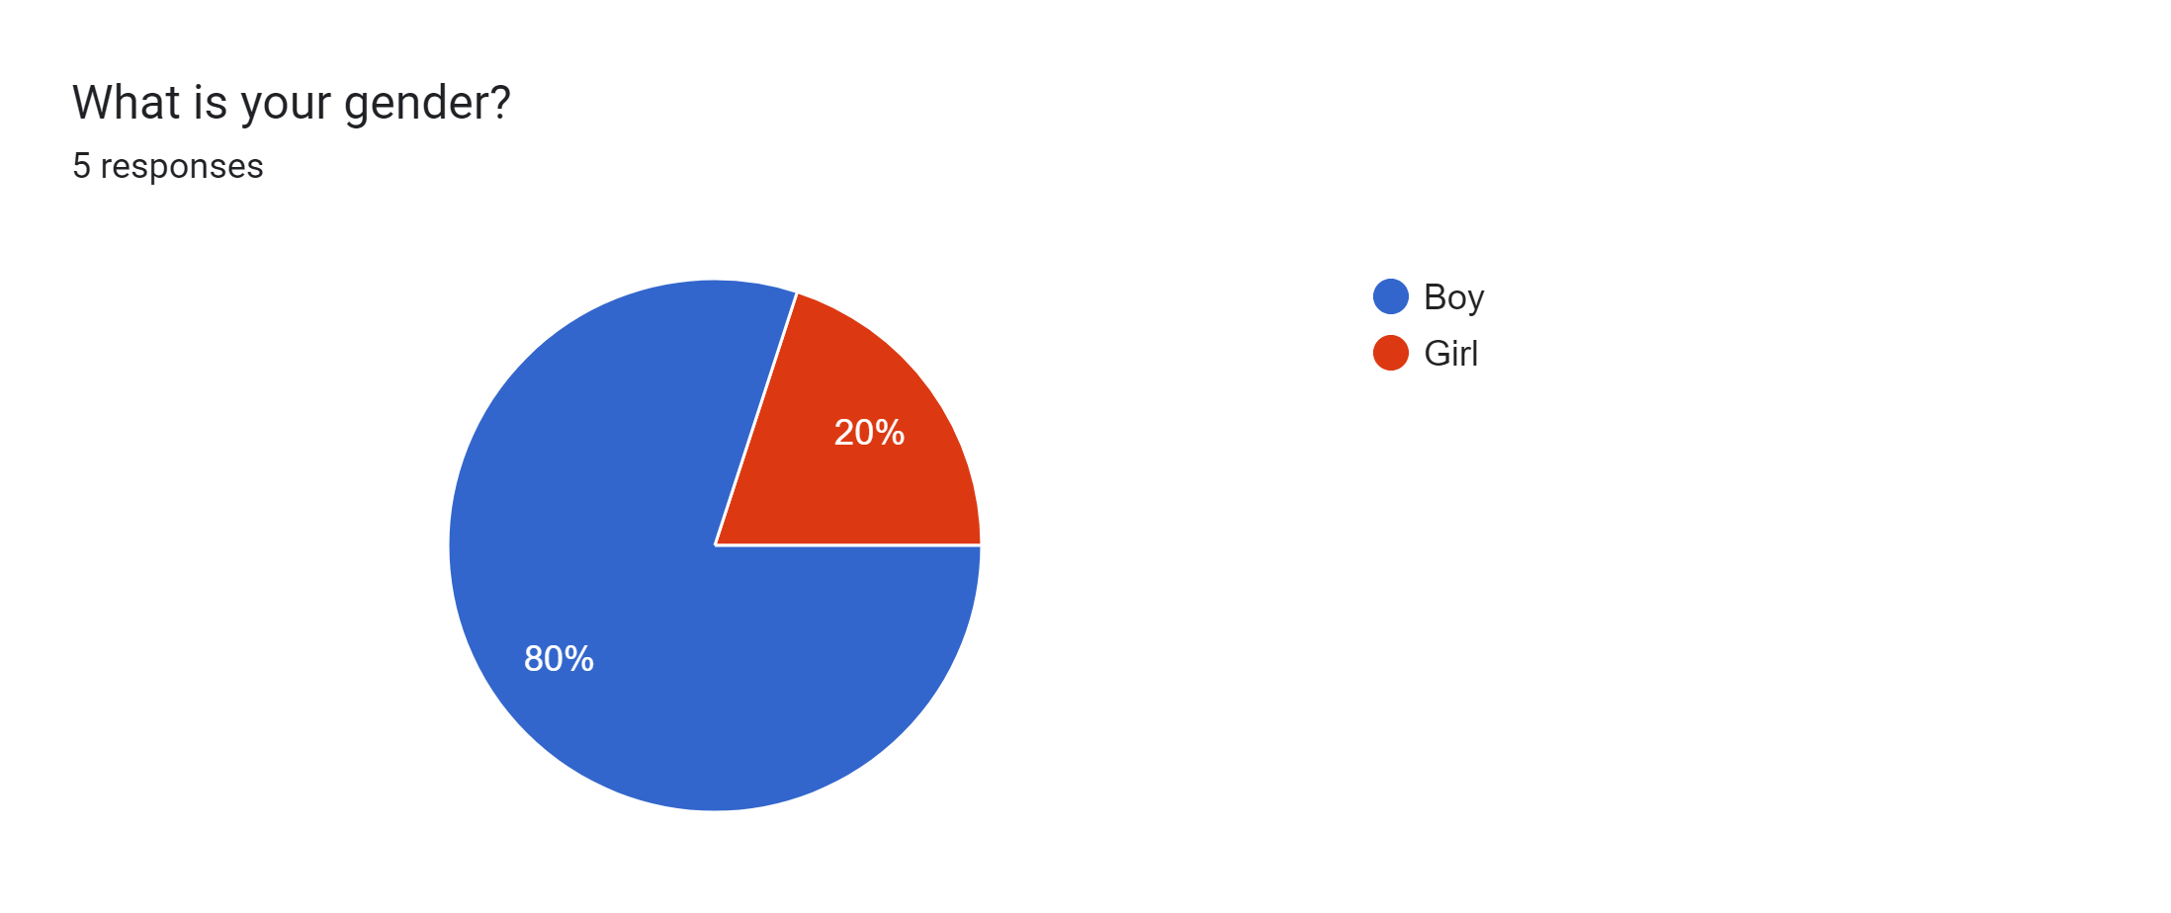
Question 3:
1
4

Slide 6
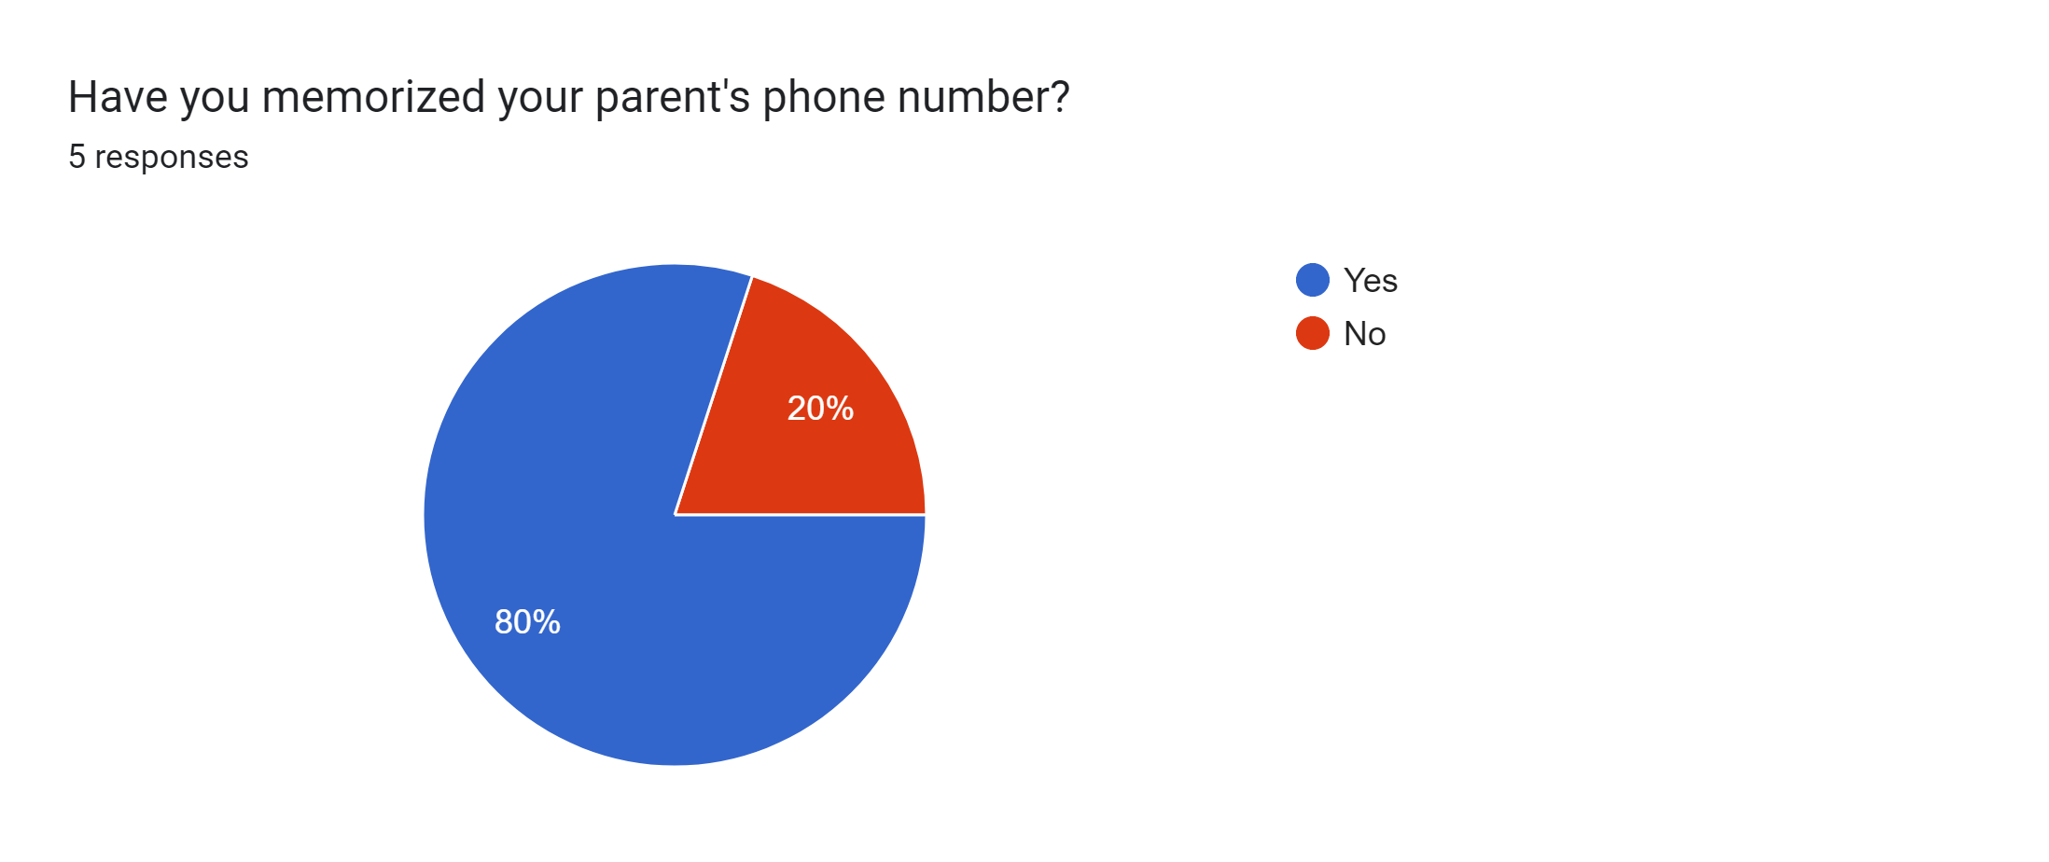
Question 4:
1
4

Slide 7
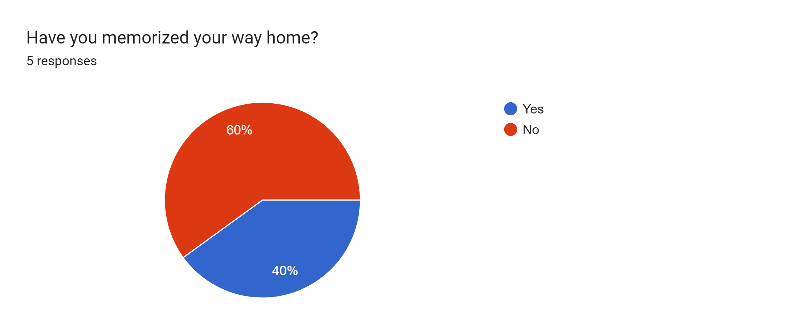
Question 5:
3
2

Slide 8
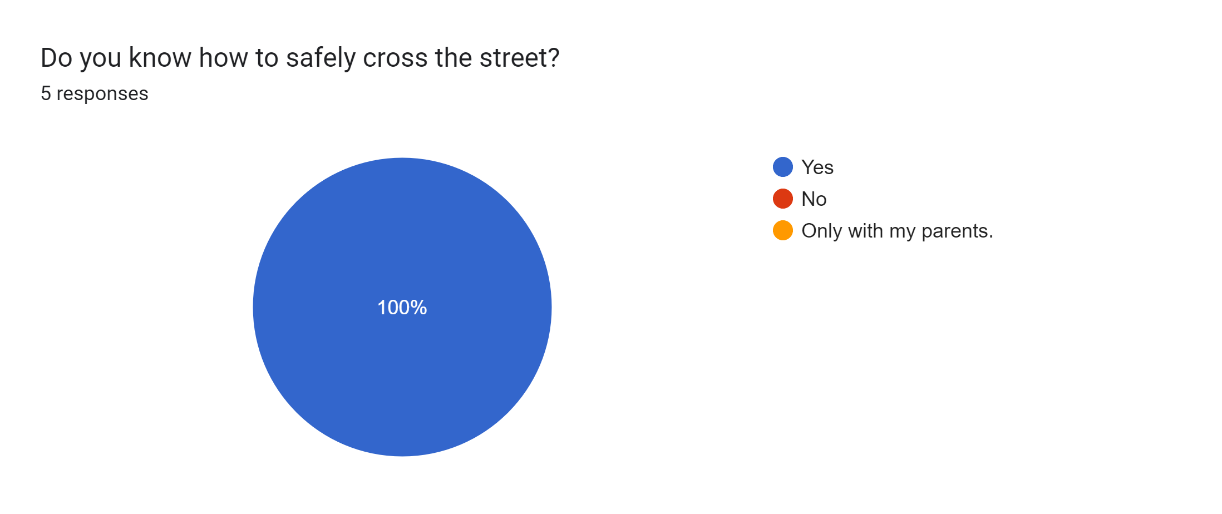
Question 6:
5

Slide 9
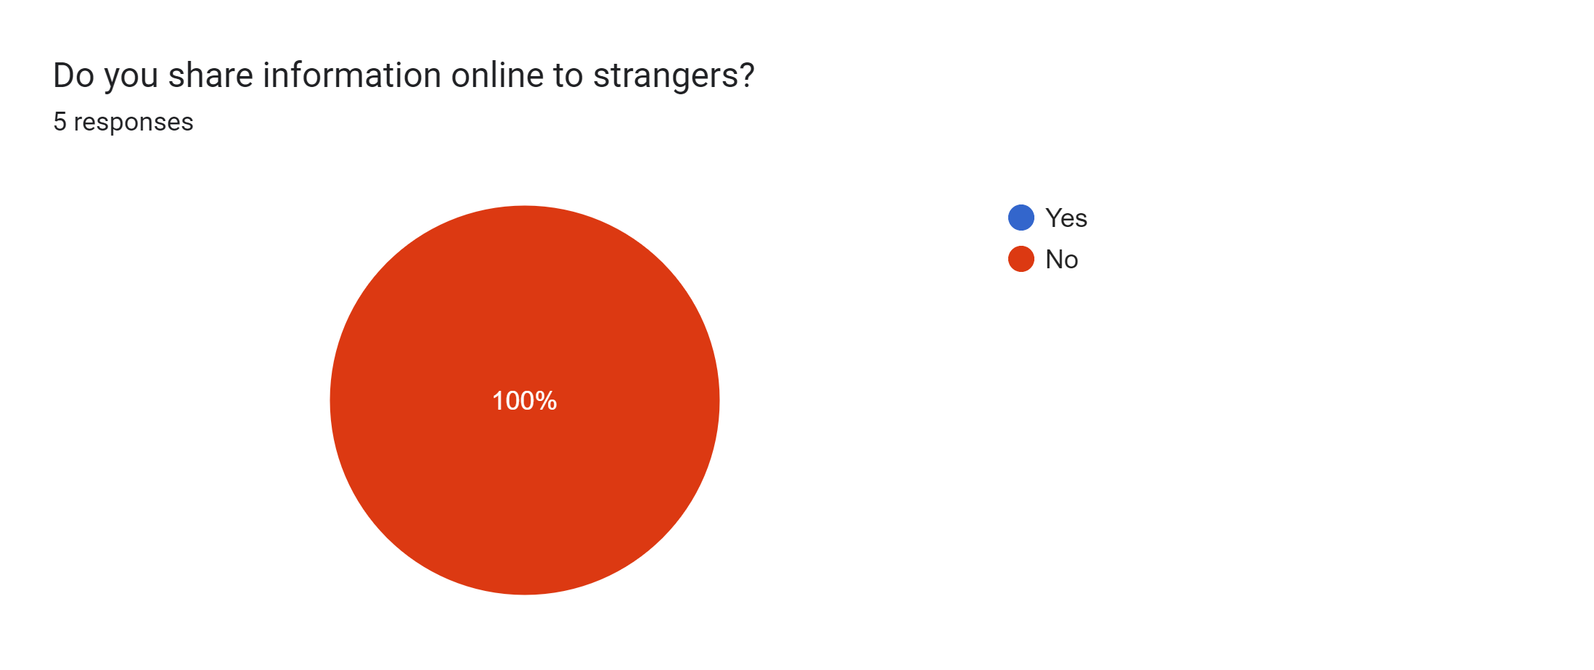
Question 7:
5

Slide 10
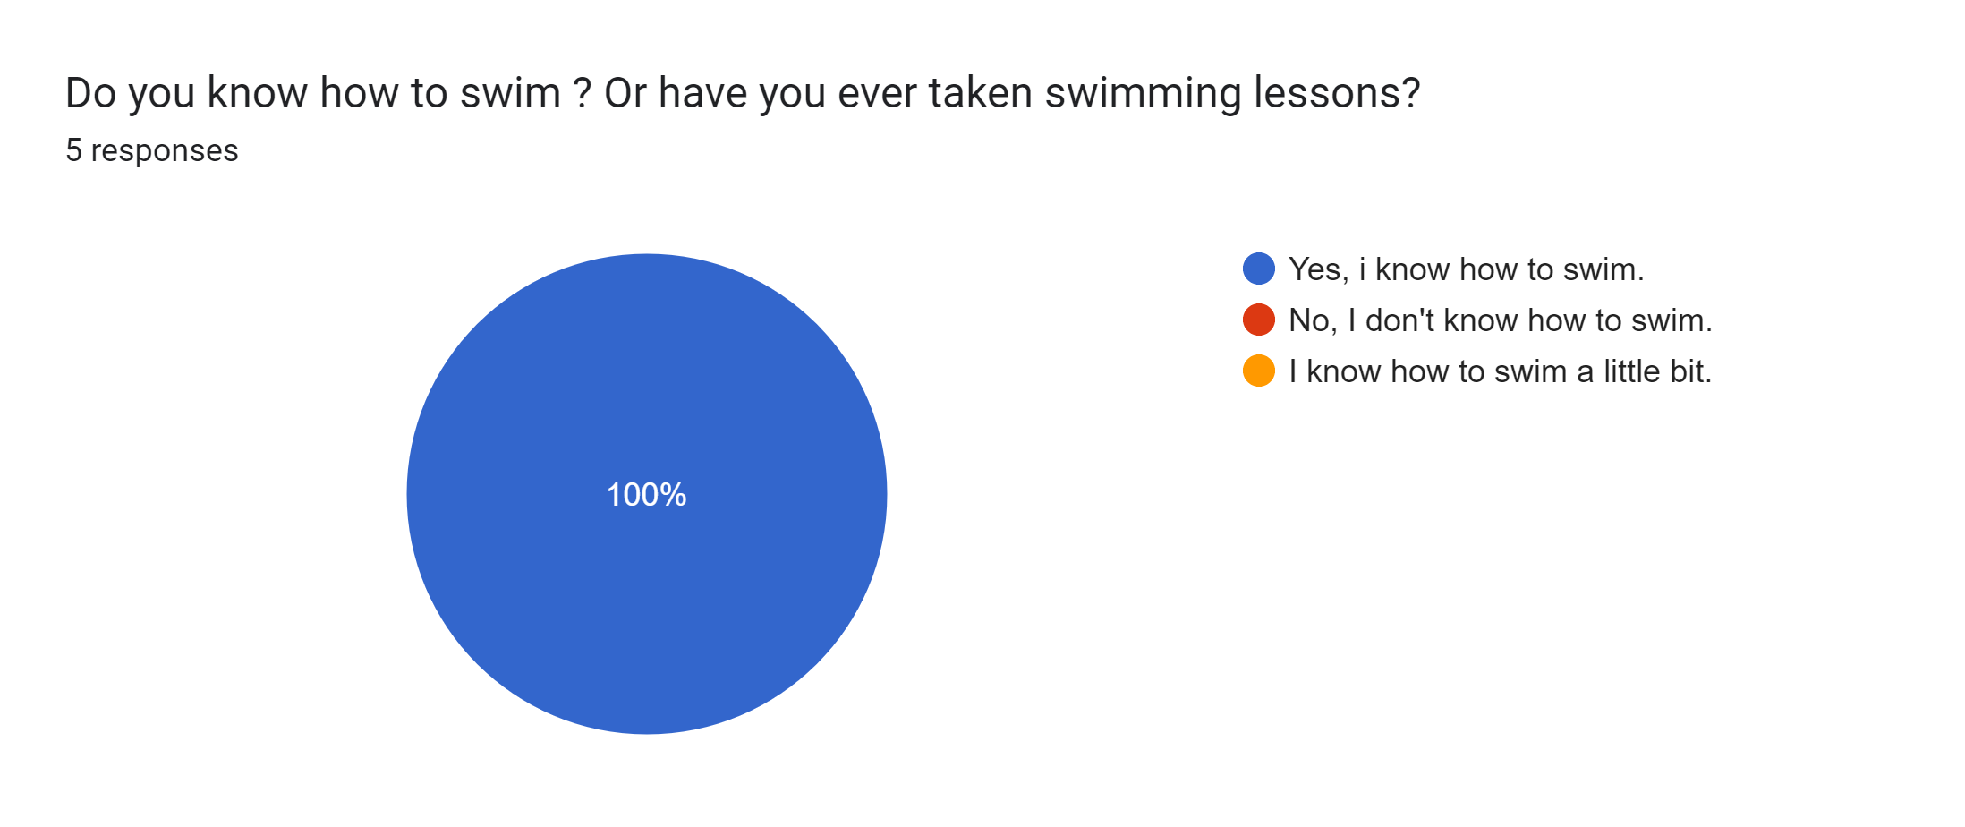
Question 8:
5

Slide 11
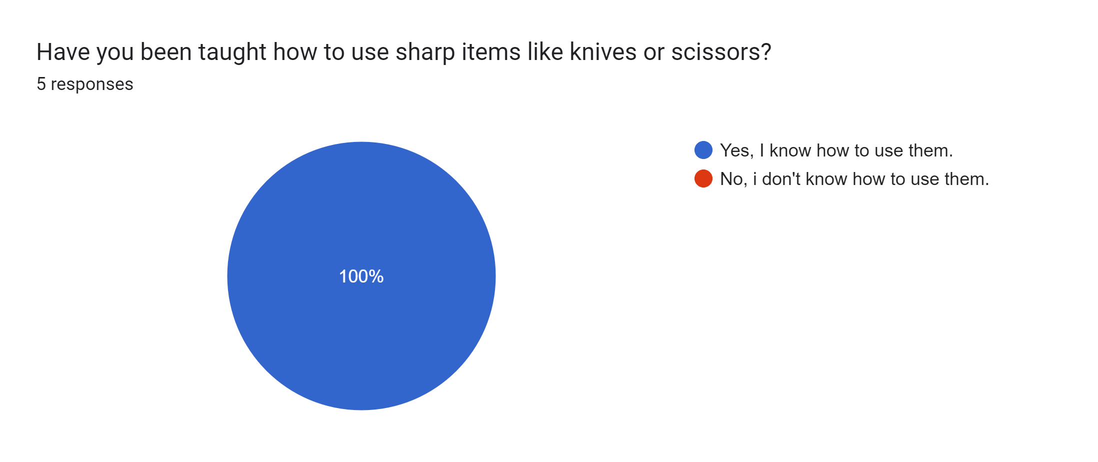
Question 9:
5

Slide 12
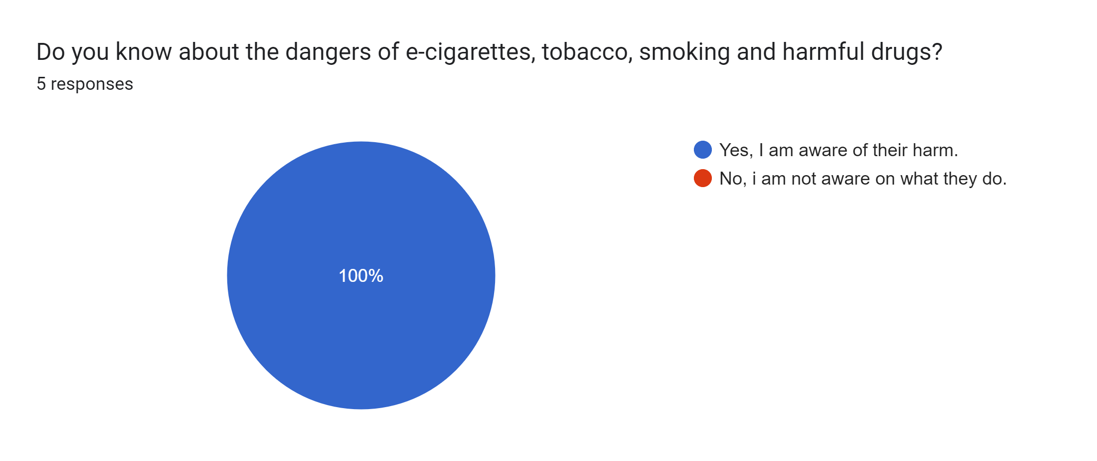
Question 10:
5

Slide 13
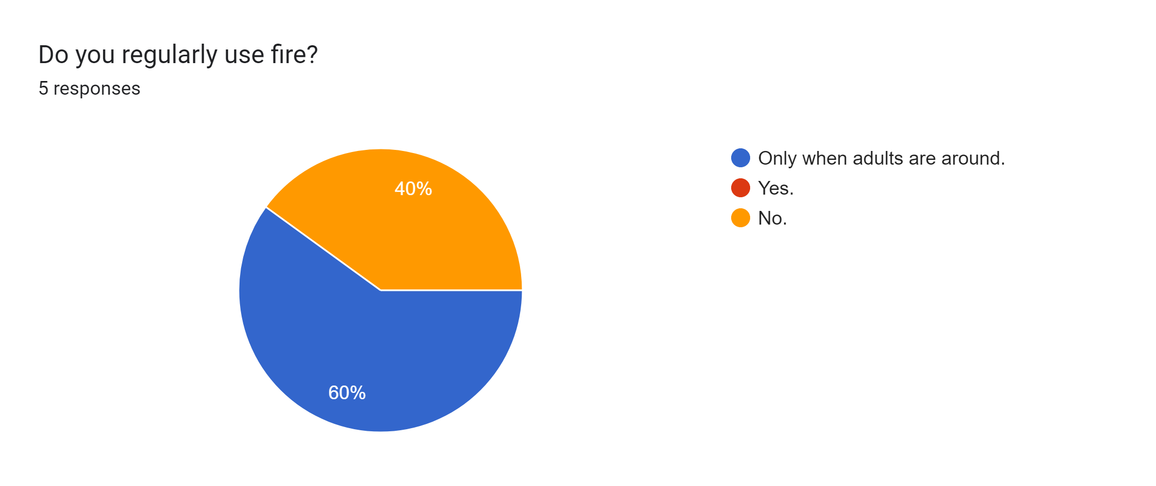
Question 11:
2
3

Slide 14
Conclusion
6th graders are mostly aware of their own safety. With only a few faults.
Thank You.

