Slide 1
Personal Hygiene
Made By: Taleen, Elizabeth, Layan

Slide 2
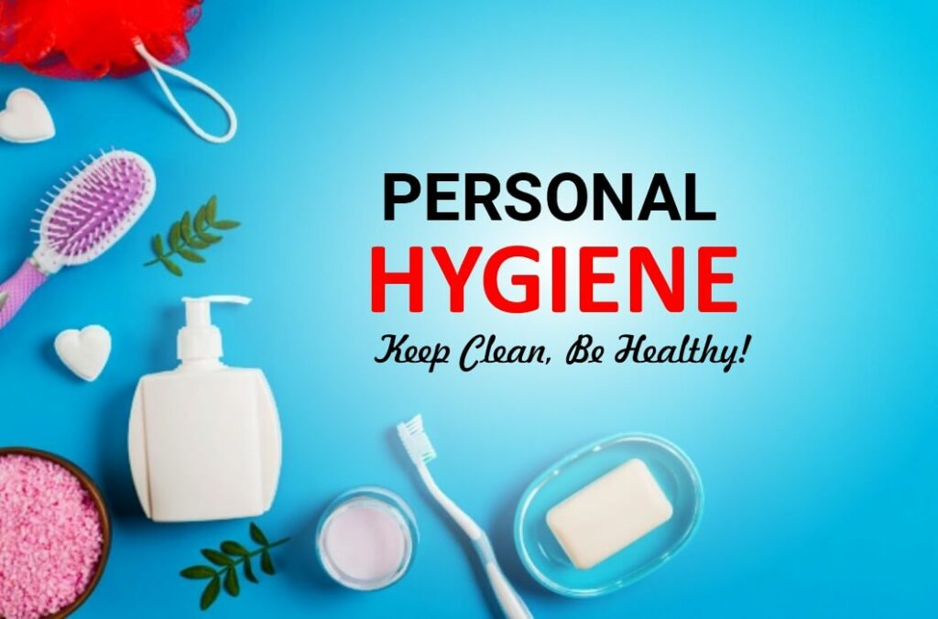
What is Personal Hygiene and Why is it IMPORTANT?
Personal Hygiene is cleansing your body. Showering, brushing your teeth, washing your hands, and washing your face are the basics of good personal hygiene. It’s really important to maintain good hygiene because if you don’t you might get diseases, bad-smelling body odors, etc. Generally, we suggest you have a routine that will allow you to develop great habits.

Slide 3
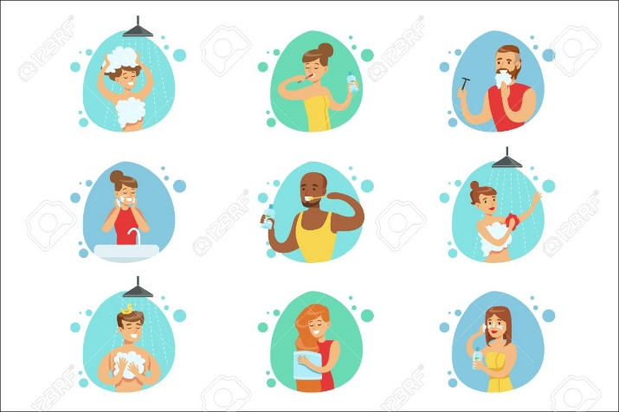
How can you have a Routine?
Honestly, there is no way to force yourself to start doing something and sticking with it, but we advise taking baby steps and not overthink it. Start by bathing yourself regularly, sanitizing your hand, and most importantly maintaining good oral hygiene by brushing at least 2-3 times a day and don’t forget to floss.

Slide 4
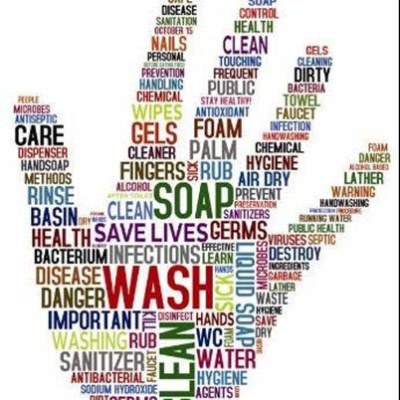
Can not washing your hands regularly lead to some diseases?
The answer is yes, some diseases can infect you by spreading to your hands when you touch a surface. This why it is key to sanitize your hand frequently.

Slide 5
What is body odor and how can I prevent it?
Body odor is what you smell when your sweat comes in contact with the bacteria on your skin. Sweat itself doesn’t smell, but when the bacteria on your skin mix with your sweat, it causes an odor. You can prevent it by bathing regularly as we have said before, wearing clean clothes, etc. If you want to approach a more natural way, some examples are using baking soda, apple cider vinegar, and lemon juice. We know it sounds but trust us it works. And please wash yourself before applying deodorant, with out it, it would smell way worse and you would spread more bacteria.

Slide 6
Should I focus on skincare?
As we are still young, we shouldn’t really focus on extensive product that aren’t for our age. Dermatologists suggest we use only use minimalistic products such as facial cleansers that will remove the dirt on our face, moisturizer as well as sunscreen.

Slide 7
survey
We designed a survey to get information; to help us understand if people are aware about personal hygiene.
We sent the survey to 17 people ages 12-14.

Slide 17
Citations
Healthdirect Australia. (n.d.). Personal hygiene. Healthdirect. https://www.healthdirect.gov.au/personal-hygiene#:~:text=Personal%20hygiene%20includes%3A,sleeve)%20when%20sneezing%20or%20coughing
Aabcx. (2022). Basic Personal Hygiene Habits To Practice In Daily Life. Training Express. https://trainingexpress.org.uk/basic-personal-hygiene-habits-to-practice-in-daily-life/
Skin care for children and teens. (n.d.). https://www.boystownpediatrics.org/knowledge-center/skin-care-children-teens
Department of Health & Human Services. (n.d.). Handwashing - Why it’s important. Better Health Channel. https://www.betterhealth.vic.gov.au/health/conditionsandtreatments/handwashing-why-its-important#handwashing-helps-prevent-spread-of-infectious-diseases
Professional, C. C. M. (n.d.). Body odor. Cleveland Clinic. https://my.clevelandclinic.org/health/symptoms/17865-body-odor

