Slide 1
Bad Habits (Vaping)
Target audience: ages 12-16
By:Ammar,Firas,Katia,Tia

Slide 2
What is vaping(Definition)
Vaping is the action or practice of inhaling and exhaling vapor containing nicotine and flavoring produced by a device designed for this purpose.

Slide 3
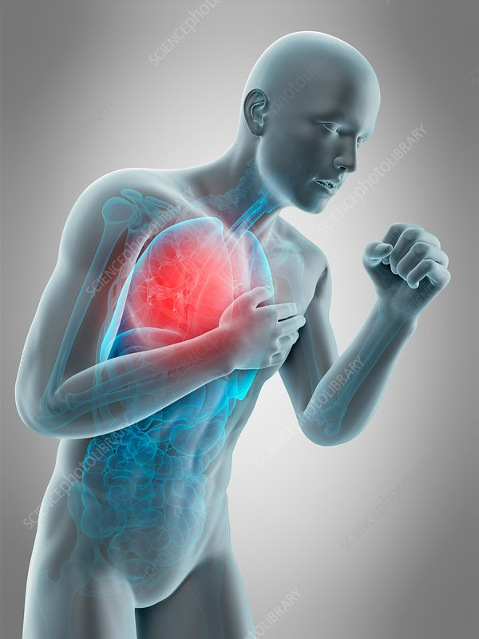
What are the causes of vaping
There are many causes of vaping such as: the belief that it relieves stress or looks cool.
There are adults who sells vapes for teenagers to get profit illegally.
Many teens believe vaping is less harmful than smoking, but it not.
The availability of flavors, such as mint, candy, fruit or chocolate called : juices.

Slide 4
What are the effects of vaping?
There are common side effects of vaping such as:
Dry mouth, coughing, nausea and headaches as well as cardiovascular (heart) disease. And it can also cause asthma.
Nicotine exposure during the teenage years can harm brain damage.
It produces a number of dangerous chemicals including acetaldehyde, acrolein and formaldehyde.

Slide 5
How can we quit vaping?
exercise: physical activity is a reliable way to crush a craving.
Use a distraction: using a distraction to take your mind off the craving of vaping will help speeding up the process of quitting it.
Find stress solutions: many people turn to vaping and they are stressed out, so they should try other solutions such as: meditating.

Slide 6
Our observation took place in the supermarket next to NOS. When we got there we saw about 16 people smoking e-cigarettes from the ages of 14 to 17 year olds who think they are cool, and some older people selling and giving vapes to little children so they get addicted and start to buy more and more vapes. During our observation we saw cigarettes and vapes around and next to the supermarket. We went back to the supermarket a few weeks later we saw that the number of people doubled, which means that there are more and more people getting addicted everyday.
Our observation

Slide 7
https://www.drugwatch.com/e-cigarettes/side-effects/
https://vapingfacts.health.nz/the-facts-of-vaping/side-effects-of-vaping.html
https://teen.smokefree.gov/quit-vaping/how-to-quit-vaping
https://truthinitiative.org/research-resources/quitting-smoking-vaping/quitting-vaping-here-are-5-tips-handling-nicotine
https://www.google.com/url?sa=t&source=web&rct=j&opi=89978449&url=https://www.lung.org/quit-smoking/e-cigarettes-vaping/impact-of-e-cigarettes-on-lung%23:~:text%3DE%252Dcigarettes%2520produce%2520a%2520number,as%2520cardiovascular%2520(heart)%2520disease.%26text%3DE%252Dcigarettes%2520also%2520contain%2520acrolein,primarily%2520used%2520to%2520kill%2520weeds.&ved=2ahUKEwi2-br_r4GCAxXs7bsIHeJ8AU4QFnoECAsQBQ&usg=AOvVaw18tXWA6Dahq4Vwq-vOSDkF
https://healthmatters.nyp.org/can-vaping-lead-to-lung-disease/

