Slide 1
Diabetes
By: Natali Nijmeh, Omar Alsumrain, Laith Boshnaq, Tala AlWazani

Slide 2
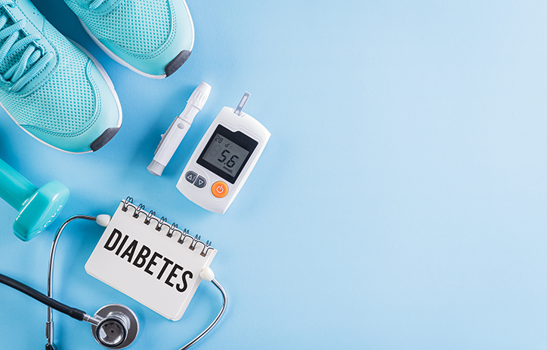
There are many chronic diseases, one of the most common diseases is diabetes, there are many types of diabetes.
Approximately 422m have diabetes worldwide. How many of your friends and loved ones suffer from diabetes?
To protect your loved ones you have to raise awareness and inform them about the dangers of this menacing disease.

Slide 3
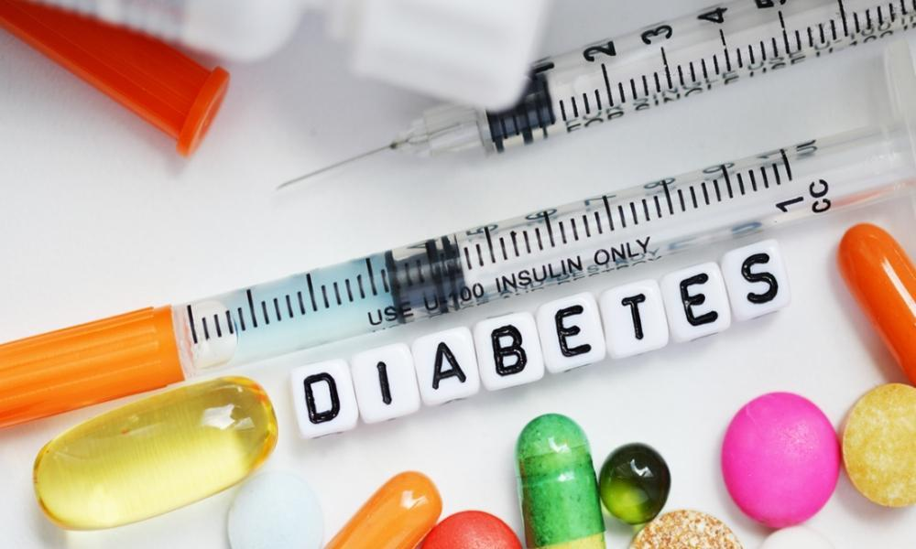
What is diabetes?
Diabetes is when the pancreas fails to generate sufficient insulin or when the body struggles to utilize the insulin it produces, it leads to an imbalance in blood glucose levels. Insulin, a hormone responsible for controlling blood sugar, is crucial in this process.

Slide 4
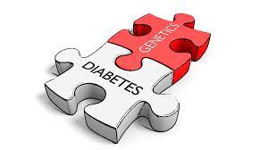
What are the causes of Diabetes?
Diabetes type 1 is caused by the immune system’s attacking and destroying of the beta cells which are cells that produce insulin, a hormone that controls the glucose level in the blood. Diabetes type 2 is the most common type of diabetes and is caused by various factors such as obesity, being physically unactive, insulin resistance and genes. Insulin resistance is when cells in the muscles, fat and liver cannot take up glucose from the blood easily and do not respond well to insulin. Gestational diabetes is believed to be developed during pregnancy.

Slide 5
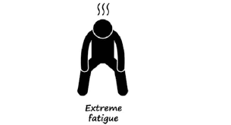
What are the symptoms of diabetes?
There are many symptoms of diabetes and they include:
Extreme exhaustion
Unintentional weight loss
Intense hunger and thirst
Slow healing wounds
Tingling or numbness in body parts
Increased frequency of urination

Slide 6
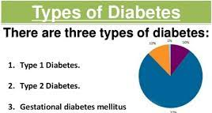
What are the types of Diabetes?
There are three types of diabetes and they are:
Type 1: Resulting from an autoimmune reaction where the body attacks itself, this type prevents insulin production.
Type 2: Is the most common type of diabetes, this type occurs when the body can't produce enough insulin to control high blood sugar level
Gestational diabetes: Occurring during pregnancy in women with no prior diabetes history, it increases health risks for the baby and usually resolves after childbirth.

Slide 7
How does diabetes affect the lives of the ones suffering from it?
When diabetes is not controlled well, the blood sugar level goes up. This can damage many body parts including: The eyes, the heart, the feet, the nerves and the kidneys. It can also cause high blood pressure which is very dangerous. In the terms of social life, diabetes can cause anxiety and stress, especially hypo anxiety that is the fear of situations where a person might get low blood sugar, for example during exercise, which can lead to avoiding such social situations.

Slide 8
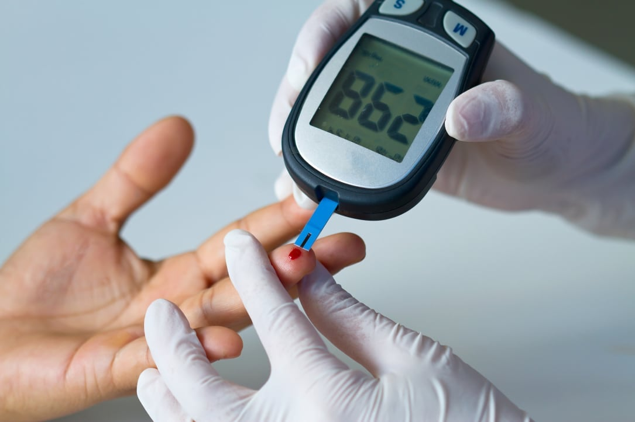
How can we prevent diabetes?
There are many ways to prevent diabetes, and they include:
Healthy eating, by choosing a variety of nutrient-dense foods to maintain a balanced diet
Engaging in regular physical activity such as swimming or jogging
Achieving and maintaining a healthy weight
Drinking plenty of water
Decreasing the consumption of sugary drinks
Scheduling regular check-ups with your doctor to monitor your health and blood glucose levels

Slide 9
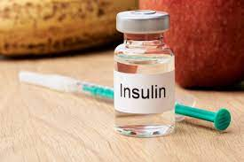
Interesting Facts about Diabetes:
Did you know that:
The first successful insulin injection in humans took place on January 11th 1922, which marked a significant breakthrough in diabetes treatment
Dogs and cats can also develop diabetes
The International Space Station has had astronauts with diabetes go to space while closely monitoring their health
November is diabetes awareness month, and national diabetes day is the 14th of November
Before the development of insulin, insulin used to be extracted from animals such as cows
Sometimes, uncontrolled diabetes can lead to a fruity or sweet odor on the breath

Slide 10
Below is the animated video we made :

Slide 11
Sources:
https://www.niddk.nih.gov/health-information/diabetes/overview/symptoms-causes
Crosscheck: https://www.mayoclinic.org/diseases-conditions/diabetes/symptoms-causes/syc-20371444
https://www.who.int/news-room/fact-
sheets/detail/diabetes
Crosscheck: https://www.cdc.gov/diabetes/basics/diabetes.html#:~:text=With%20diabetes%2C%20your%20body%20either,releases%20it%20into%20your%20bloodstream
https://dtc.ucsf.edu/types-of-diabetes/
Crosscheck: https://www.narayanahealth.org/blog/types-of-diabetes/
https://www.communityaccessnetwork.org/10-facts-about-diabetes/
https://www.cdc.gov/diabetes/basics/diabetes.html
https://www.who.int/health-topics/obesity#tab=tab_1

