Slide 1
Gaming addiction
By: Mohammed Al-Radaideh, Hashem Abdulrazik, Yazan Khoury, Michel Mousa

Slide 2
Methodology: Field-work observation
Topic: Addiction(Gaming addiction)
Location: Aliens Gaming Centre(Tilaa’ Al Ali)
Time: At night( 8pm on Thursday)

Slide 3
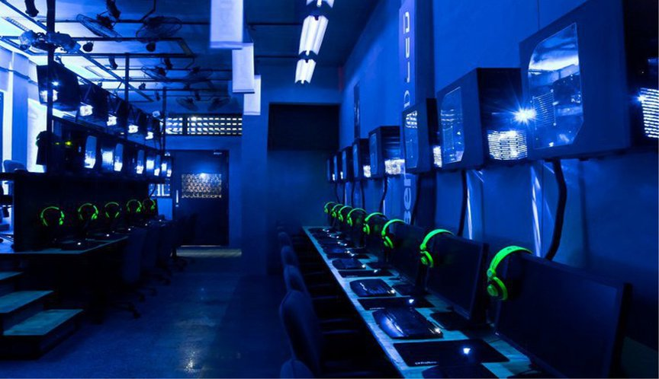
We went to one of the most famous gaming exhibits in Jordan,(Aliens Gaming Centre) and observed people from different ages being locked to the screen and focusing so hard that these kids were screaming at one another when they lose in a game. They sometimes shout and use words that can have a negative impact on the sensitive society.

Slide 4
They are being brainwashed by these games and they are not noticing it. Believe it or not, we saw kids aged 4-7 playing games non-stop and being locked to the screen, this can have a huge impact on the societies’ future and turning it to a negative one from these brainwashed kids. We went there on a weekend, and we also went at the Gaming Centre on a Thursday night where we found a lot of people sitting and playing games for hours.

Slide 5
We asked some questions to the employs in the Centre and they told us that the number of people that come to the Centre at night is way more than the number of people that come at midday. We assumed that the people that come at night and do not come midday are people that have schools in the day and come at the Centre at night. In addition, the Gaming Centre provides snacks and drinks which make people stay for more hours.

Slide 6

Moreover, we noticed that the prices for playing in the Centre were not really expensive at all. This means that the Centre is trying to promote their business and attract customers. Even at home, the new generation always have access to video games and electronic devices. Video games can be distracting to school work. Also, video games give you access to online play where you can meet people that can be harmful and dangerous.

Slide 7
This can expose to human threats and viruses. One of the group members’ little brother plays all day on his IPad and sometimes play with people that he doesn’t know and have never met before which can be extremely harmful, he keeps shouting and throwing his IPad when he loses or the IPad turns off. This behavior can effect their familie’s point of view on them.

Slide 8
Thank you

