Slide 1
Cancer
By: Jeeda Karadsheh, Maria Awad, Tina Ghawi, Zina Bawab

Slide 2
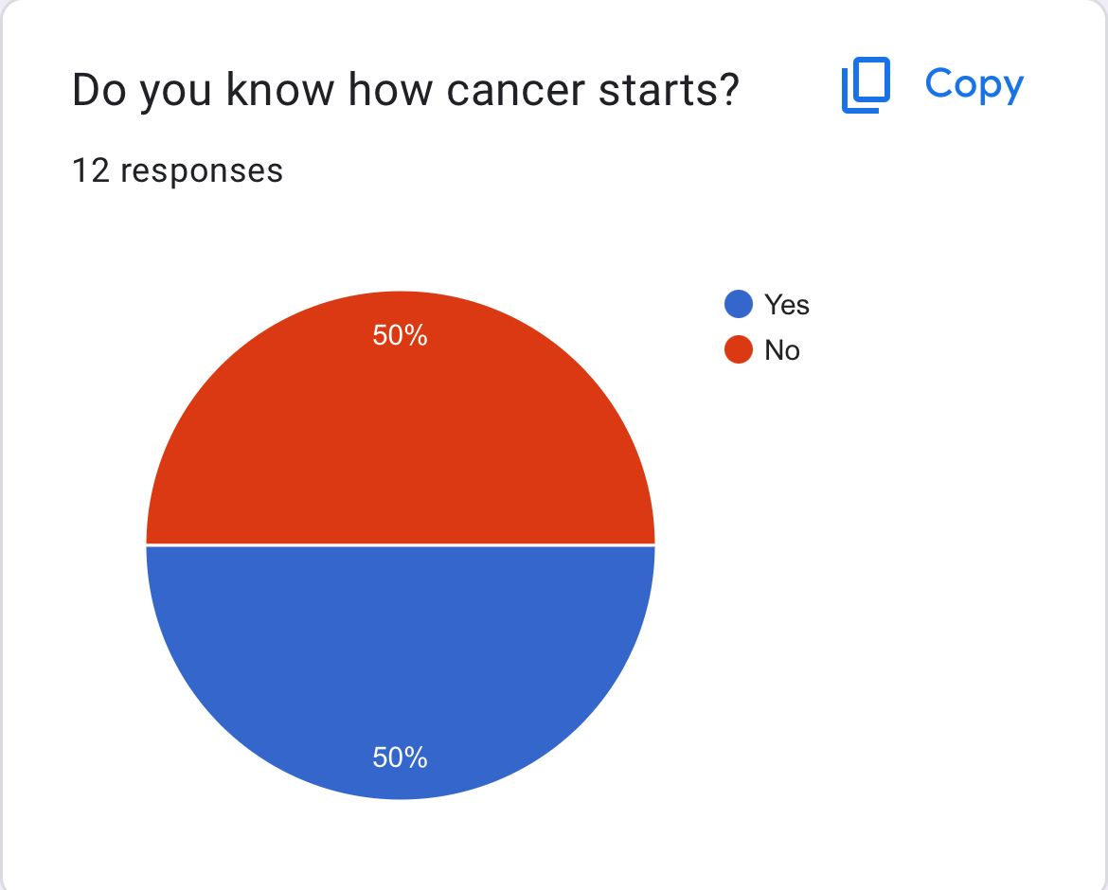
Introduction
For this presentation we have done our research using a survey and we have seen that 50% of people have no knowledge about the beginning of cancer. Here is the results:
However this presentation will help you get more knowledge about the topic.

Slide 3
What is cancer?
Cancer is a disease, which is caused when the cells divide uncontrollably and spread into the surrounding tissues. Cancer is also a Malignant tumor which can grow quickly and spread into areas close by.

Slide 4
What can cause cancer?
Cancer may be caused by changes to the DNA within cells. The DNA which is inside the cell is packaged into a large number of individual genes and they can be getting different functions to perform at the same time causing a disruption in its growth.

Slide 5
What are some warning signs for cancer?
Some of the early warning signs for cancer are:
Rapid and unexpected weight loss
Fatigue
Fever
Harsh pain
Skin changes

Slide 6
What are common types of cancer?
Some of the most common types of cancer are:
Breast cancer
Colorectal cancer
Prostate cancer
Leukemia
Lung cancer

Slide 7
What can help cure cancer?
The most common cure for cancer is to go through chemo- therapy or surgery. However they are very different cases.
The surgery will remove the cancer, while the chemotherapy will use drugs to kill the cancer cells. But there are other ways to cure it such as radiation therapy and also cryoablation.

Slide 8
Links and Resources
http://www.cancer.gov
http://www.cancer.org
http://www.mayoclinic.org
http://www.hopkinsmedicine.org

Slide 9
Thank you for listening

