Slide 1
Flu Season
Made By: Bandar Al Omari, Faris Dabit, Omar Jumaian, Sanad Darwish, Sanad Qussous
Class: 8E

Slide 2
What We Will Be Covering
How does it
spread
How to prevent it & Places to avoid
How to know if you got the
flu
What is the flu
How to
recover

Slide 3
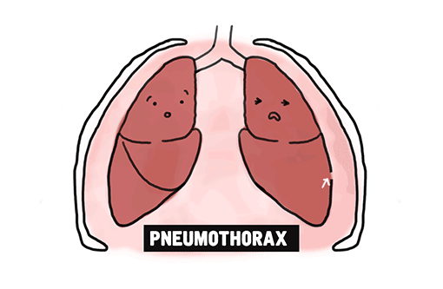
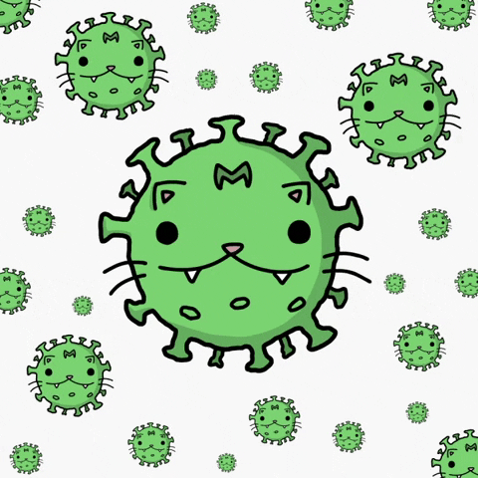
What is the flu?
The flu, commonly known as influenza, is an infection which occurs in our respiratory system (Our breathing system) that affects the lungs, nose, and throat and it mainly lasts from autumn season till spring
Germs
In Lungs

Slide 4
How does the flu spread?
People who have the flu can spread it to others. Doctors have said that flu viruses are mostly transferred when a sick person:
Coughs
Sneezes
Exhales

Slide 5
How to Prevent The Flu!
Avoid being around a
sick
person
Tidy up your hands and clean them
Engage in more healthy acts!
NOTE Some areas are highly contaminated with bacteria and bad germs for you , therefor you should avoid going to them to stay strong and healthy! Places like these include: restrooms , dirty playgrounds and work places
Don’t touch your face if your hands are dirty
Stay away from sick people's close spaces
Keep your own space
TRY
TO
AVOID
THEM

Slide 6
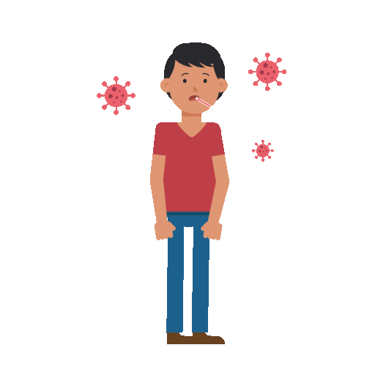
How do you know if you caught the flu?
if you are experiencing body pains, headaches, chills, fever, coughing, sore throats, runny or stuffy noses, and/or exhaustion , then this means you have caught the flu. Vomiting can happen in certain people, but more often with kids. People may be experiencing breathing issues from the flu without having high temperature

Slide 7
How to recover from the flu!
The best thing you can do to recover from the flu is allow yourself to sleep, rest, and drink lots of fluids , aside from that , you should be easy on yourself and be at peace with yourself so you can get the best recovery

Slide 8
Links
Main Links
Cross Checking
https://www.cdc.gov/flu/about/season/index.html
https://onlinenursing.duq.edu/when-flu-season/
https://www.healthdirect.gov.au/flu
https://intermountainhealthcare.org/health-information/germwatch/germ-school/influenza/
https://www.mayoclinic.org/diseases-conditions/flu/symptoms-causes/syc-20351719
https://www.sandiegocounty.gov/content/sdc/hhsa/programs/phs/immunization_branch/Vaccine_Preventable_Diseases/Seasonal_Influenza/

