Slide 1
Obesity
Made By: Zaid Zeidan, Khalid Qutob, Mohammed Mustafa, Eliya Ayoub

Slide 2
What is Obesity
Obesity is defined as being overweight which also means abnormal which shows a risk to the body. The body mass index is something that helps individuals know if they are obese, So if u have a BMI higher than 25 it means that you are overweight and anything above 30 means that you are obese. This issue also grows daily. Obesity is also calculated using BMI

Slide 3
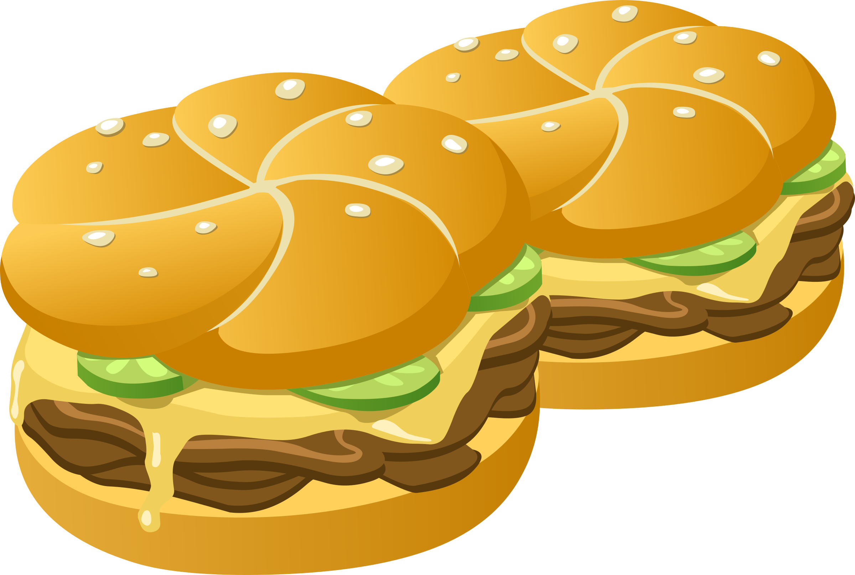
What are the Causes of Obesity
the causes of obesity are overeating
Eating fatty foods like fast food
having a high sugar intake

Slide 4
The Effects of Obesity
heart diseases like coronary heart disease
high blood pressure
It can make u tired throughout the day
It makes u prone to recieve chronic diseases like diabetes

Slide 5
Disadvantages of Obesity
The disadvantages of obesity are the following:
People who are obese receive hate from the public
They become tired throughout the day
Its tougher to play sports

Slide 6
How to Prevent Obesity
To prevent obesity you need to stop eating junk food as often and eat healthier food for your body, in addition you need to lower your carbs intake so that you can lower your weight. Going to the gym and doing cardiovascular exercises like running on a treadmill can help you with this. Lastly go to a nutritionist so that you can receive efficient help to lose weight.

Slide 7
Sites Used
U.S. Department of Health and Human Services. (n.d.). National Institute of Diabetes and digestive and kidney diseases (NIDDK). National Institute of Diabetes and Digestive and Kidney Diseases. https://www.niddk.nih.gov/
Mayo Foundation for Medical Education and Research. (n.d.). Top-ranked hospital in the nation. Mayo Clinic. https://www.mayoclinic.org/
Scottish Health Information You Can Trust. NHS inform. (2023, September 25). https://www.nhsinform.scot/
World Health Organization. (n.d.). Obesity. World Health Organization. https://www.who.int/health-topics/obesity
Obesity consequences. Obesity Prevention Source. (2016b, April 12). https://www.hsph.harvard.edu/obesity-prevention-source/obesity-consequences/#:~:text=The%20High%20Cost%20of%20Excess%20Weight&amp;text=No%20less%20real%20are%20the,overweight%20does%20not%20decrease%20mortality.

Slide 8
Cross-checking
Obesity - Symptoms and causes
Obesity: Causes, Types, Prevention & Definition
What Are Overweight and Obesity?

