Slide 1
Tourette's syndrome
By Joelle Janho , Sara Shehadeh , Sama Haddad

Slide 2
Target audience: 8th graders
power point, poster, focus group
Focus group, poster and presentation

Slide 3
Research questions
What is Tourette's
What causes Tourette's?
how to know if someone has Tourette's?
How can Tourette's be treated?
How common are Tourette's?

Slide 4
Why we used interviews:
It is more efficient
We get quick answers
Raises awareness
Increase social and communication skills

Slide 5
What is Tourette's syndrome
Tourette's is a condition of the nervous system, it can have an impact on children, adolescents, and adults by the neurodevelopment (the brains development if these systems or networks disease known as tourette syndrome)..Tics are brief, uncontrollable motions or sounds that are indicative of the disorder. Tics can range from minor and unimportant to strong and severe, and they can even be insanely unbearable in certain people.
Scientists found that there is an obvious connection between TS(Tourette’s syndrome) and ADHD(Attention deficit hyperactivity disorder).

Slide 6
Terminologies used
Condition
Neurodevelopment
networks disease
uncontrollable motions
Indicative
Disorder
minor
Severe
Unbearable
Impact
Delay
Exposed
Issues
early stages
Prevent
Paralysis
Treating
unbearable

Slide 7
Consequences
Those with TS may be more exposed to learning differences , a learning disability or a developmental delay that has an impact on how well they can understand and use things. They may go through some issues with writing, organizing, and paying attention they also might be exposed to issues with the what they hear and see.

Slide 8
How to prevent Tourette's syndrome
Spotting and treating it at early stages can slightly prevent it from becoming worse or lasting into adulthood unfortunately u can do nothing to prevent it so you just have to live with it and deal with it in certain ways.
if not treated: brain vibrations can, in some tourette cases lead to neck tics which can cause the injuries even paralysis

Slide 9
Focus group script
Do you have any idea what Tourette's is?
What are common signs of tourettes syndrome?
Do you know anyone that has Tourette's? if yes, what ticks do they have?
What causes Tourette's?
How does Tourette's affect someone's social life and what people think of them?

Slide 11
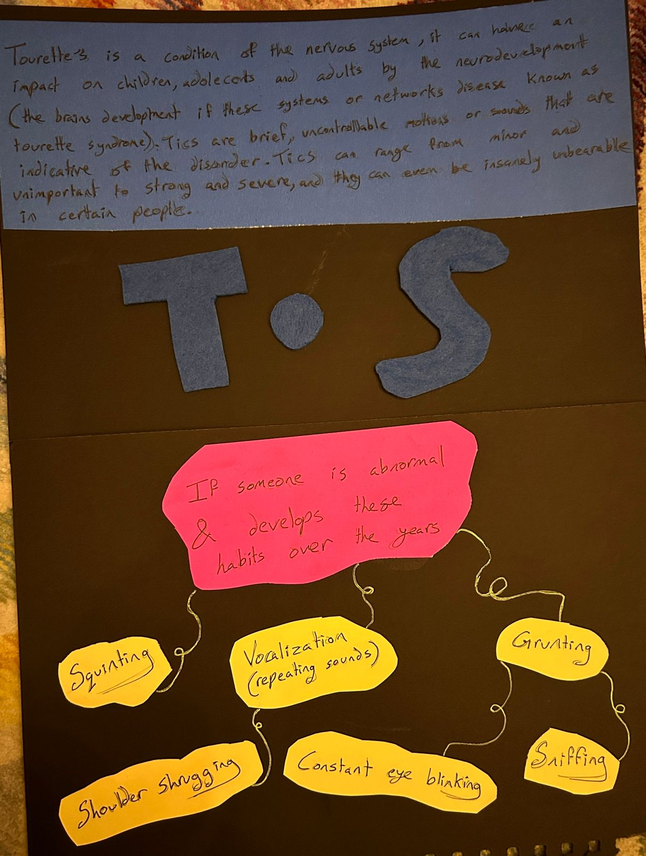

Slide 12
Cross checking
https://www.cdc.gov/ncbddd/tourette/facts.html#:~:text=Tourette%20Syndrome%20(TS)%20is%20a,keep%20blinking%20over%20and%20over.
https://my.clevelandclinic.org/health/diseases/5554-tourette-syndrome
https://www.ncbi.nlm.nih.gov/pmc/articles/PMC4737687/
All websites explain Tourette syndrome differently but deliver the same idea.

