Slide 1
Anxiety
BY: sama,marius,nuor,natalia

Slide 2
introduction
Anxiety is a natural emotion. However, it can also cause physical symptoms, such as shaking and sweating. Anxiety disorders can affect daily life and can improve with treatment. Anxiety disorders form a category of mental health diagnoses that lead to excessive nervousness, fear, apprehension, and worry. People with anxiety disorders usually have recurring intrusive thoughts or concerns. They may avoid certain situations out of worry. For example, you might feel anxious when faced with a difficult problem at work, before taking a test, or before making an important decision. Anxious thoughts or beliefs that are hard to control. They make you feel restless and tense and interfere with your daily life. They do not go away and can get worse over time.

Slide 3
Causes
there are a lot of important causes for anxiety but those are a few of them .
. Stressful life events, such as a traumatic experience, loss of a loved one, or major life change.
. High-stress environments, such as work or school pressure.
. Certain personality traits, such as perfectionism or a tendency to overthink.
. Childhood trauma or abuse.
. And you can have anxiety from feeling under pressure while studying or in work for a long time.

Slide 4
Effects
There are impacts of anxiety that can really harm your life, as well as effects that are extremely awful even if they don't directly cause harm.
. Sweating
. Feeling weak or tired
. Having trouble sleeping
. Having difficulty controlling worry
. Having a sense of impending danger, panic or doom

Slide 5
Solutions
Keep yourself from being anxious and look for ways to overcome anxiety.
. You can learn relaxation techniques
. Do Exercise
. Eat a balanced diet to provides all of the energy you need to keep you active
. Sleep enough to stay in good health
. talk to someone you trust

Slide 6
Department of Health &amp; Human Services. (2002, May 23). Managing and treating anxiety. Better Health Channel. https://www.betterhealth.vic.gov.au/health/conditionsandtreatments/anxiety-treatment-options
Mayo Foundation for Medical Education and Research. (2018, May 4). Anxiety disorders. Mayo Clinic. https://www.mayoclinic.org/diseases-conditions/anxiety/symptoms-causes/syc-20350961
U.S. National Library of Medicine. (n.d.). Anxiety. MedlinePlus. https://medlineplus.gov/anxiety.html
WebMD. (n.d.). Anxiety causes and prevention. WebMD. https://www.webmd.com/anxiety-panic/causes-anxiety

Slide 7
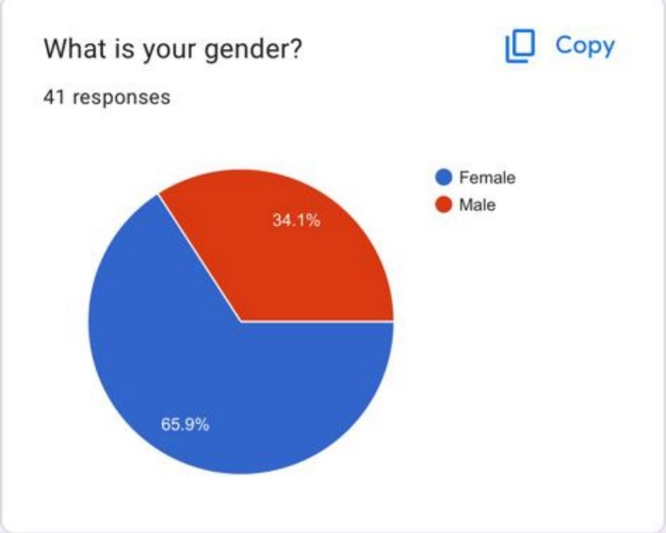
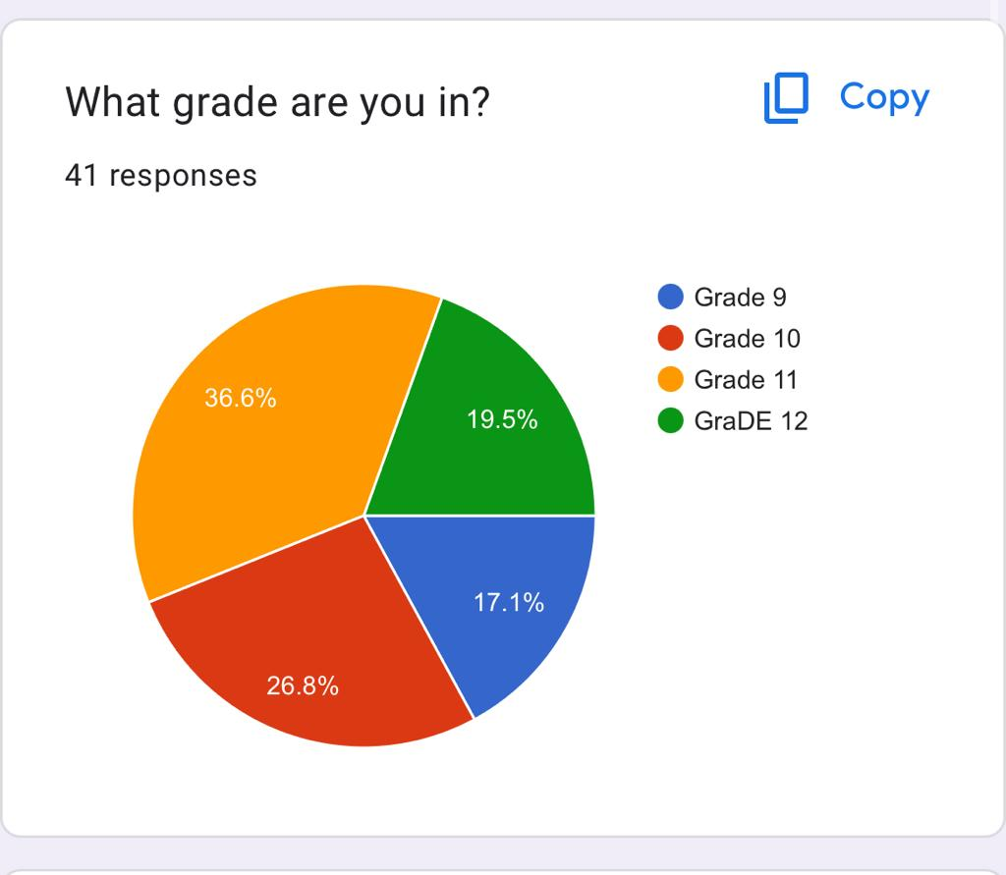
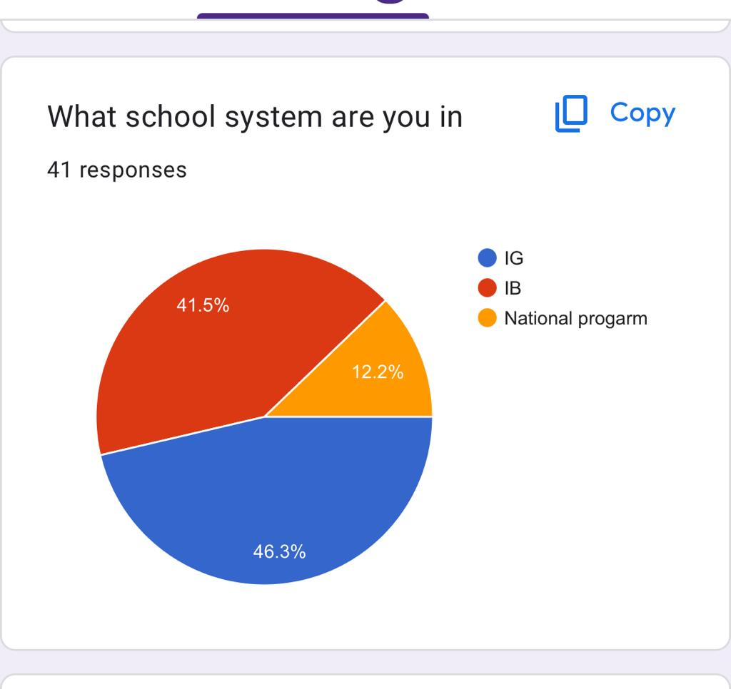
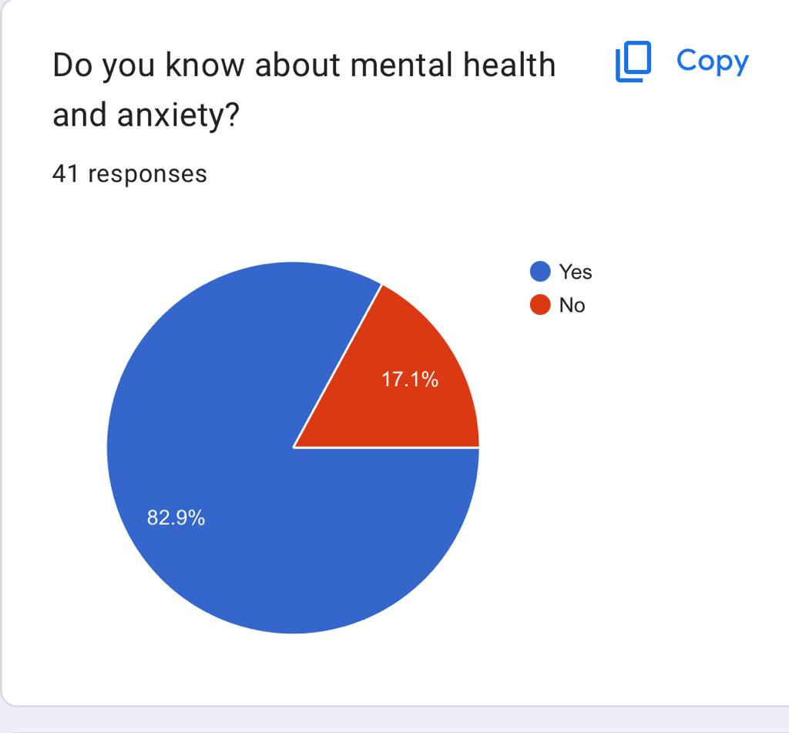
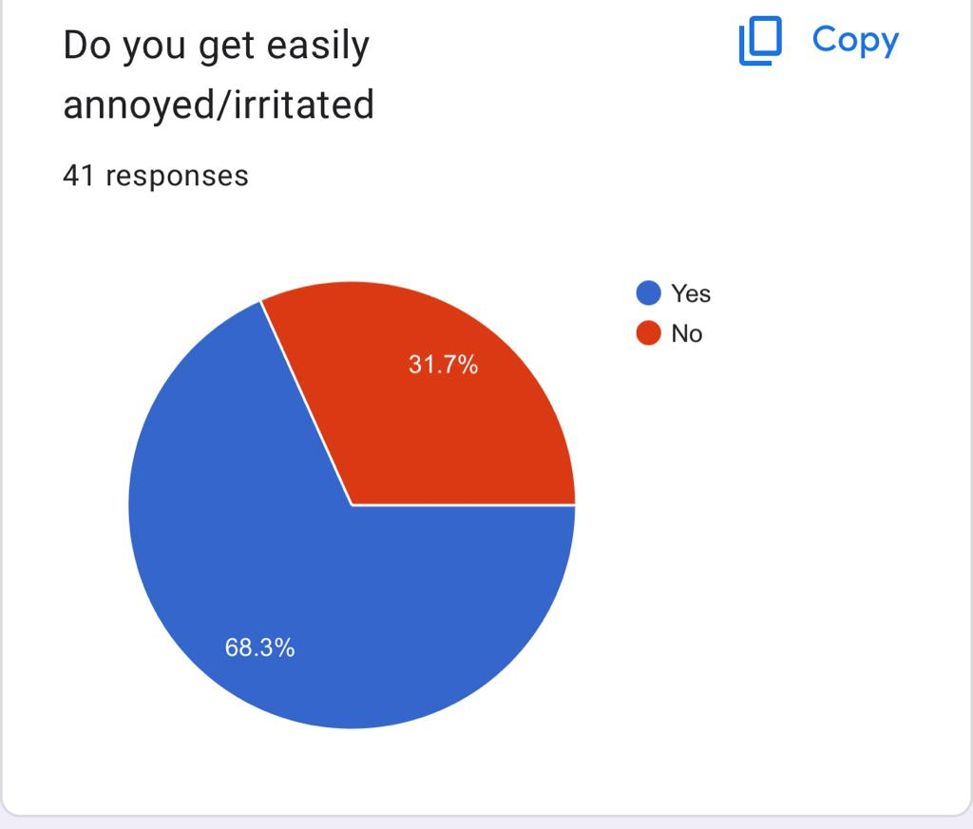
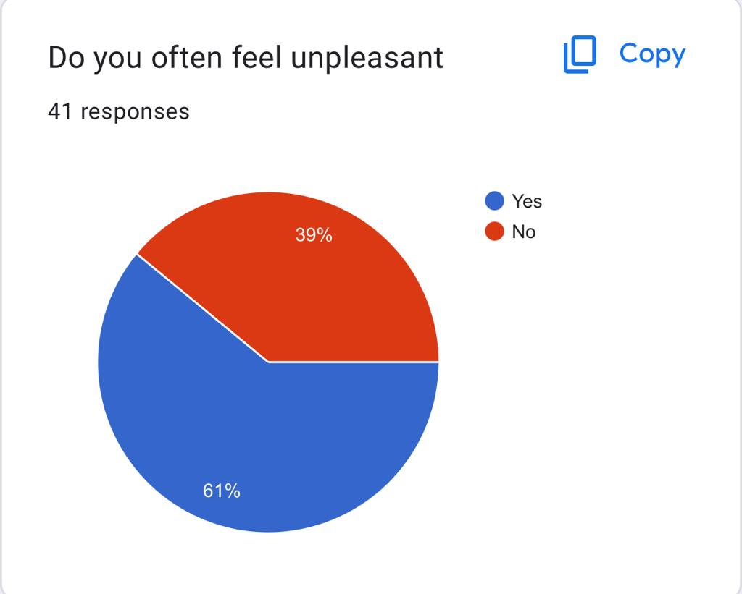
Survey answers

Slide 8
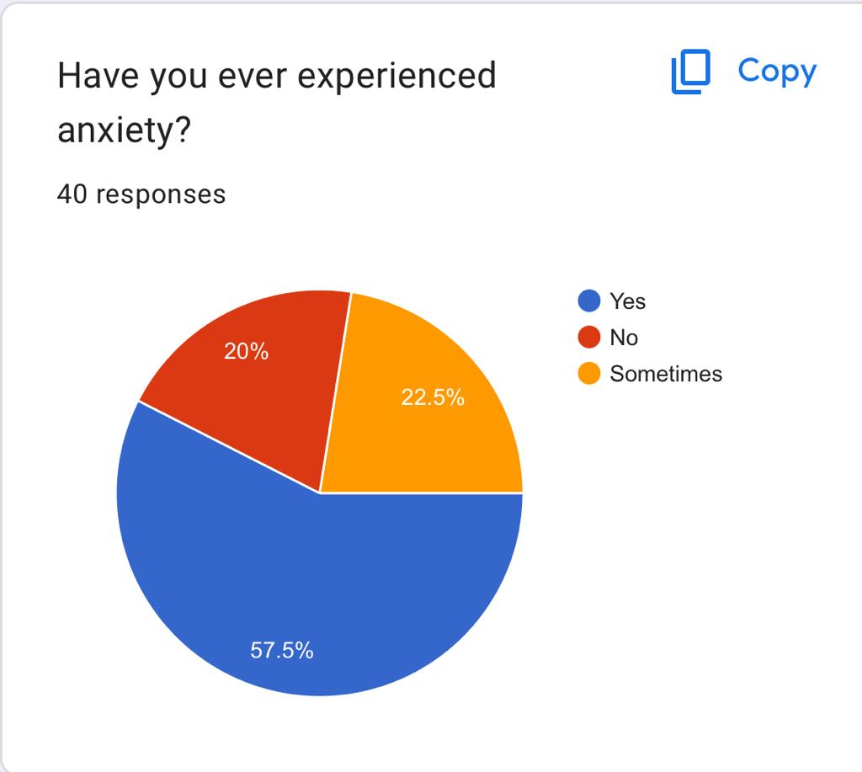
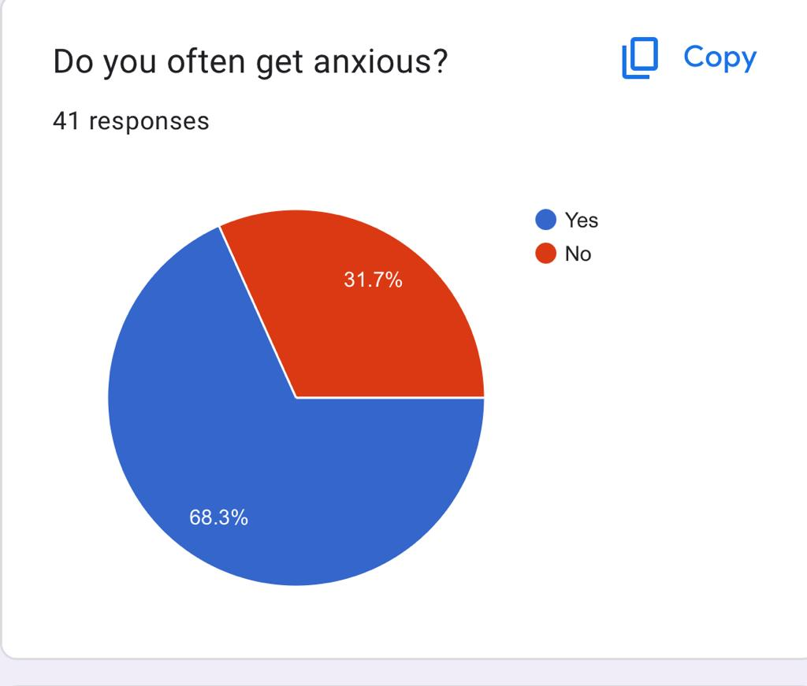
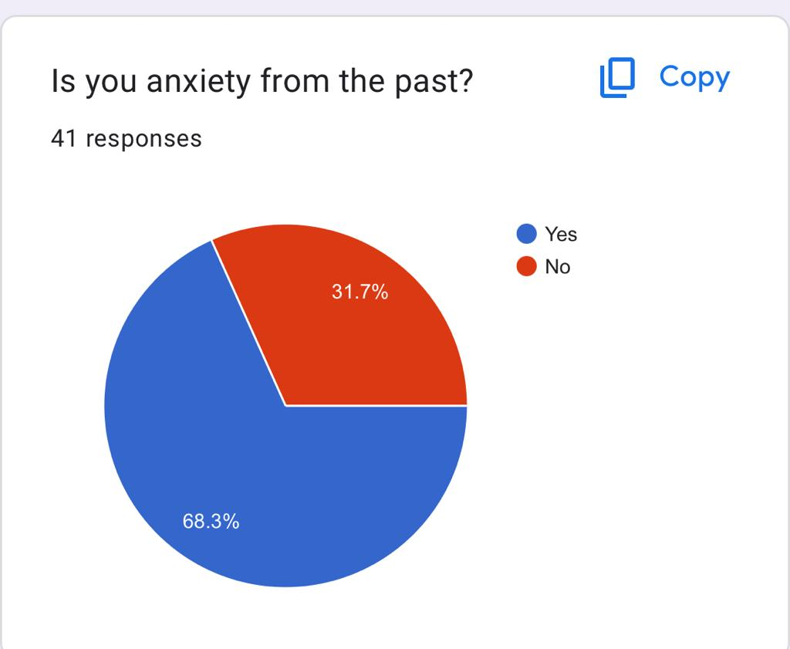
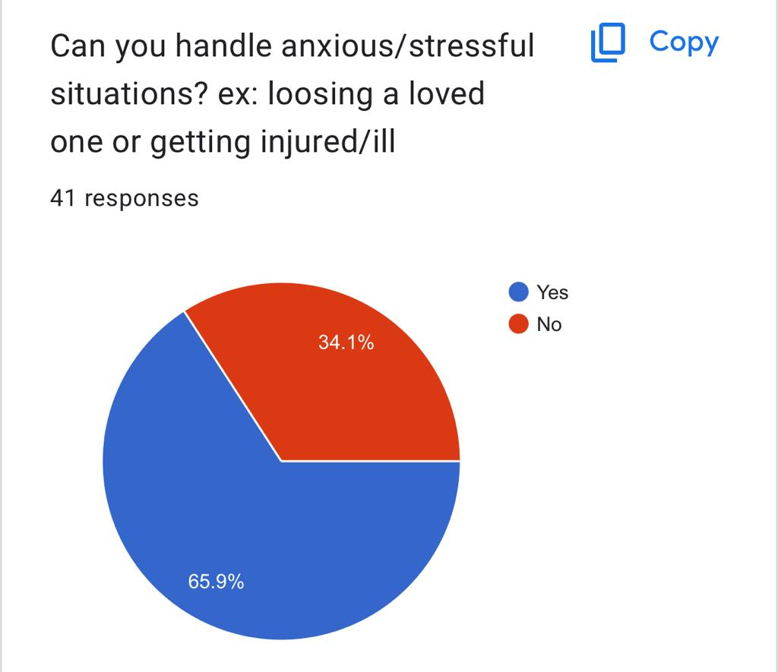
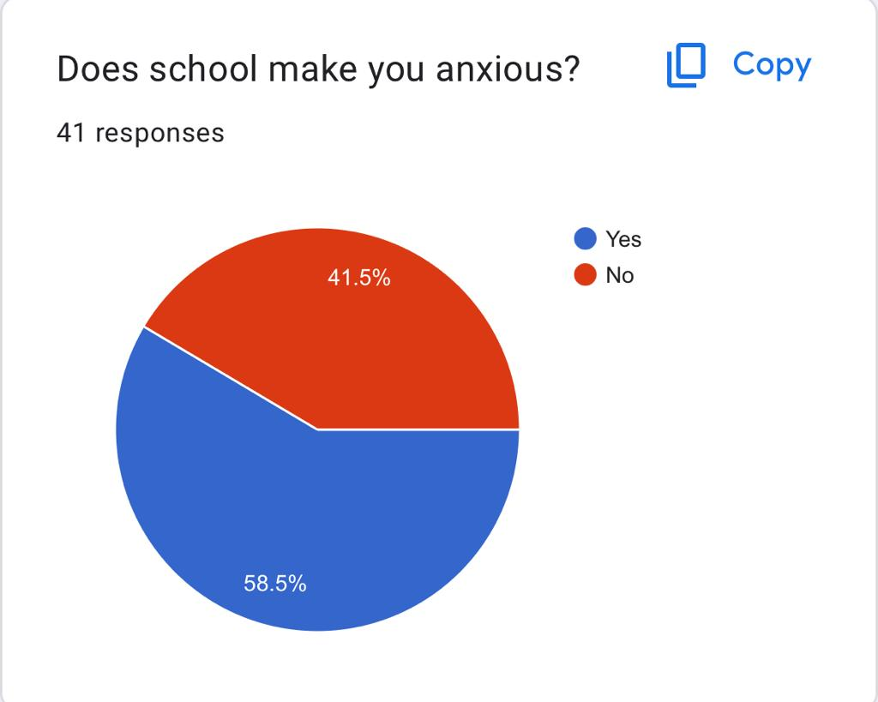
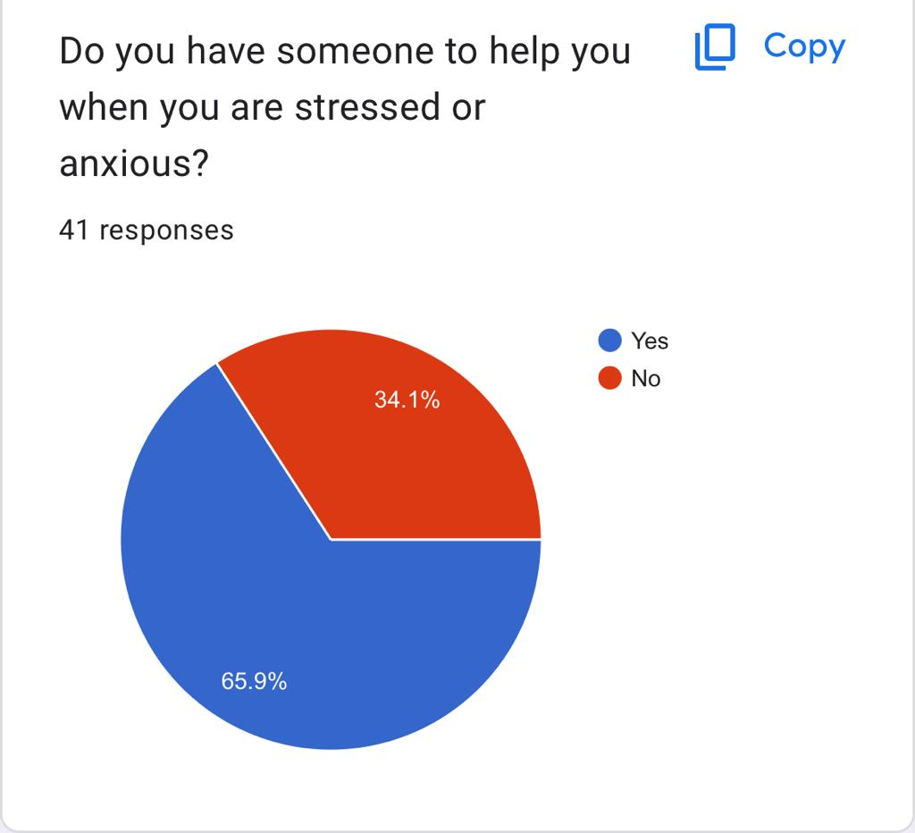

Slide 9
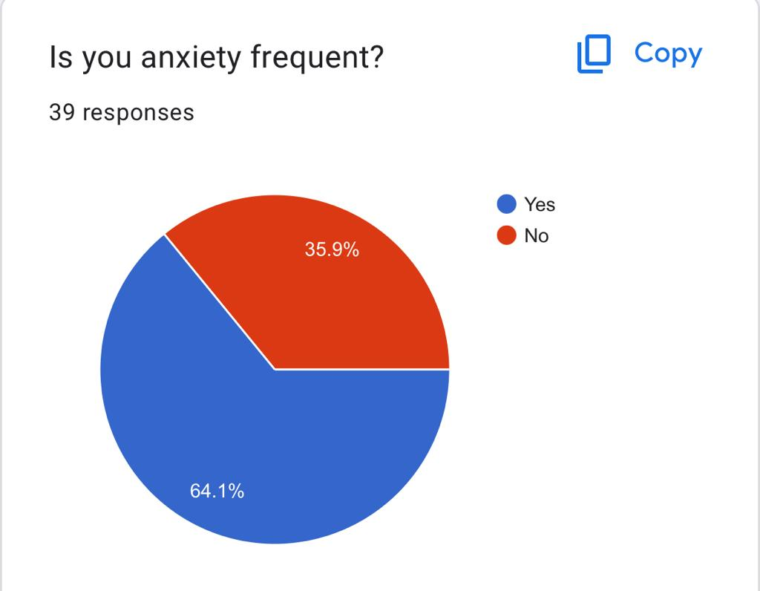
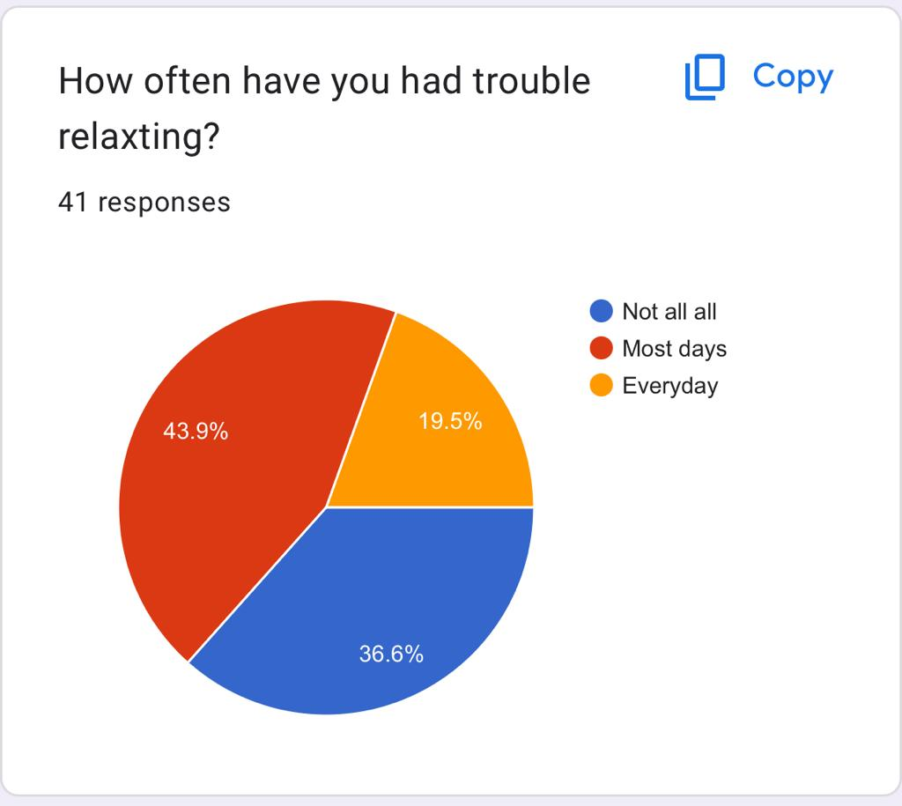
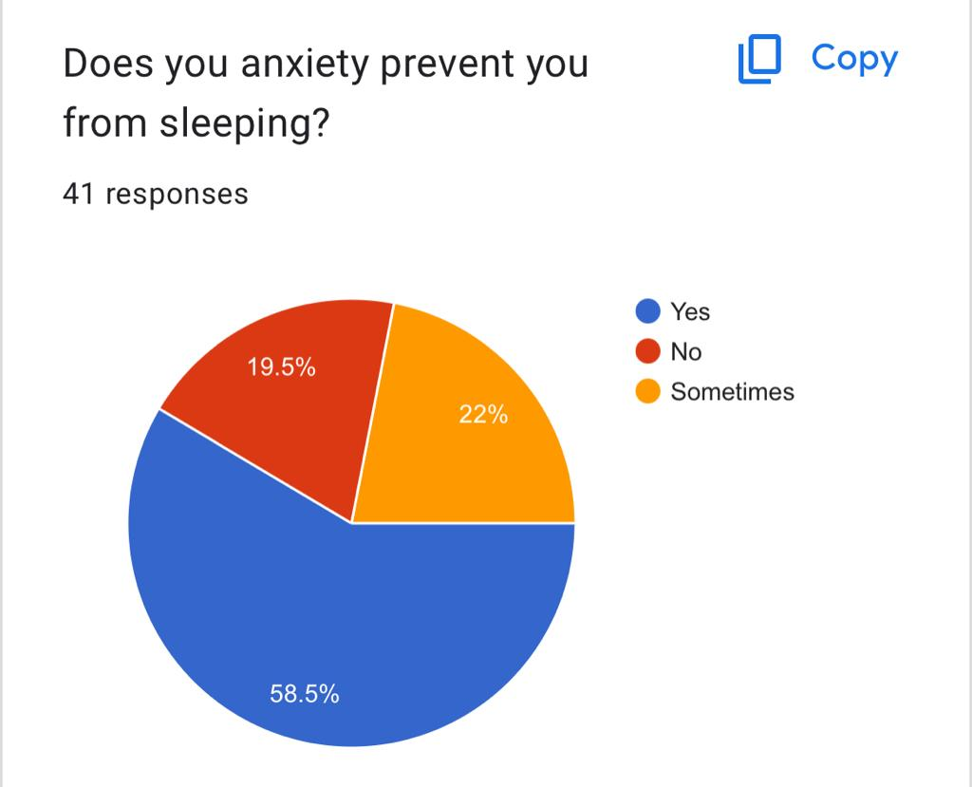
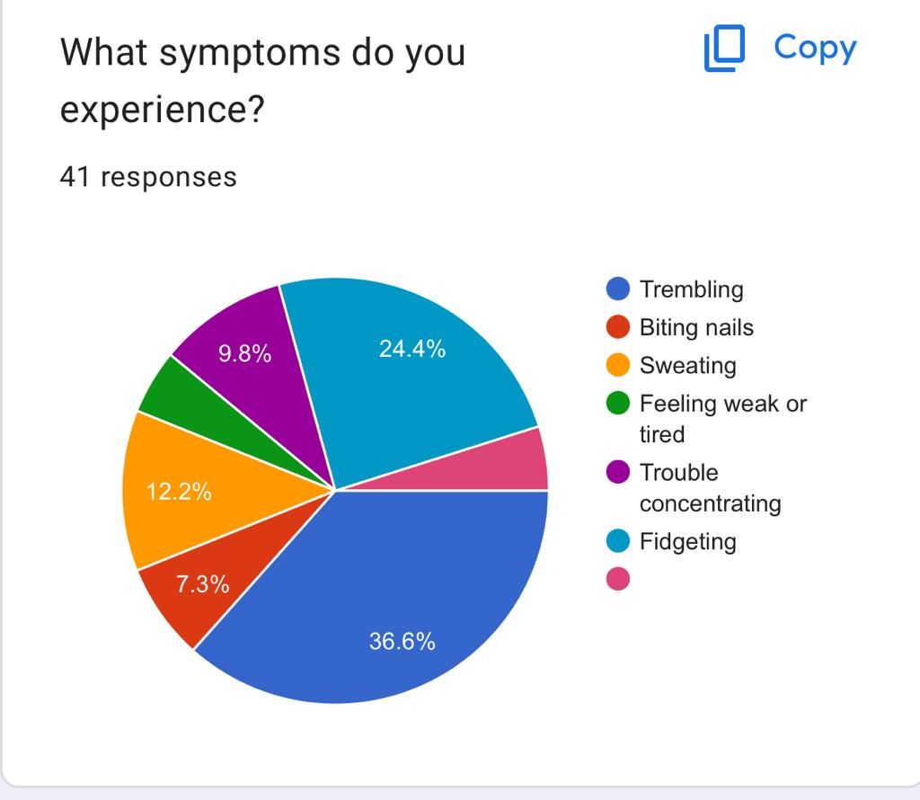
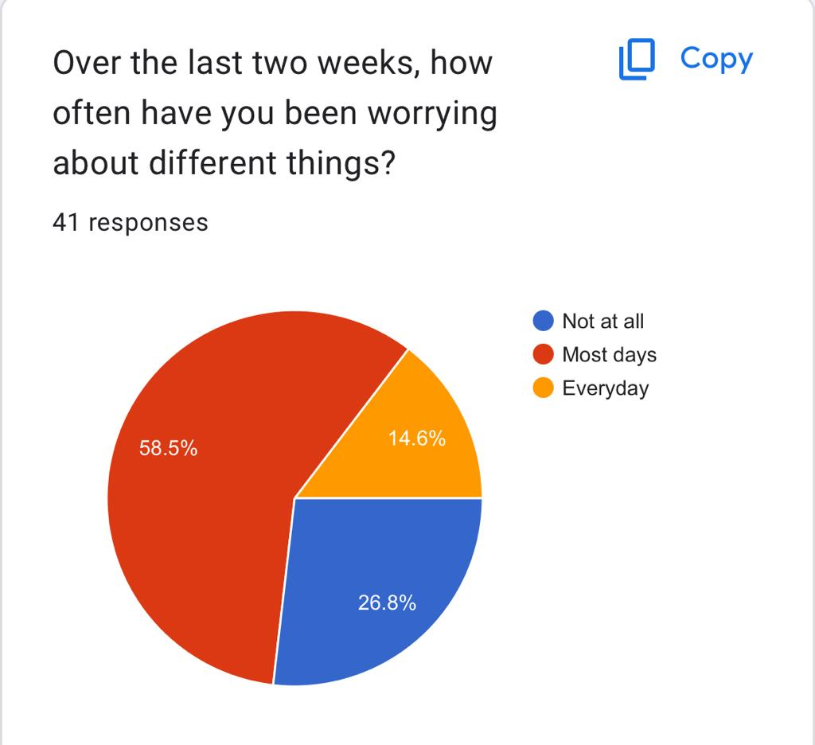
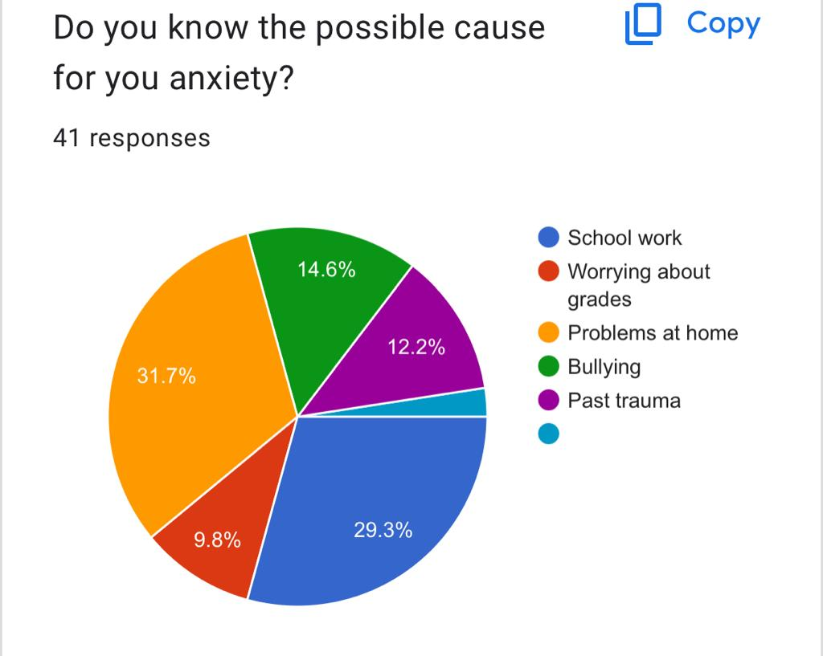

Slide 10
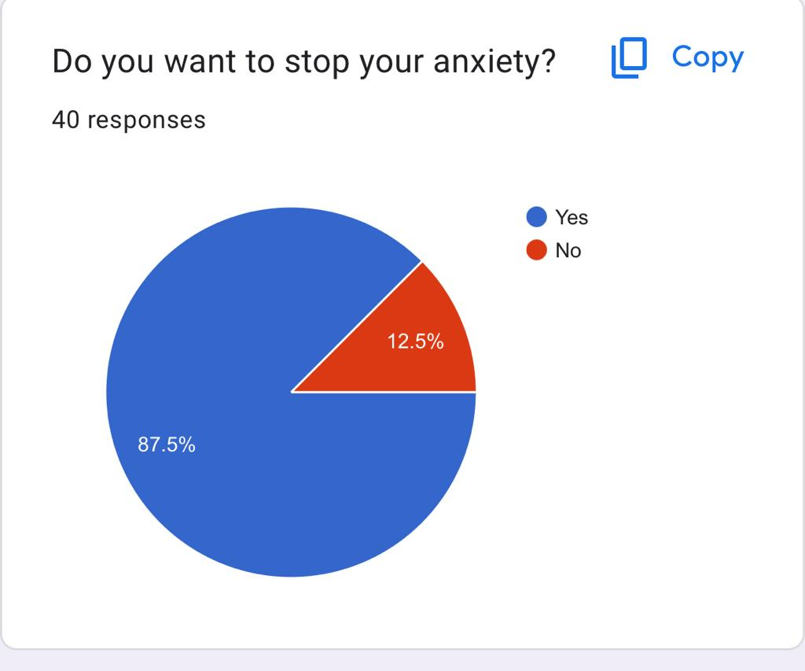
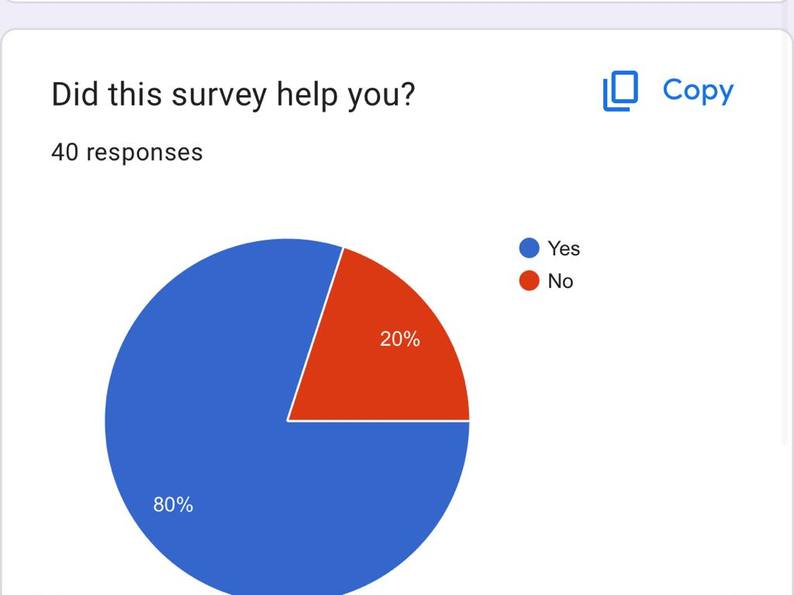

Slide 11
Thank you!

