Slide 1
Traditional Jordanian Foods
Done By:
Mariam Haroun
Saif Awaisheh
Qamar Abu Bakir
Kameel Sama’an
Grade 6 “C”

Slide 2
Traditional Jordanian Foods
Jordan is famous for its spectacular food filled with Levantine flavors. There is no real count for the most delicious traditional dishes that the Jordanians pride themselves with. Some of them, though, you cannot leave Jordan without trying.
The following presentation contains information about three Jordanian dishes that we encourage you to try.

Slide 3
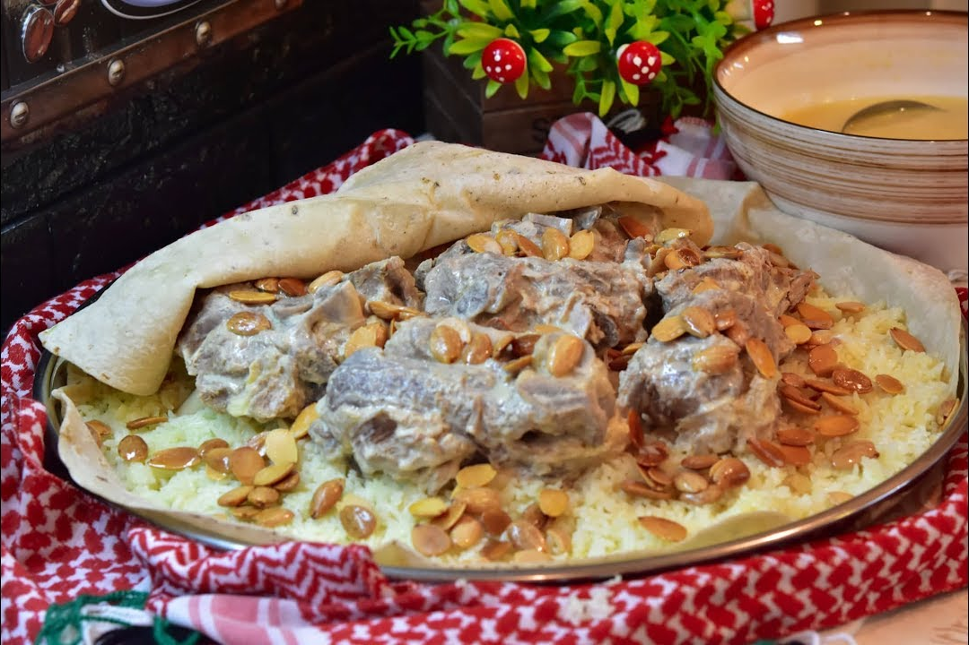
Mansaf

Slide 4
Mansaf
Jordan’s most famous traditional dish and a nationally celebrated pride is Mansaf. The very fatty dish consists of rice stirred with heavy domestic margarine, cooked separately from the thick yogurt essence, and is stirred until boiled. Big lumps of meat are added to the yogurt to cook until it’s well-done.
Manasf Is closely associated with the Bedouin culture of Jordan, and particularly in Karak, south of Jordan.

Slide 5
Makmoura

Slide 6
Makmoura
This is an old Jordanian-oriented dish, eaten mostly by people in North Jordan. Some Jordanians might not even recognize it, nonetheless, it is a traditional Jordanian dish deeply rooted to the country life. Makmoura, meaning buried, is exactly what it sounds like. Boiled chicken and onions are buried under a thick blanket of dough and cooked in the oven until well-done. It is later served in triangle pieces, exactly like cake.

Slide 7
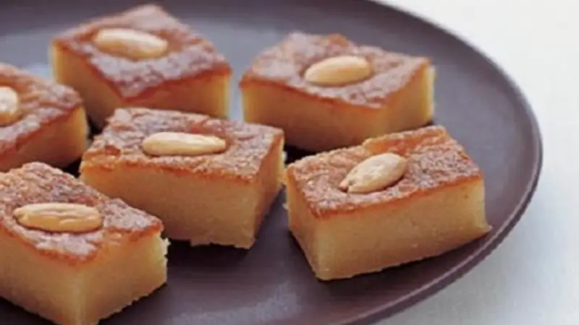
Harrisseh

Slide 8
Harrisseh
Harisseh is indeed a well known sweet in Jordan, especially in the middle of part like in Salt. It's a semolina cake that is soaked in simple syrup, often flavored with orange blossom or rose water. The result is a moist and sweet dessert with a unique texture. When in Salt or other parts of Jordan, you can find Harisseh in local bakeries and sweet shops, offering you a taste of the country's delightful traditional sweets.

Slide 9
Interview

Slide 10
Resources
Hiba, A. Bawad. Developing a meal-planning exchange list for traditional dishes in Jordan. Journal of the American Dietetic Association.
Traditional Foods in Jordan. From Meat Products to Dairy Foods. (2021). Book available online.
https://www.touristjordan.com/popular-jordanian-food/

