Slide 1
Diabetes
By, Victor, Jad, Maya 8C

Slide 2
What are the effects of Diabetes
The effects of Diabetes are as followed:
Heart disease.
Blindness.
Kidney failure.
Nerve damage etc.

Slide 3
Target Audience
Our target audience will be middle schoolers; grades 6-8.

Slide 4
How to reduce the risk of getting diabetes
Exercising often / exercise regularly.
Drink a minimum of 2L a water per day.
Lead and maintain a healthy diet.
Reducing consumption of junk food and sweets.
Maintain a healthy lifestyle.

Slide 5
The common questions about Diabetes
What is Diabetes
What are the causes of Diabetes
What are signs and symptoms of Diabetes
How to treat Diabetes
How does Diabetes affect a person's daily life

Slide 6
Answers to those common questions
Diabetes is a disease that occurs when your blood glucose, also called blood sugar, is too high.
There are many causes to diabetes but the most common are: genes,
obesity, physical inactivity.
The most common symptoms of diabetes are: to be very thirsty, have blurry vision, lose weight without trying, feel very tired, the need to urinate a lot.
There is no way to cure diabetes but there are some ways that you can get your blood sugar levels back in range again and these ways are: healthy eating, regular exercise, weight loss, diabetes medication or insulin therapy.
Diabetes affects a person's lifestyle in a negative way, in terms of school or work success, self-confidence, relationships, and many more ways.

Slide 7
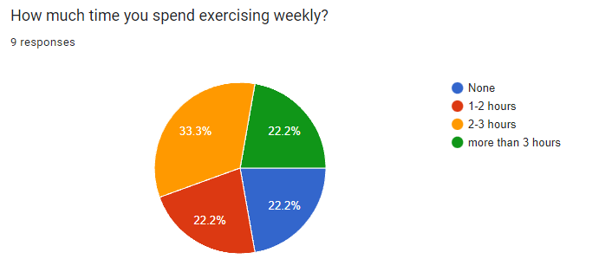
Survey statistics: Regular exercise
As we can see most survey takers exercise for more than an hour a week, but ¼ of people don’t exercise so we can see that ¾ of people are regularly exercising.

Slide 8
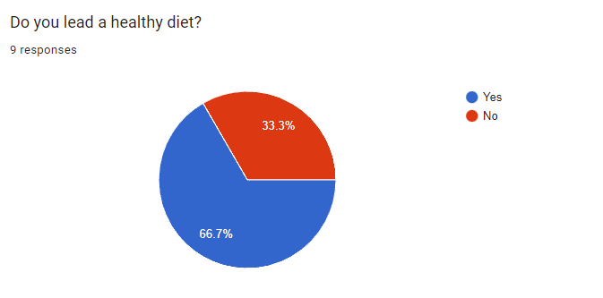
Survey statistics: Diet
As we can see most of the survey takers lead a healthy diet, to be exact 2 thirds of them lead a healthy diet, whereas the other survey takers do not lead a healthy diet.

Slide 9
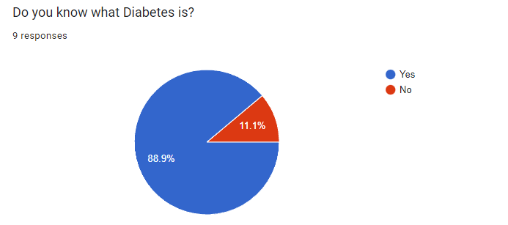
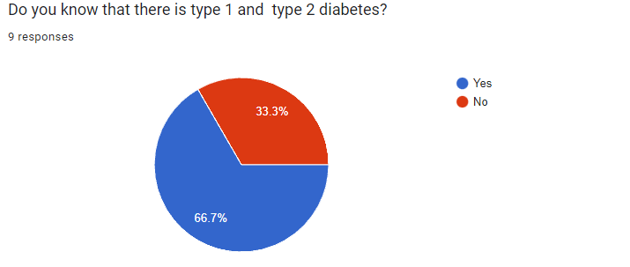
Survey statistics: Knowledge about diabetes
As we can see all of the survey takers know what diabetes is except 1.
As we can observe most survey takers know that there are type 1 and 2 diabetes except a small handful of them.

Slide 10
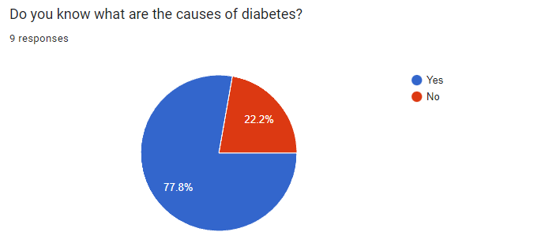
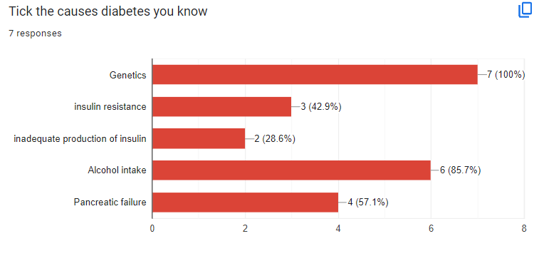
Survey statistics: Knowledge about diabetes
As we can make out a large handful of survey takers know the causes of diabetes, except a small few.
As we can see the most known cause of diabetes among survey takers is genetics, unlike inadequate production of insulin which is the least known among survey takers.

Slide 11
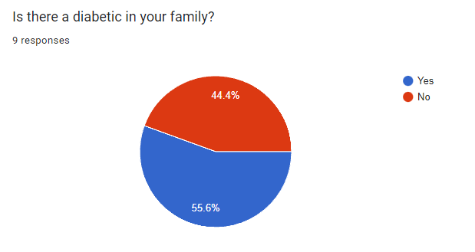
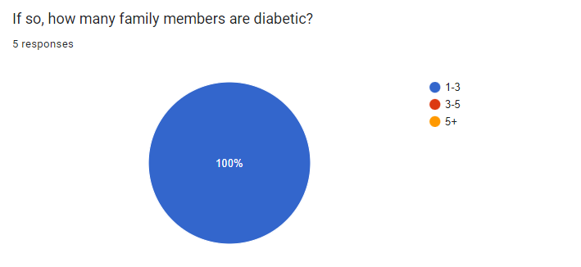
Diabetes in survey takers family tree
As we can see most survey takers have a diabetic in their family.
As we can observe all survey takers only have 1 to 3 diabetics in their family.

Slide 12
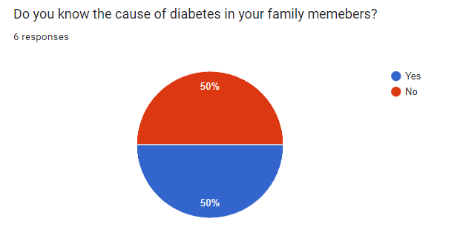
Cause(s) of diabetes in survey takers family tree
As we can see half of the survey takers know the cause of diabetes in their family tree while the other half doesn't
The most common cause(s) in survey takers family tree are:
Problems with blood sugar levels
Genetics

Slide 13
Citation and crosschecking
Slide 6 bullet point 1
Cite: U.S. Department of Health and Human Services. (n.d.). What is diabetes? - niddk. National Institute of Diabetes and Digestive and Kidney Diseases. https://www.niddk.nih.gov/health-information/diabetes/overview/what-is-diabetes
Cross checking:
https://www.who.int/health-topics/diabetes#tab=tab_1
https://www.diabetes.org.uk/diabetes-the-basics
https://www.diabetesaustralia.com.au/about-diabetes/what-is-diabetes/

Slide 14
Citation and crosschecking
Slide 6 bullet point 3
Cite: Centers for Disease Control and Prevention. (2023, September 7). Diabetes symptoms. Centers for Disease Control and Prevention. https://www.cdc.gov/diabetes/basics/symptoms.html
Cross checking:
https://www.mayoclinic.org/diseases-conditions/diabetes/symptoms-causes/syc-20371444
https://www.diabetes.org.uk/diabetes-the-basics/diabetes-symptoms
https://www.webmd.com/diabetes/understanding-diabetes-symptoms

Slide 15
Citation and crosschecking
Slide 6 bullet point 4
Cite: Mayo Foundation for Medical Education and Research. (2023, March 14). Type 2 diabetes. Mayo Clinic. https://www.mayoclinic.org/diseases-conditions/type-2-diabetes/diagnosis-treatment/drc-20351199
Cross checking:
https://www.diabetes.org.uk/diabetes-the-basics/diabetes-treatments
https://www.mayoclinic.org/diseases-conditions/diabetes/diagnosis-treatment/drc-20371451
https://www.webmd.com/diabetes/type-2-diabetes

