Slide 1
Diabetes
By: Naser ,Issa , Emil , Kareem Wahab

Slide 3
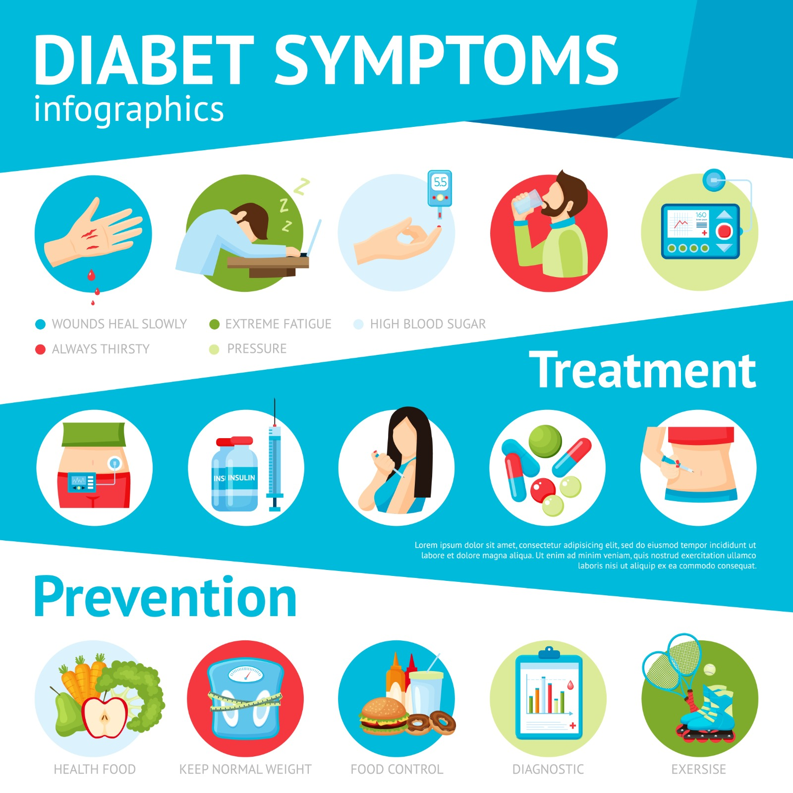
Introduction about diabetes
Diabetes is a serious condition where your blood glucose level is too high. It can happen when your body doesn't produce enough insulin or the insulin it produces isn't effective. Or, when your body can't produce any insulin at all.

Slide 4
What are the types of diabetes
Type 1 diabetes is a medical condition in which, for unknown reasons, your immune system targets and kills the insulin-producing cells in your pancreas.
Type 2 diabetes: In this condition, the body either generates not enough of insulin or the cells don't react to it properly (insulin resistance). This kind of diabetes is the most common kind. Though it can also affect children, adults are the primary attackers.
professional, C. C. medical. (n.d.). Diabetes. Cleveland Clinic. https://my.clevelandclinic.org/health/diseases/7104-diabetes

Slide 5
What causes diabetes?
What causes type 1 diabetes?
Scientists think type 1 diabetes is caused by genes and environmental factors, such as viruses, that might trigger the disease.
What causes type 2 diabetes?
The most common kind of diabetes, type 2, comes due to a number of elements, including genetic and eating habits.
U.S. Department of Health and Human Services. (n.d.). Symptoms &amp; causes of diabetes - NIDDK. National Institute of Diabetes and Digestive and Kidney Diseases. https://www.niddk.nih.gov/health-information/diabetes/overview/symptoms-causes

Slide 6
How does diabetes effect the other organs?
Diabetes has so many what you call micro and macro vascular complications. These may lead to disorders in the retina so affecting the eyes, the kidneys, the heart, of course, and the upper and lower limbs which might lead to amputations so there are so many co- morbidities.
related to what dr.suhair zoumot said

Slide 7
How to prevent it?
1.Lose extra weight
2.Be more physically active
3.Eat healthy plant foods
4.Eat healthy fats
5.Skip fad diets and make healthier choices
Mayo Foundation for Medical Education and Research. (2023, March 24). Diabetes prevention: 5 tips for taking control. Mayo Clinic. https://www.mayoclinic.org/diseases-conditions/type-2-diabetes/in-depth/diabetes-prevention/art-20047639

Slide 8
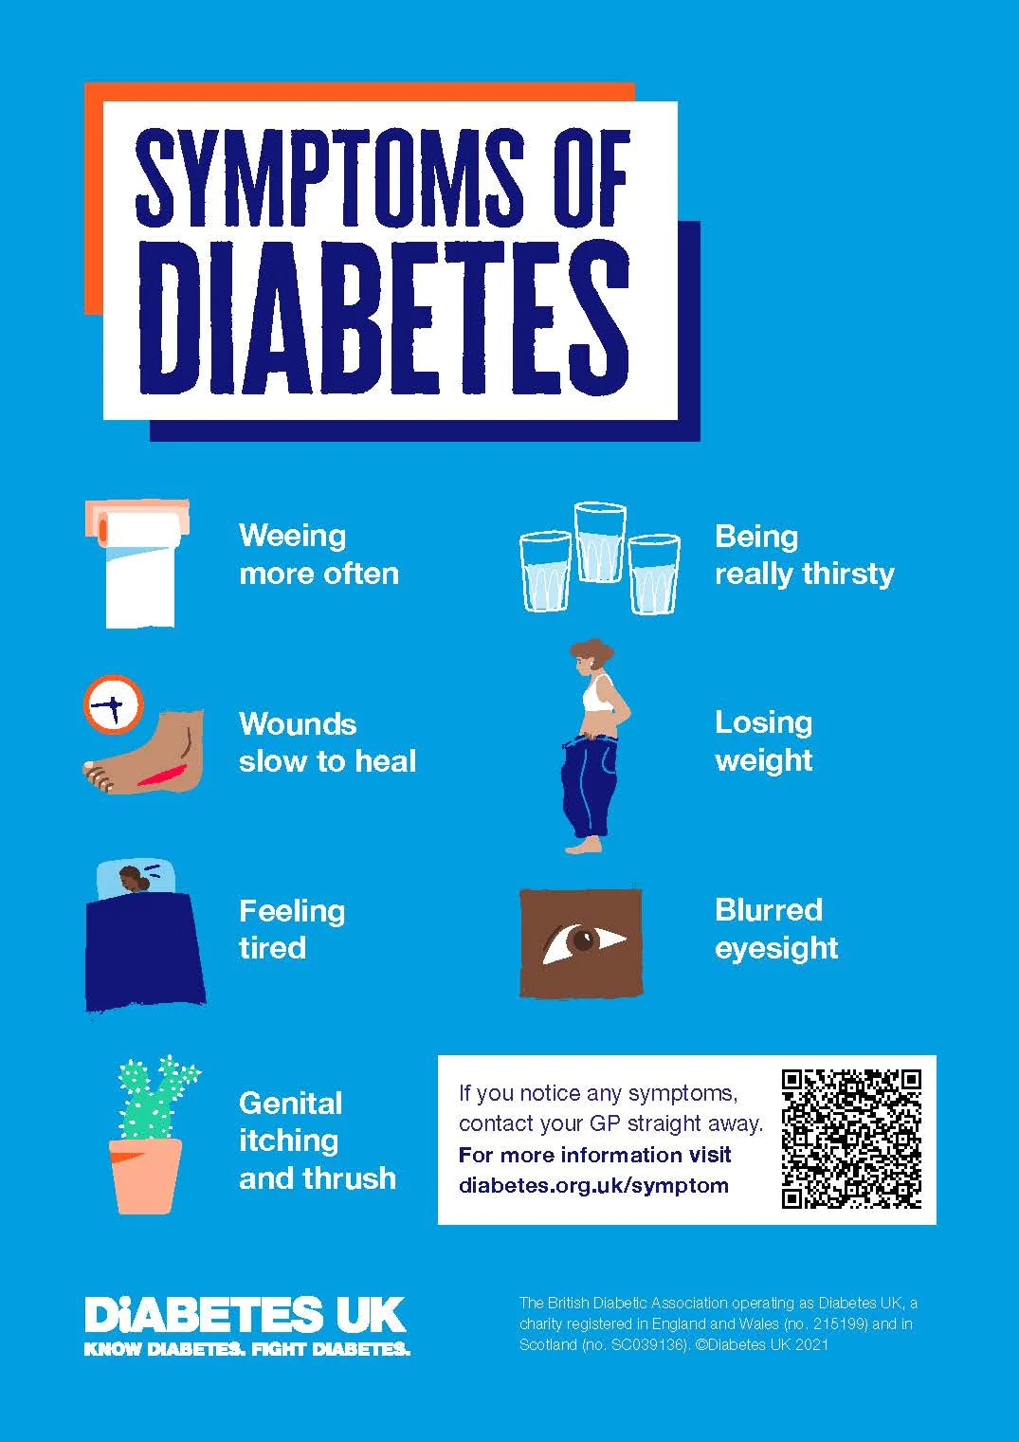
What are the symptoms of diabetes?
Toilet - going for a wee a lot, especially at night. Thirsty - being really thirsty. Tired - feeling more tired than usual. Thinner - losing weight without trying to. Genital itching or thrush. Cuts and wounds take longer to heal. Blurred eyesight Increased hunger.
What the patient will feel in the beginning first hunger, sweating and thirst in the first place but all of these symptoms has to be confirmed by lab test to measure the blood glucose level of course. (What doctor suhair zoumot said)
Diabetes UK. (n.d.). What are the signs and symptoms of diabetes? https://www.diabetes.org.uk/diabetes-the-basics/diabetes-symptoms

Slide 9
Summary (video)
https://www.youtube.com/watch?v=wZAjVQWbMlE

Slide 10
Cross checking
https://my.clevelandclinic.org/health/diseases/7104-
2. https://www.niddk.nih.gov/health-information/diabetes/overview/symptoms-causes
3. https://www.diabetes.org.uk/diabetes-the-basics/diabetes-symptoms
1. https://www.nhs.uk/conditions/type-2-diabetes/( cross checking )
2. https://www.bhf.org.uk/informationsupport/risk-factors/diabetes(cross checking)
3. https://www.who.int/news-room/fact-sheets/detail/diabetes (cross checking)

Slide 11
.

