Slide 1
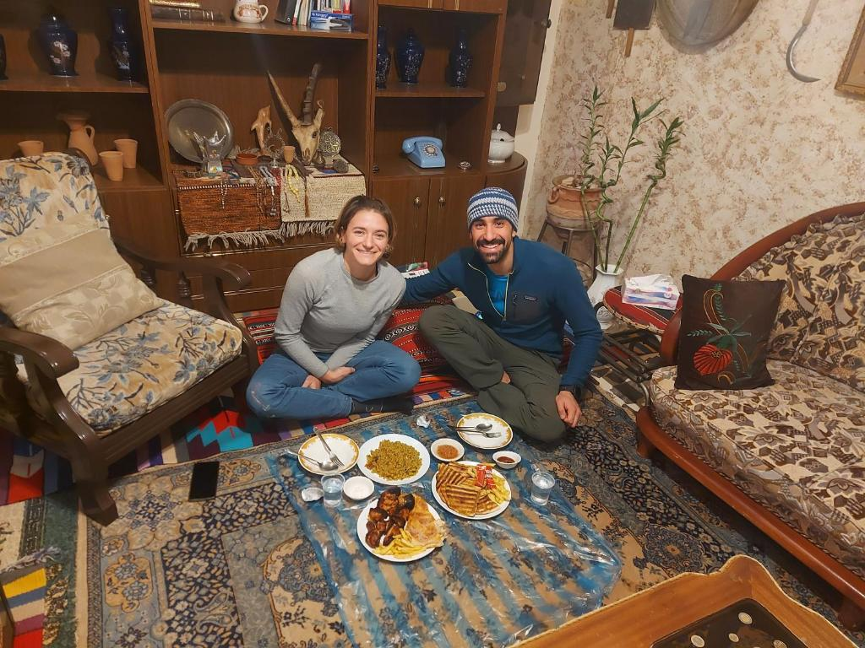

Slide 2
Introduction
In this presentation we will be talking about
traditions associated with hosting in
regions in the North and South of
Jordan.

Slide 3
Introduction
One of the amazing things in Jordanian
culture is their hospitality and kindness
towards guests. From the moment that guests
arrive, they are happily welcomed.

Slide 4
North area (Al Mafraq)
Guests are greeted with Arabic coffee and then yogurt when they arrive.
Then comes food. The wealthy would most likely have sheep slaughtered for the guests, and the poor would still feed the guests, even if it meant bread and a date.
People in Al Mafraq would give all they could for a guest. They would never leave a guest hungry.

Slide 5
South (Wadi Rum)
A house in Wadi Rum is incomplete without coffee. Coffee is more than just a drink there.
It is considered rude to ask about the guests’ information or the reason for their visit in the first three days from arrival, and they just welcome them during this period.

Slide 6
Interview – Hosting Traditions

Slide 7
Resources
North: ich.gov.jo
South: jordantimes.com

