Slide 1
Traditional Food In Jordan
By Jad Jichi, Rawhi Albarqawi, Rayana Rehani, Markella Masri

Slide 2
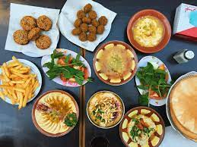
What Is Jordanian Traditional Food
Jordanian cuisine is a middle eastern cuisine that has traditional style of food preparation originating from or commonly used in Jordan that has developed through centuries of social and political change.

Slide 3
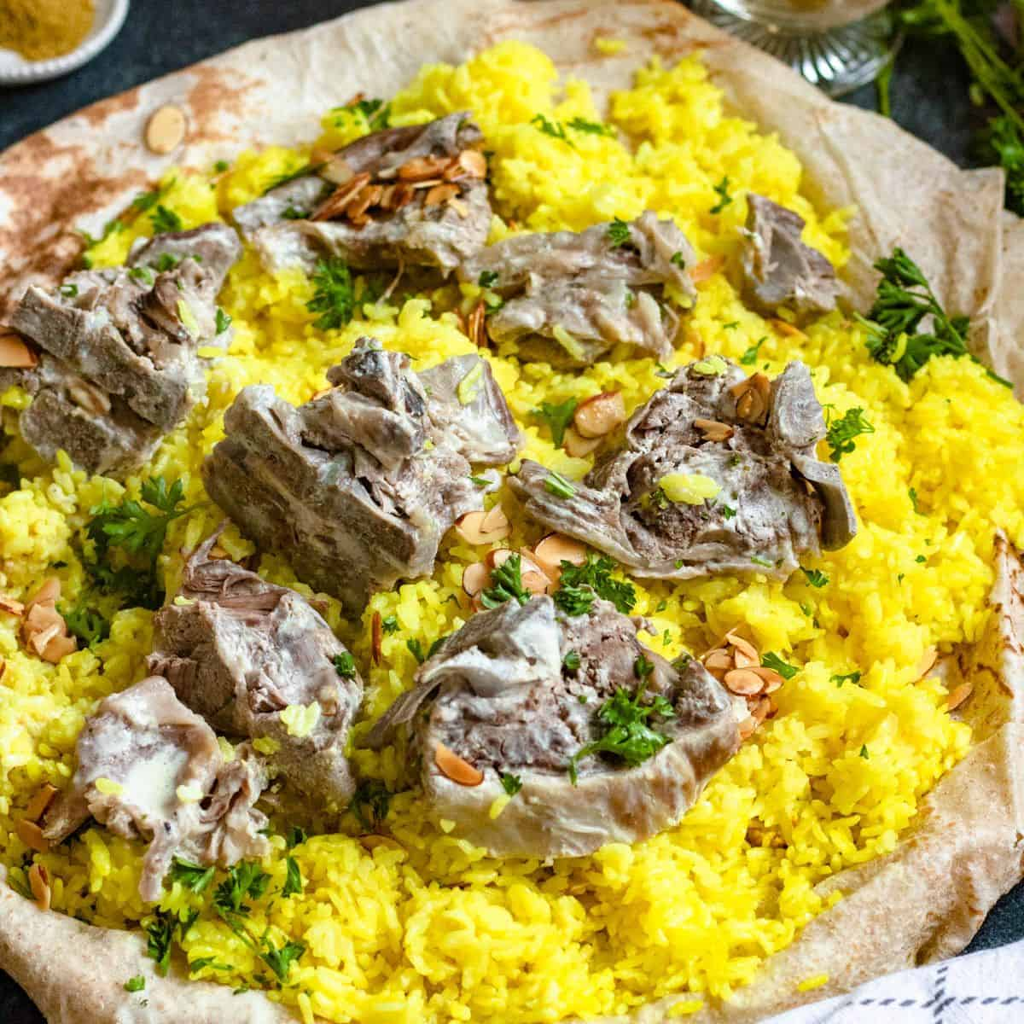
Techniques in Jordanian Cuisines
There are a wide variety of techniques used in Jordanian cuisines ranging from baking sateeing and grilling to stuffing vegetables (courgettes , capsicum, eggplants , etc). Meat is an important component of Jordanian cuisine.

Slide 4
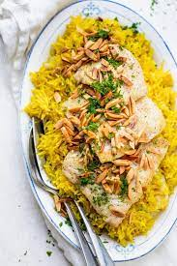
What Is the national Foods In Jordan
The national dish of Jordan is Mansaf. Mansad is a traditional dish made of lamb cooked in sauce fermented dried yogurt called jameed and served with rice or bulgur
Sayadieh and Mansaf are very popular in Aqaba ,but in Irbid makura is a tradional dish deeply looted in Irbid’s culture.

