Slide 1
The Introduction for traditions in Jordanian weddings
Traditional weddings in Amman Jordan is an special day for the broom and bride but mostly the broom and brooms family and they have a special way to celebrate the wedding and often the brooms family take care of all weddings expenses like the food the cake etc

Slide 2
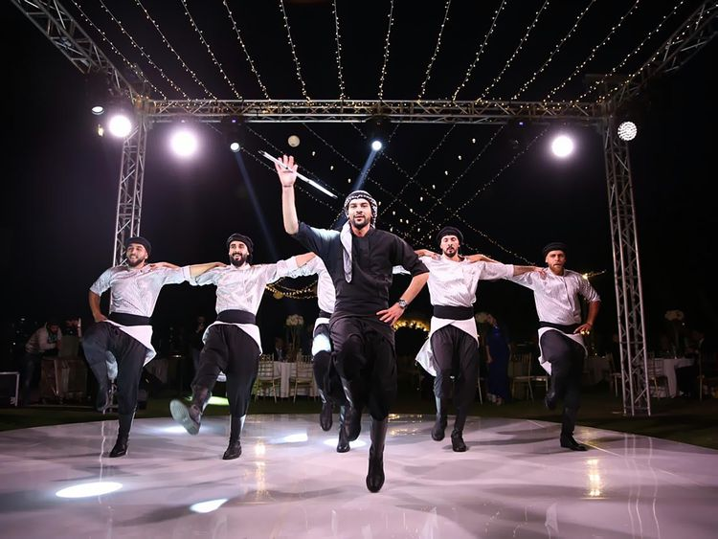
Traditions in Jordan's weddings
1st
2nd
3rd
4th
Resource
weakapida.org
(Dabke) all of Jordan
its know as a small dance that girls and boys but mostly boys are beter in dabke and some of them get paid for doing the dabke people preform the dabke for weddings or graduation or any kind of achievement.
(zagrouta) all of Jordan
it’s a high pitch nosie mostly girls and grandmas or aunts perform girls move there tongue left and right so fast
Then a sound ”lalalaesh” is realesed and the zagrouta is a special way of shouting but in there own way .
(zafeh) Amman
it’s a group of people mostly boys gather around and hold hand and start jumping to the floor and sing and dance and it can include elaborate costumes as well some people get paid for zafeh.
(حمام لاعريس)
All of Jordan
It’s a shower for the broom before the wedding and the brooms family and friends starts scrubbing so the broom can be clean and when the broom gets out of the shower they start singing.

Slide 3
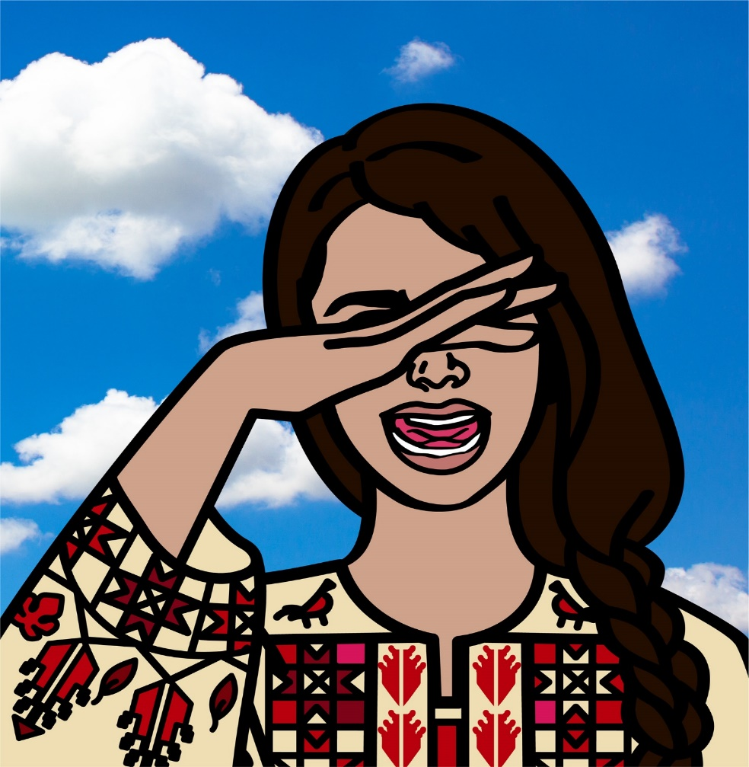
Traditions in Jordan's weddings
2nd
3rd
4th
Resources https://scholar.archive.org/
(zagrouta) all of Jordan
it’s a high pitch nosie mostly girls and grandmas or aunts perform girls move there tongue left and right so fast
Then a sound ”lalalaesh” is realesed and the zagrouta is a special way of shouting but in there own way .
(zafeh) Amman
it’s a group of people mostly boys gather around and hold hand and start jumping to the floor and sing and dance and it can include elaborate costumes as well some people get paid for zafeh.
(حمام لاعريس)
All of Jordan
It’s a shower for the broom before the wedding and the brooms family and friends starts scrubbing so the broom can be clean and when the broom gets out of the shower they start singing.

Slide 4
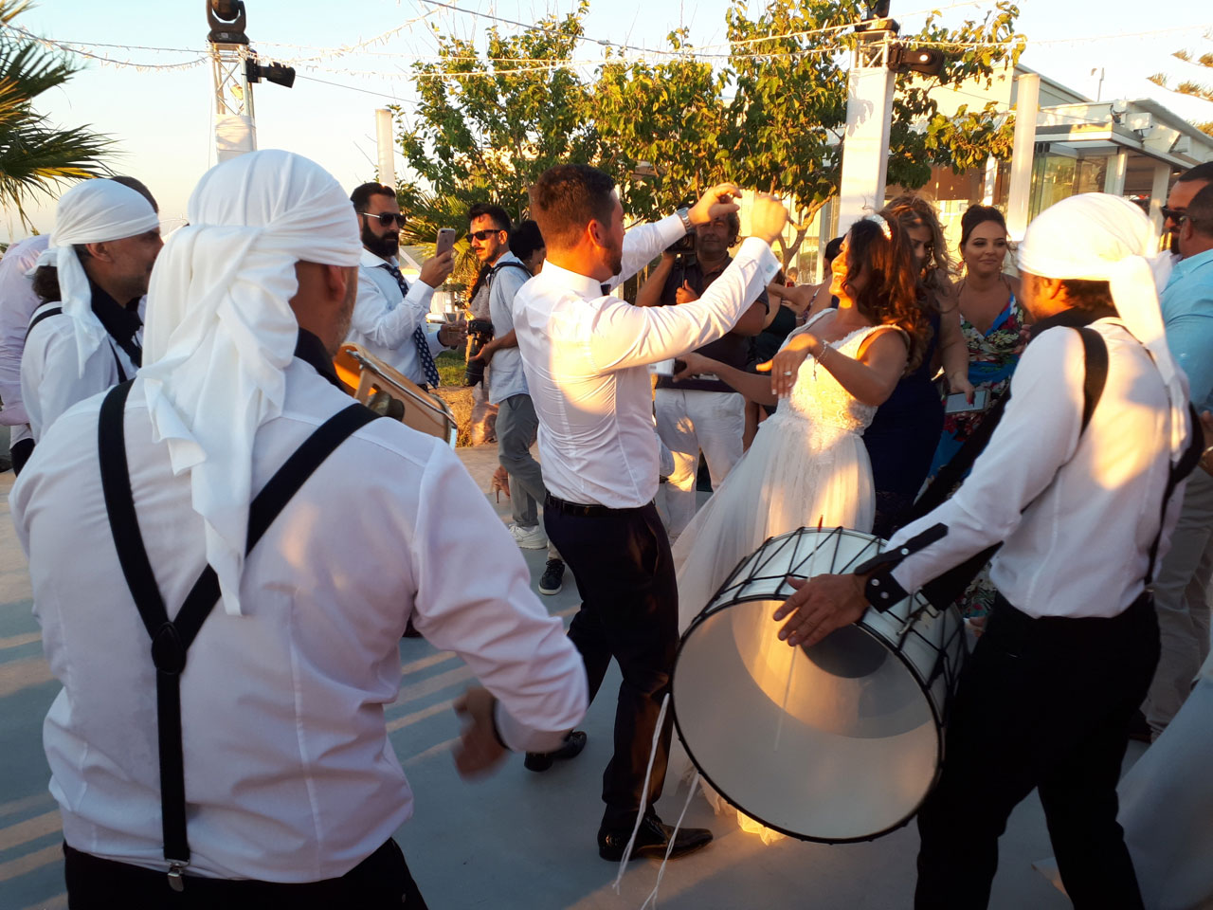
Traditions in Jordan's weddings
4th
3rd
Resource weakapida.org
(zafeh) Amman
it’s a group of people mostly boys gather around and hold hand and start jumping to the floor and sing and dance and it can include elaborate costumes as well some people get paid for zafeh.
(حمام لاعريس)
All of Jordan
It’s a shower for the broom before the wedding and the brooms family and friends starts scrubbing so the broom can be clean and when the broom gets out of the shower they start singing.

Slide 5
Traditions in Jordan's weddings
4th
Resource https://scholar.archive.org/
(حمام العريس)
All of Jordan
It’s a shower for the broom before the wedding and the brooms family and friends starts scrubbing so the broom can be clean and when the broom gets out of the shower they start singing.

Slide 6
The interview
..\Videos\WhatsApp Video 2023-11-10 at 10.59.21_7abdd870.mp4

