Slide 1
Dabkeh
BY: Samer.Z/Rashed.B/Naya.M/Basel.T
6B NOS

Slide 2
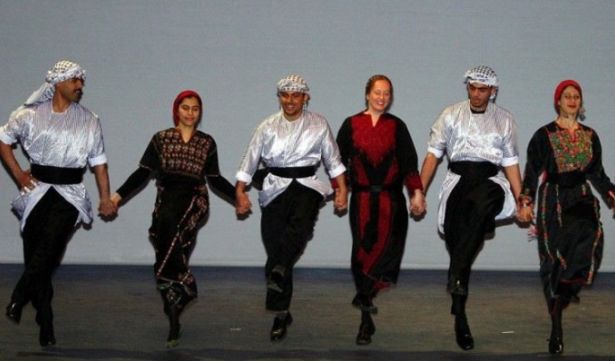
What is Dabkeh?
Dabkeh is an Arabic folk dance, which was originated in the countries of Palestine, Lebanon, Jordan, and Syria. Dabke means stamping of the feet or to make noise.

Slide 3
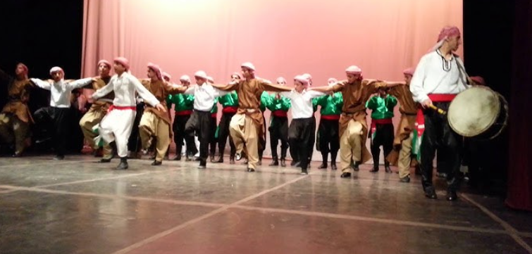
Dabke Ramthawiyya
This dance is performed in the far north of Jordan in the city of Al-Ramtha, it is the most popular folk dance in this city.

Slide 4
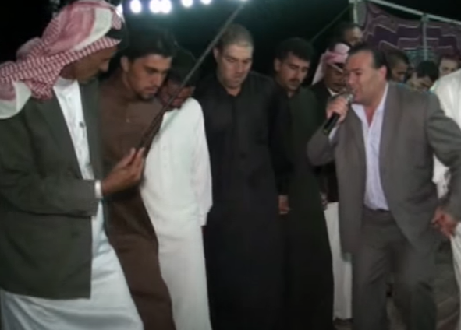
Dabkeh In Mafraq
A type of popular dabkeh (farewell rope) performed to the sound of the majuz, in which the brides/Grooms family, men and women, and also the Ma’azim, clasp hands. The hands are clasped by one man, followed by a women, then a man, followed by a woman, until oddments.

Slide 5
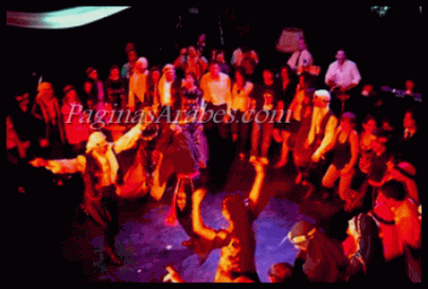
Dabkeh in Mafraq
The companion of the married man is in the middle, and the groom also greets and welcomes those present. It is a clearly visible dabkeh, in which there are no family transgressions. Also, through the dabke, poems and mountain poetic arrangements are sung. This loop is called (deposited rope)

Slide 6
Interview Link

Slide 7
Resources
u.osu.edu.jo
Citydance.org.jo
Ich.gov.jo
Pictures:
https://www.youtube.com/watch?v=LLpr6Fs9MDA
https://www.youtube.com/watch?v=w49eHUUW0As

