Slide 1
Vaping
By: Majd, Kareem F, and Omar A

Slide 2
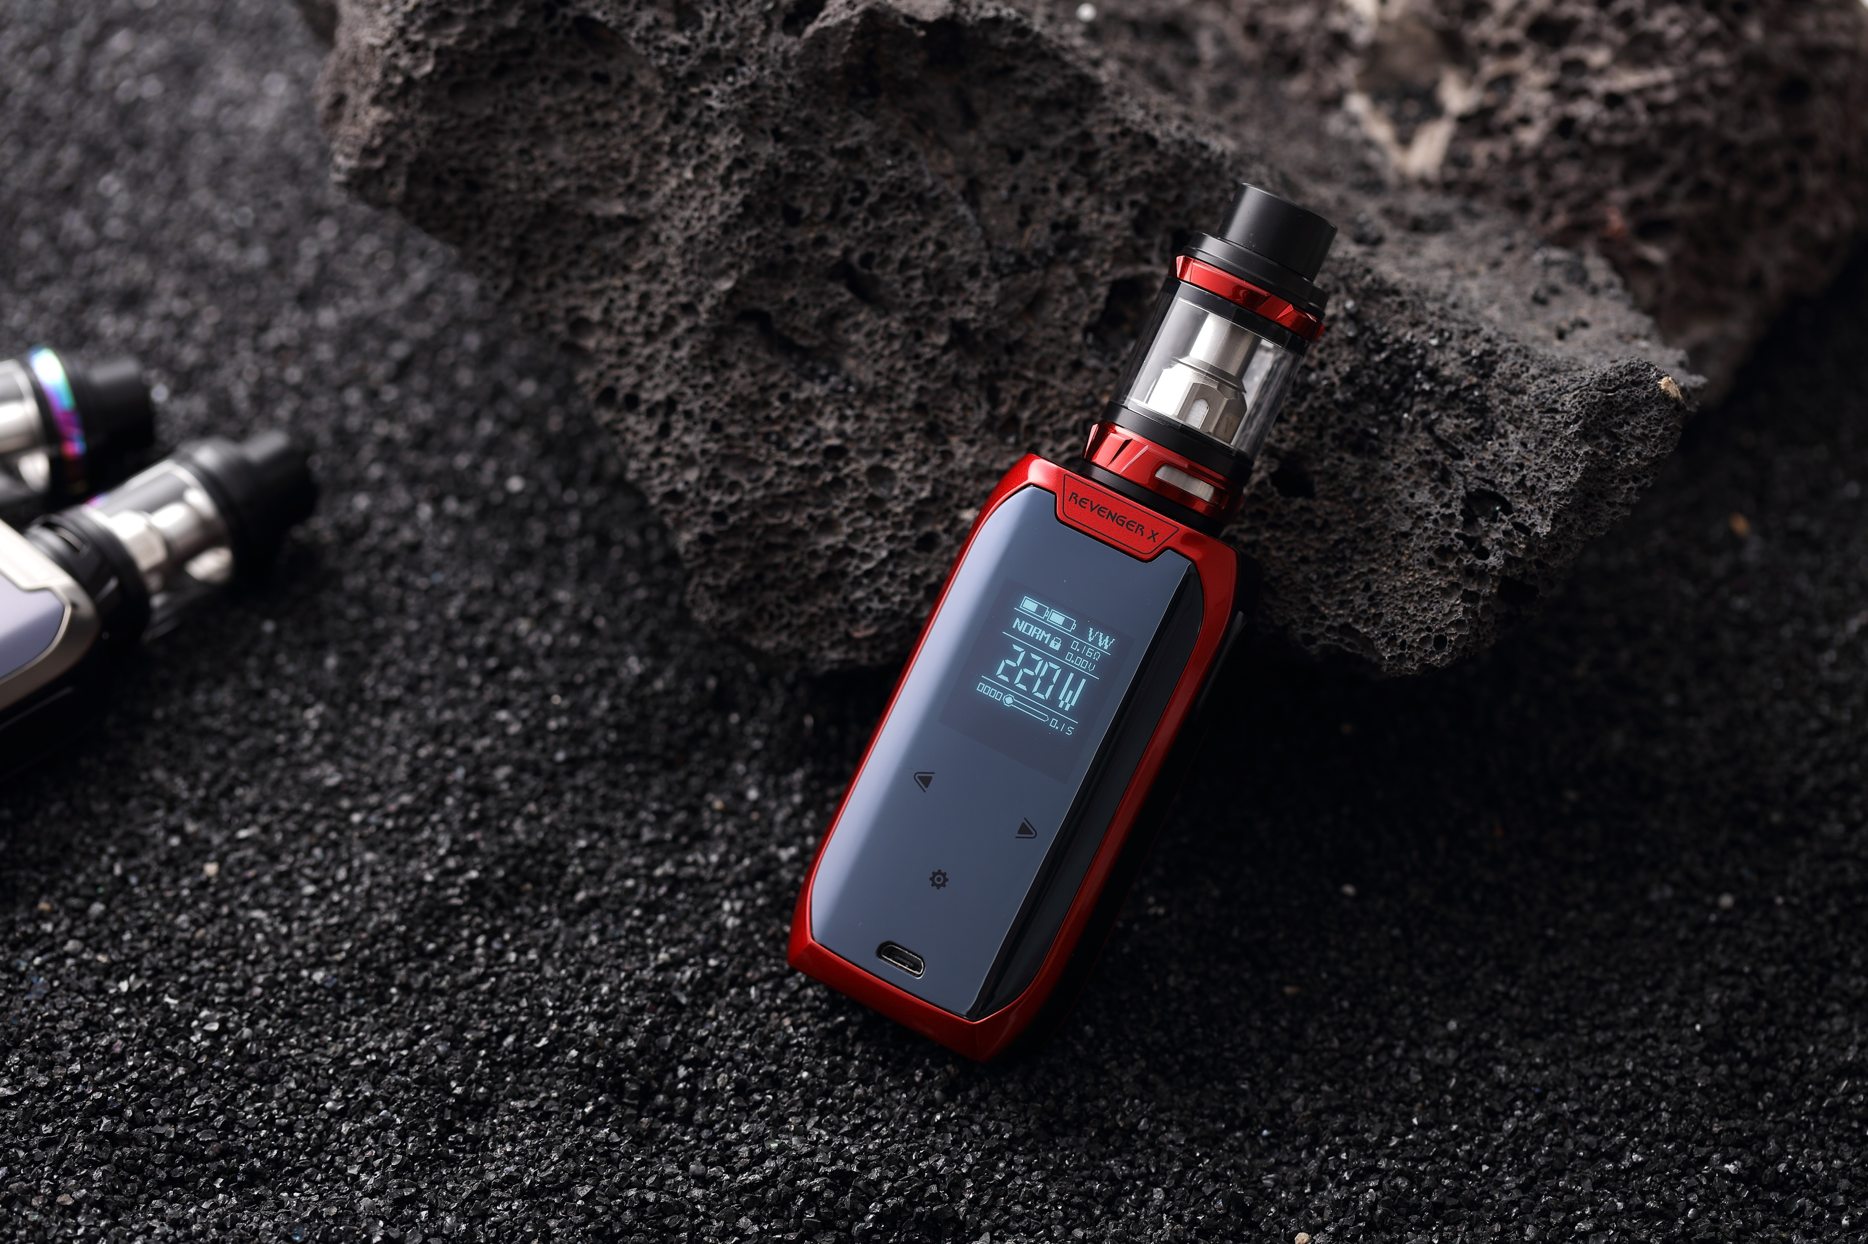
What is vaping?
Vaping is a type of smoking but instead of using tobacco it’s electric. The difference is cigarettes burns tobacco which makes smoke. Vaping involves heating a liquid and inhaling the aerosol into the lungs. Inside of this liquid in can contain flavors such as nicotine, marijuana, or may even contain dangerous substances. Almost all vapes in U.S. have nicotine in them.

Slide 3
Why is it addictive?
Just like using a cigarette a vape also have nicotine. Nicotine is an very addictive product used outside of just vaping it's used in tobacco products such as: cigarettes, and cigars.

Slide 4
How is vaping bad and how does it affect our body?
Vaping is harmful to our lungs. In the vapor have connection to higher chances of cancer because of when you inhale in and out from the vape it could contain harmful chemicals in it like propylene glycol and glycerin. This doesn't only affect the person using a vape but the people around you. Vaping can cause:
Asthma
Cancer
Organ damage
Lung scarring
Image of a person using asthma
From freepik

Slide 5
why do underage people vape?
Possibly on of your friends or family member uses vapes or smokes before. As mentioned before there's a huge variety of flavors like mint, candy, fruit, or chocolate. Some people believe that vape are less bad than regular cigarettes.

Slide 6
How to stop
Here’s some essentials. How to stop vaping:
Other solutions to stress.
More Distractions.
Exercise.
Honor your accomplishments.

Slide 7
Sources
Robert H. Shmerling, M. (2023, June 15). Can vaping damage your lungs? what we do (and don’t) know. Harvard Health. https://www.health.harvard.edu/blog/can-vaping-damage-your-lungs-what-we-do-and-dont-know-2019090417734
professional, C. C. medical. (n.d.). Vaping (e-cigarettes): What it is, side effects & dangers. Cleveland Clinic. https://my.clevelandclinic.org/health/treatments/21162-vaping
The 3 main reasons youth use e-cigarettes. Truth Initiative. (n.d.). https://truthinitiative.org/research-resources/emerging-tobacco-products/3-main-reasons-youth-use-e-cigarettes
5 tips for handling nicotine withdrawal. Truth Initiative. (n.d.-a). https://truthinitiative.org/research-resources/quitting-smoking-vaping/quitting-vaping-here-are-5-tips-handling-nicotine

Slide 8
Cross Checking
https://teen.smokefree.gov/quit-vaping/how-to-quit-vaping
https://nida.nih.gov/publications/drugfacts/vaping-devices-electronic-cigarettes
https://www.cdc.gov/tobacco/basic_information/e-cigarettes/about-e-cigarettes.html#risks
https://www.rallyhealth.com/quit-smoking/why-do-so-many-teens-vape

