Slide 1
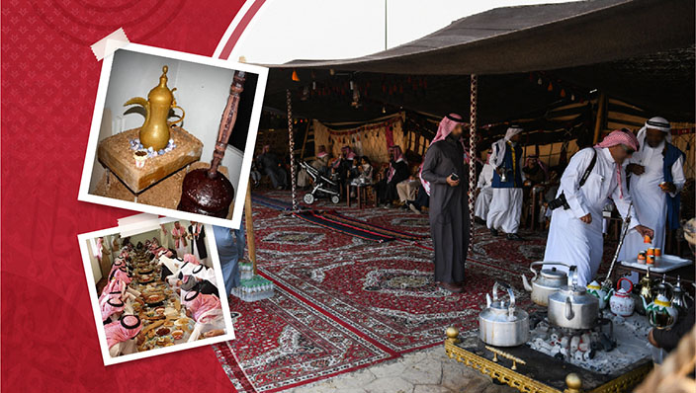
Hosting traditions
Rayna
Rayna
Done By:
Ayah Krayim
Malak Khattab
Shaker tadross
Awn Kamal

Slide 2
Hospitality in jordan
One of the key aspects of Jordanian culture is the hospitality shown by hosts to their guests.
This is felt even when walking around the streets of Jordan where the phrase (Ahlan wa Sahlan) is heard everywhere.
Some of the traditions of hospitality come from the Jordanian Bedouin culture.
The host makes sure that the guest is comfortable and stays as long as he likes such displays are referred to as karam, the Arabic word for generousity and nobility .

Slide 3
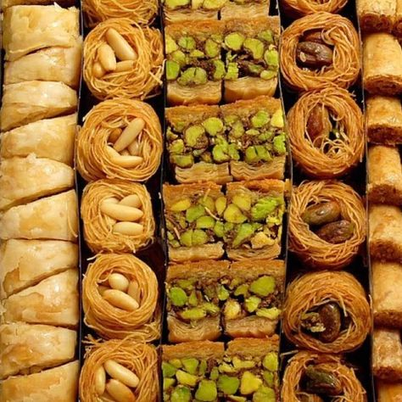
Definition of hosting in jordan
Hosting is when the owner of the house / the person living in the house, invites guests over for some breakfast ,lunch or dinner and sometimes for some coffee and arabian sweets.

Slide 4
Facts about how they dine
Men and woman commonly dine separately.
Men and woman shake hands or kiss the cheeks of members of their own gender when greeting each other .
Large feasts on weekends most commonly on Fridays or Saturdays with special Arabian sweets.
Warm greetings, as always is important when inviting people.
The guest is always offered the best seat in the house, which is usually at the right of the host

Slide 5
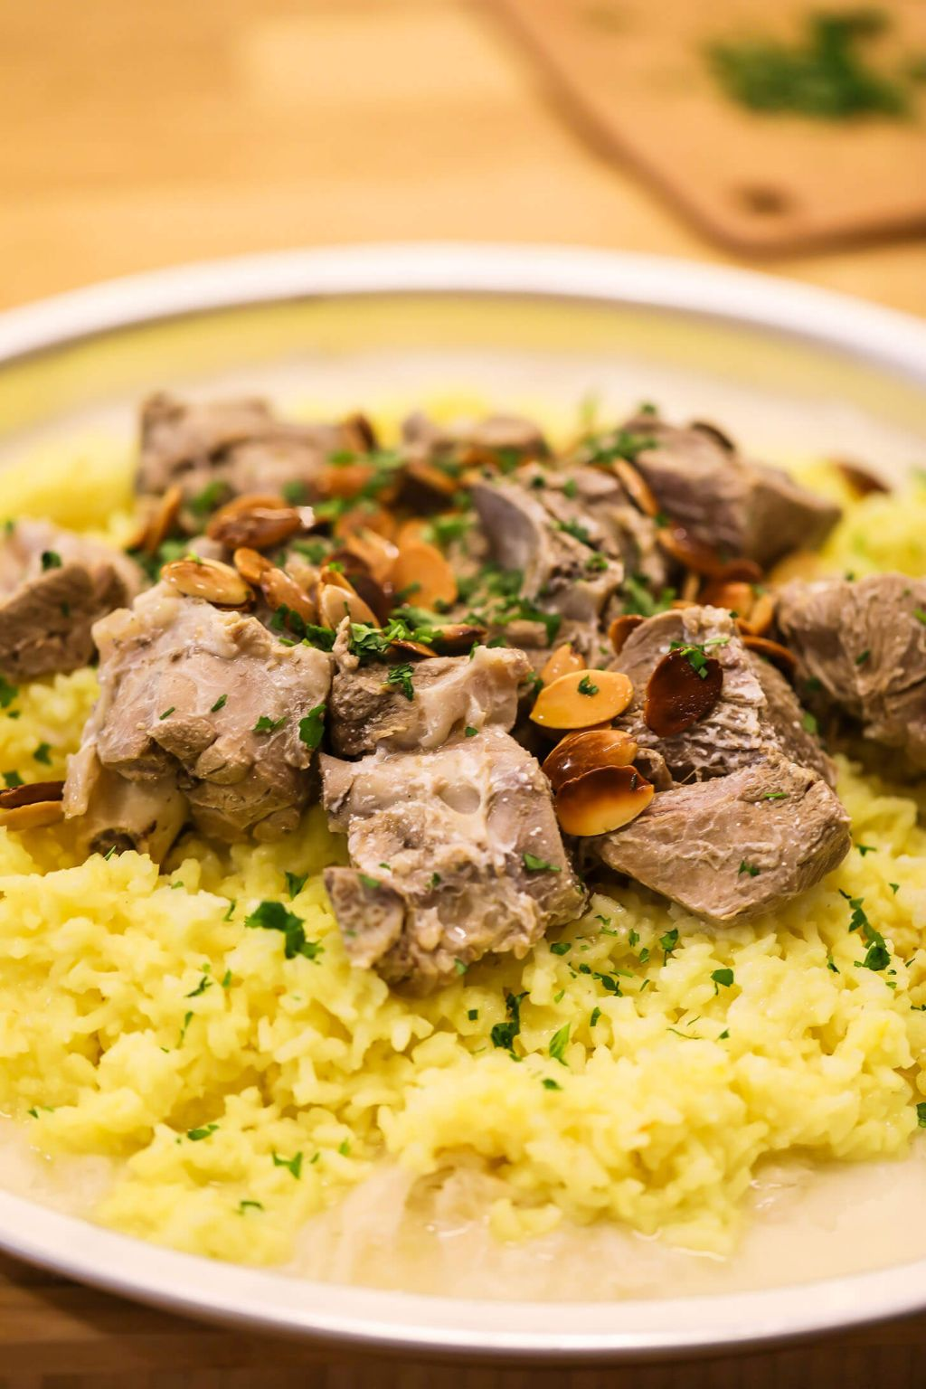
OFFERING MEALS
Food is commonly used by Jordanians to express their hospitality and generosity
Mansaf is the greatest symbol of Jordanian generosity it is usually eaten during social gatherings.
Mansaf is served with Arabic rice , lamb , and a Flavorful broth of dried sour milk.

Slide 6
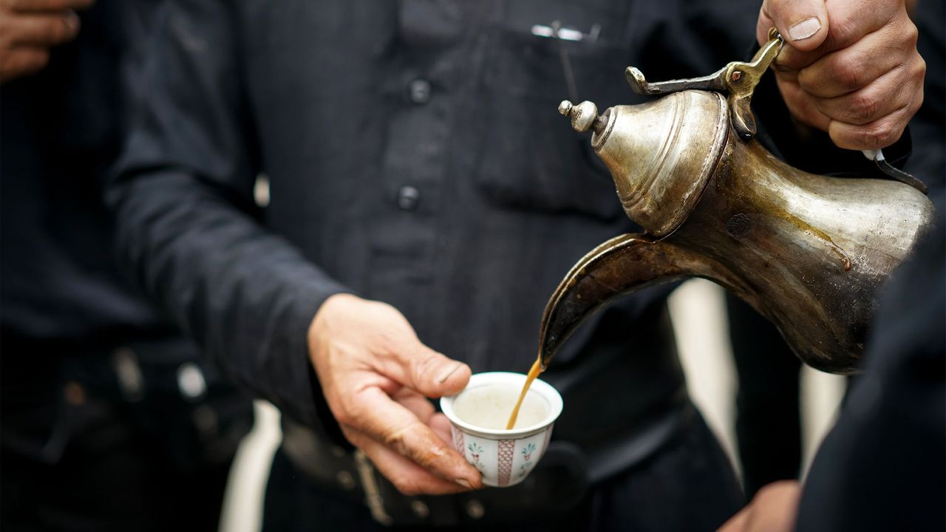
Coffee culture
Arabic coffee is usually offered by the host.
It is polite and respectful to accept.
When drinking Arabic coffee, to signify to the host that more coffee is requested, shaking the cup from side to side indicates this.
Coffee has to be served to the guest with the host’s right hand.
The host drinks out of the cup first, insuring that the coffee is the right temperature. The guest then drinks what remains of the first cup. A second cup is served to the guest and then a third.

Slide 7
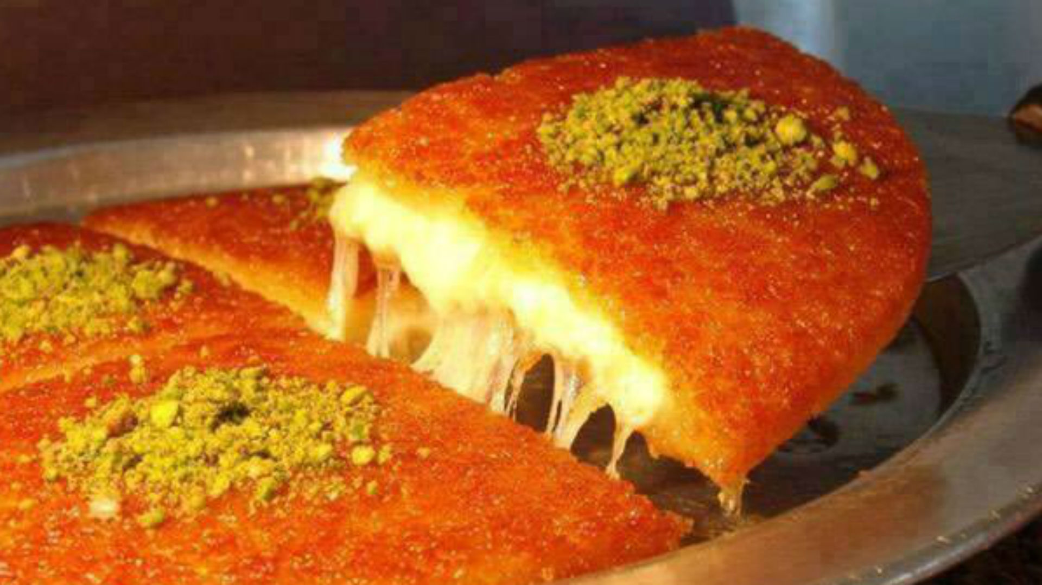
OFFERING DESSERTS
The host and his\her guest often share a cup of black coffee
The host usally offers
Baklava
Warbat
Halava
Hareeseh
Knafeh
Muhalabia
Umm Ali
Kawwameh
And sometimes Arabic Icecream

Slide 8
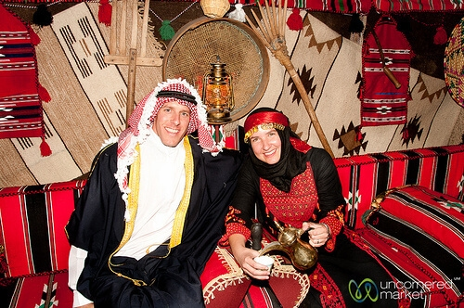
HOW THEY DRESS
When inviting someone or going to someone house the guest or the owner are supposed to wear something formal\proper, to show manners and respect
Both Guest and Host should wear something formal or proper, to show respect and manners.

Slide 9
TIME FOR QUESTIONS

Slide 10
Links
international.visitjordan.jo
jordantraditionsjohtt.edu.jo
Https:\\www.tcrhad.edu.jo
Https:\\international.visitjordan.edu.jo
Hhps:\\jordanpas.jo
https:\\johtt.jo
https:\\www.touristjordan.org
https:\\en.Wikipedia.org

