Slide 1
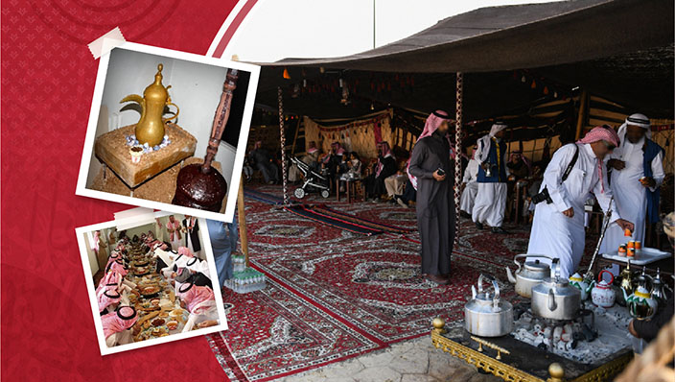
Hosting traditions
Rayna
Rayna
Done By:
Ayah Krayim
Malak Khattab
Shaker tadross
Awn Kamal

Slide 2
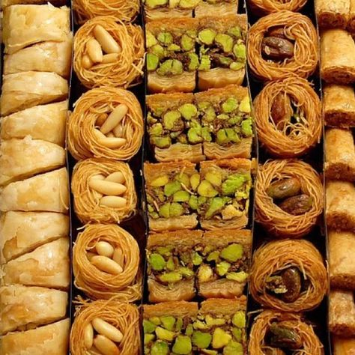
Definition of hosting in Jordan
Hosting is when the owner of the house / the person living in the house, invites guests over for some breakfast ,lunch or dinner and sometimes for some coffee and arabian sweets.

Slide 3

Facts about how they dine
Men and woman commonly dine seperatly.
Men and woman shake hands or kiss the cheeks of members of their own gender when greeting eachother .
Large feasts on weekends most commonly on Fridays or Saturdays with special arabian sweets.
Warm greetings, as always is important when inviting people.
The guest is always offered the best seat in the house, which is usally at the right of the host

Slide 4
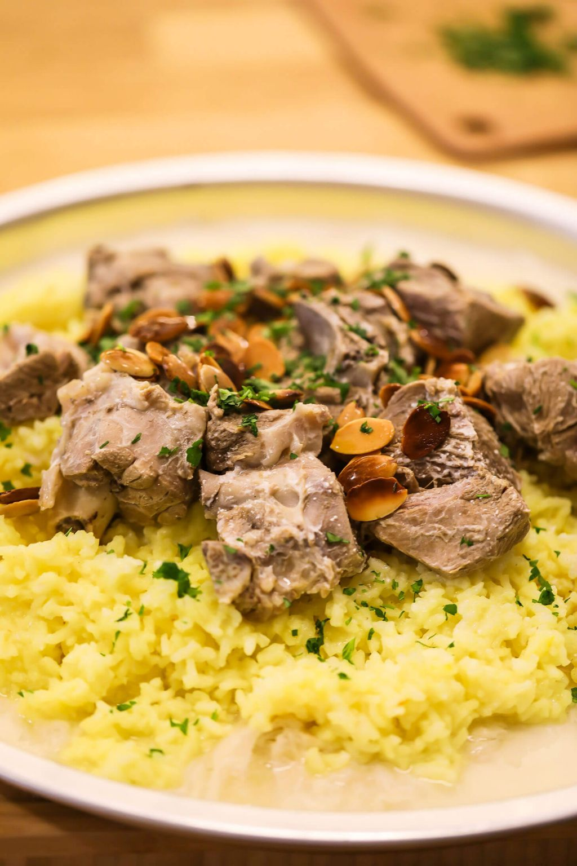
OFFERING MEALS
Food is commonly used by Jordanians to express their hospitality and generosity
Mansaf is the greatest symbol of Jordanian generosity it is usally eaten during social gatherings.
Mansaf is served with Arabic rice , lamb , and a Flavorful broth of dried sour milk.

Slide 5
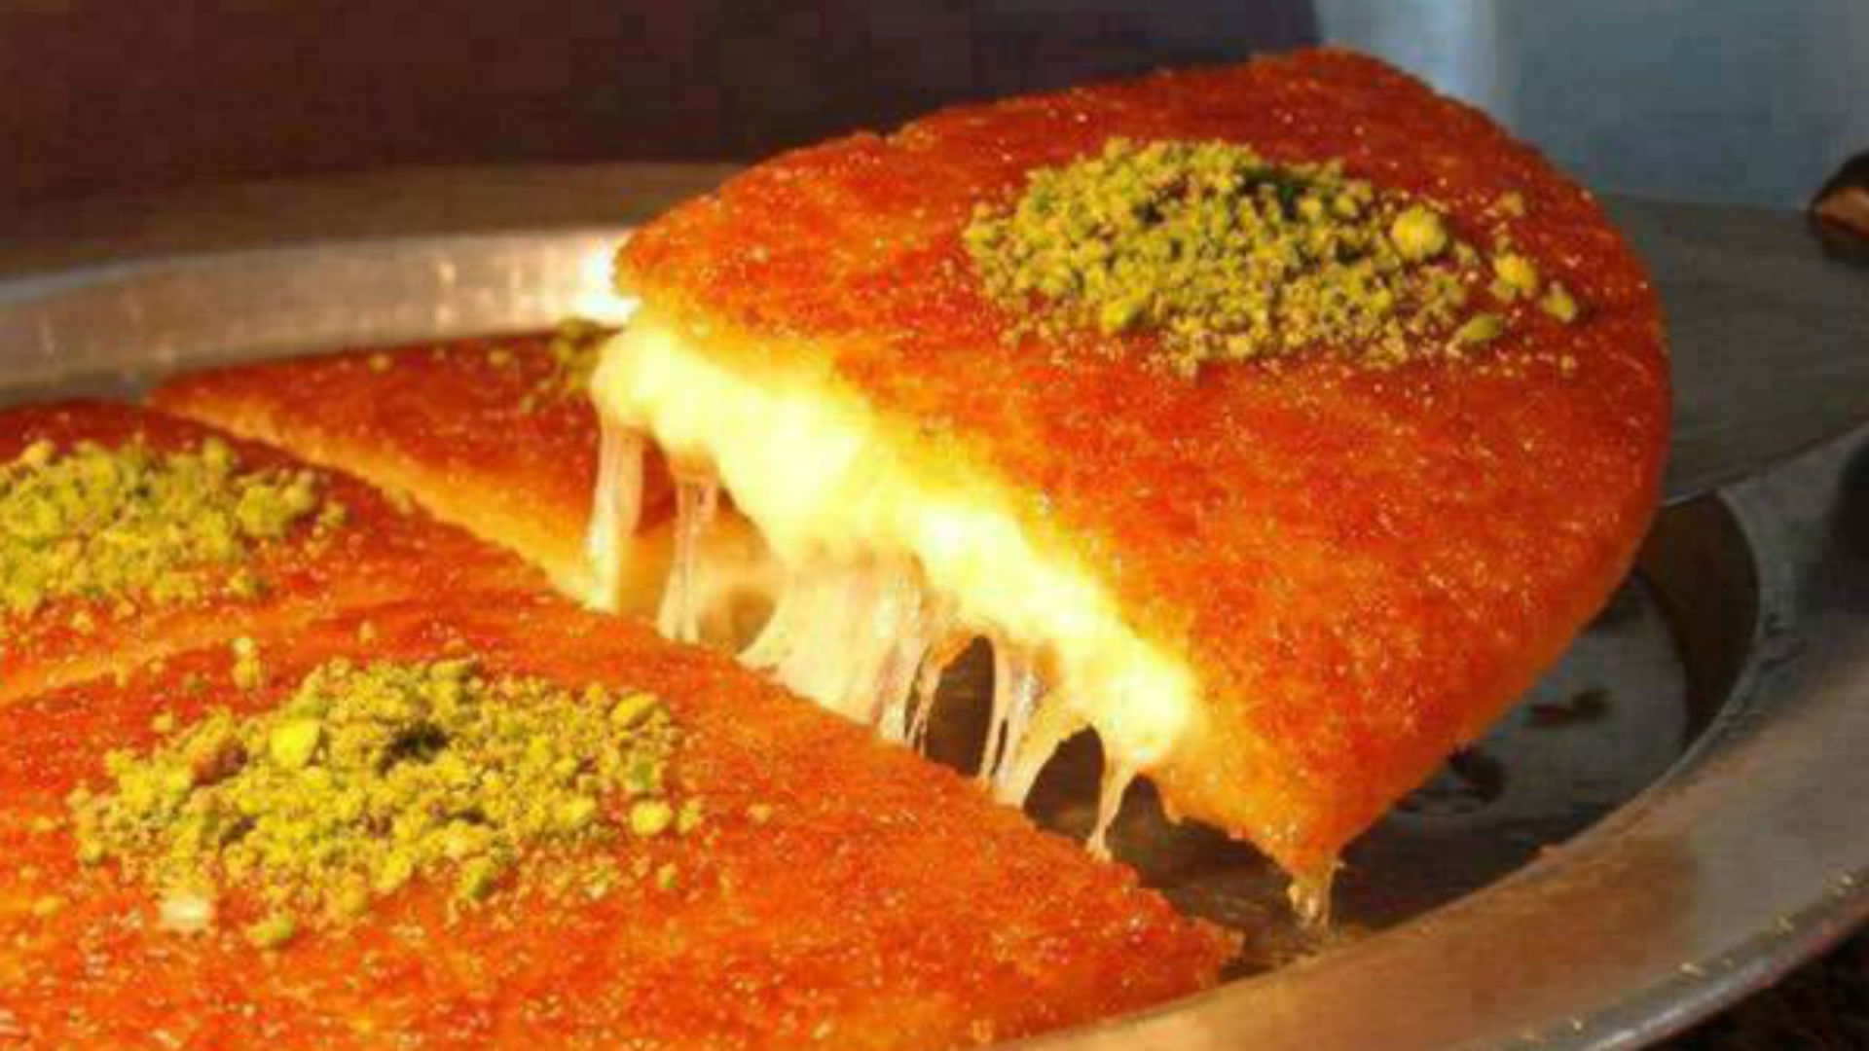
OFFERING DESSERTS
    The host and his\her guest often share a cup of black coffee
    The host usally offers
    Baklava
    Warbat
    Halava
    Hareeseh
    Knafeh
    Muhalabia
    Umm Ali
    Kawwameh
    And sometimes Arabic Icecream

Slide 6
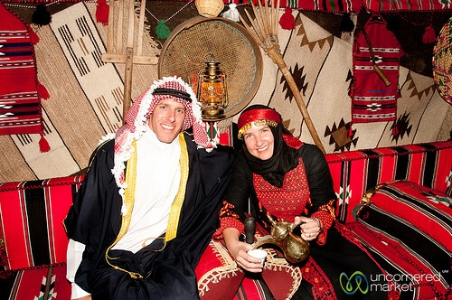
HOW THEY DRESS
When inviting someone or going to someones house the guest or the owner are supposed to wear something formal\proper, to show manners and respect
Guests:
When going to someones house you should wear something formal or proper, to show respect and manners to the person that invited you.
Owner:
When dressing up we are expected to wear something appropriate\traditional.

Slide 7

TIME FOR QUESTIONS

Slide 8
Links
international.visitjordan.jo
jordantraditionsjohtt.edu.jo
Https:\\www.tcrhad.edu.jo
Https:\\international.visitjordan.edu.jo
Hhps:\\jordanpas.jo
https:\\johtt.jo

