Slide 1

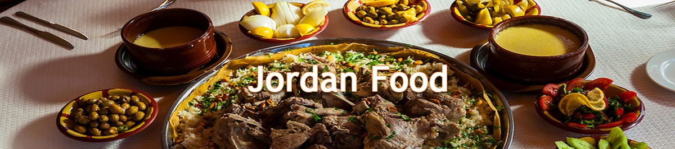
Food Tradition in Jordan
Done by: Nadia Bro
Abraham Alayyoub
Tiana Ghawi
Adam Sabbagh

Slide 2
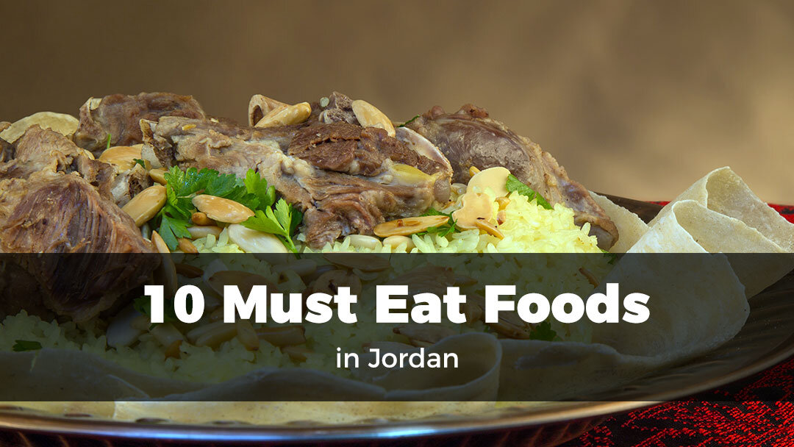
Famous Jordanian Food
Jordan is a country that is rich in culture and traditions, and where cultures meet, great food is bound to be found. We have presented a list of the top 10 traditional foods that are popular in Jordan.

Slide 3
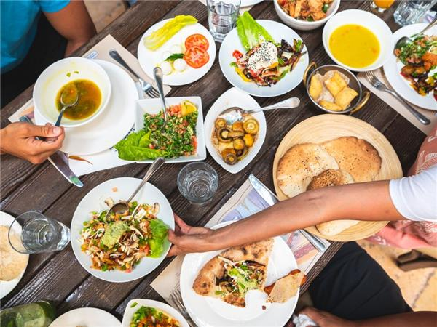
Wondering what to eat in Jordan?
While the list of food in Jordan can be bigger, we took the top 10 recommendations that reflect traditional food in Jordan. Some of the dishes can be found and shared across many countries.
In addition, food is commonly used by Jordanians to express their hospitality and generosity. Jordanians serve family, friends, and guests with great pride in their homes, no matter how modest their means. A "Jordanian invitation" means that one is expected to bring nothing and eat everything.

Slide 4
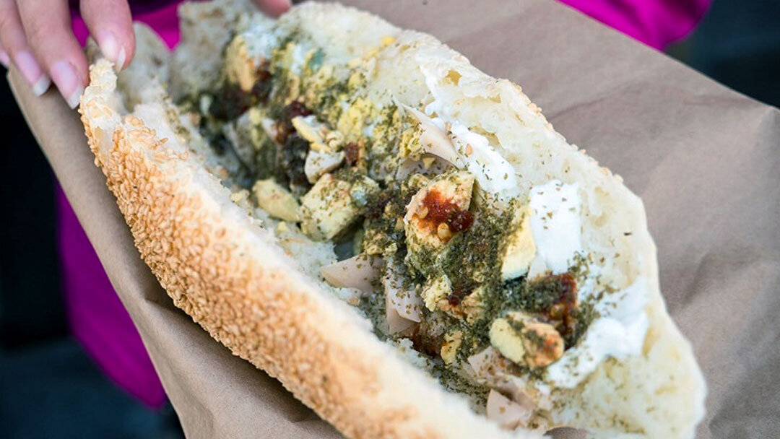
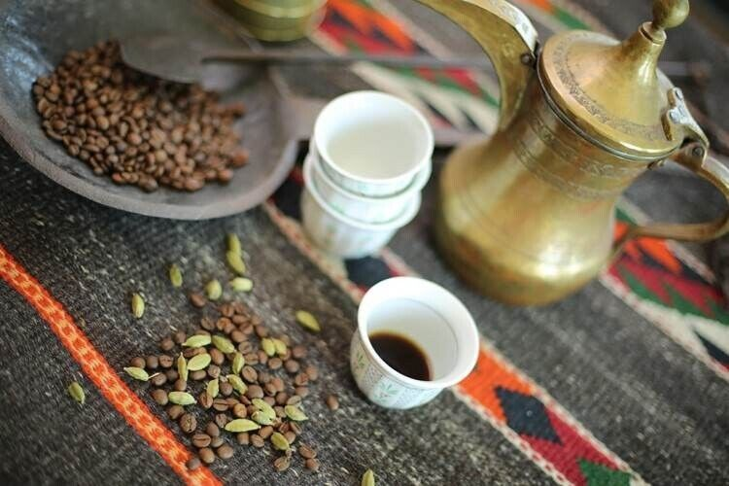
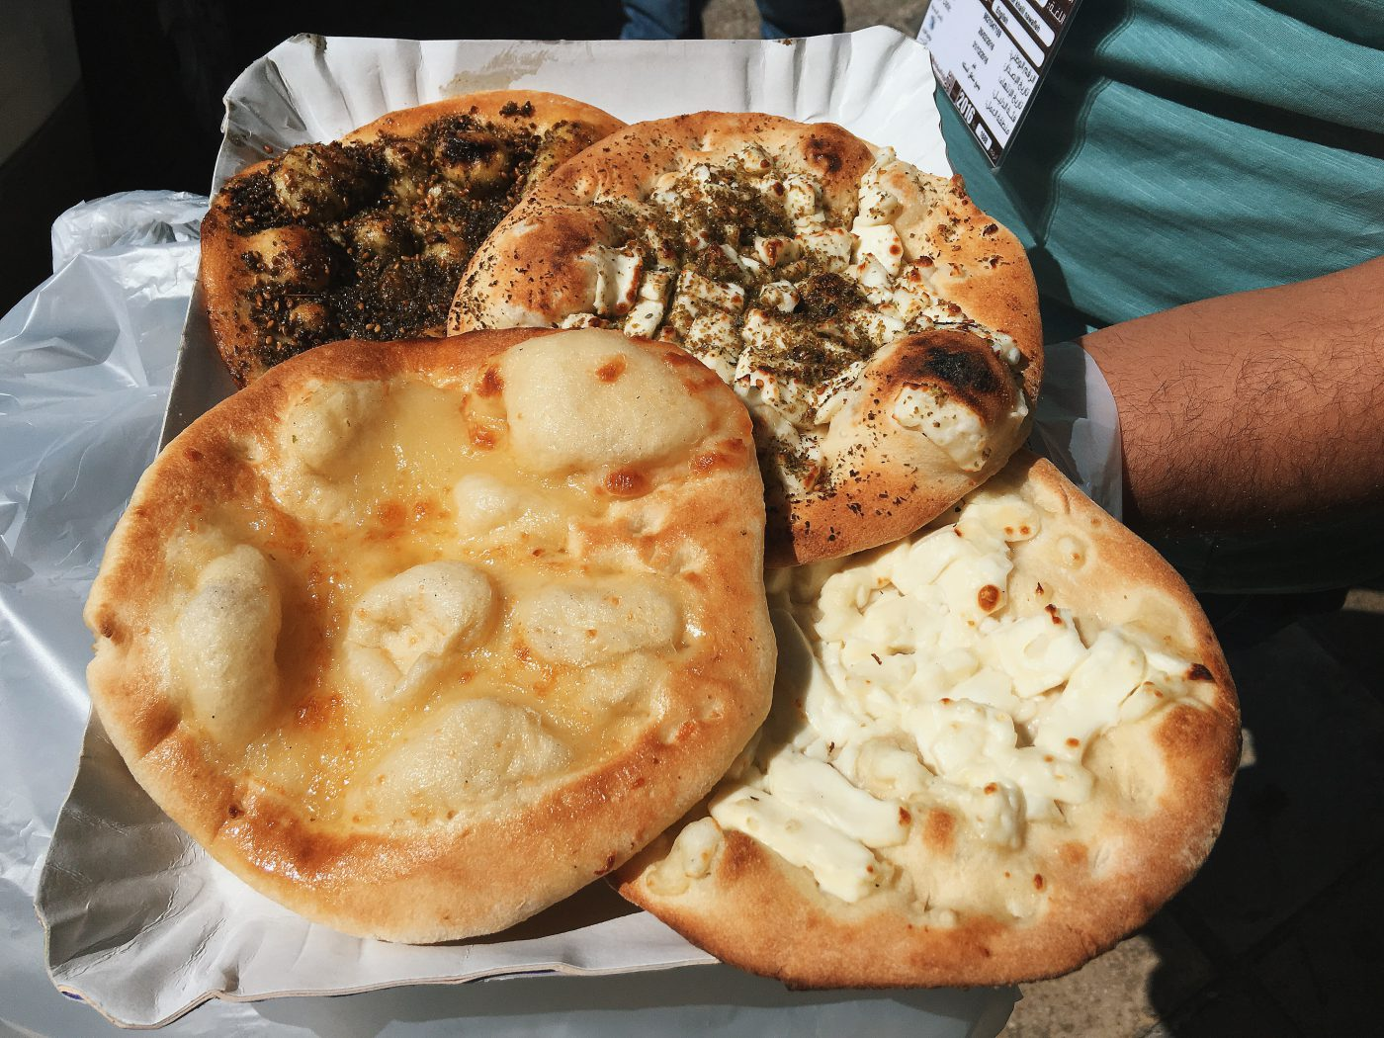
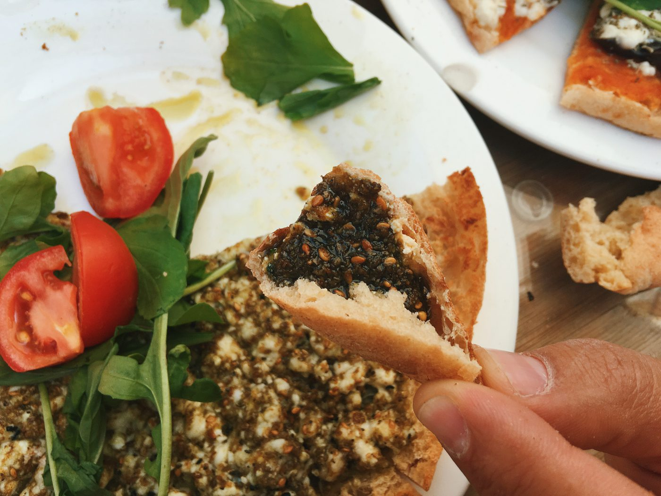
Here’s the list:
Mansaf
Makloubeh
Zarb
Sayadieh
Barbeque & Mezzah
Hummus & Falafel
Ka’ek & Eggs
Knafeh
Manakish
Za’atar
Arabic Bedouin Coffee

Slide 5
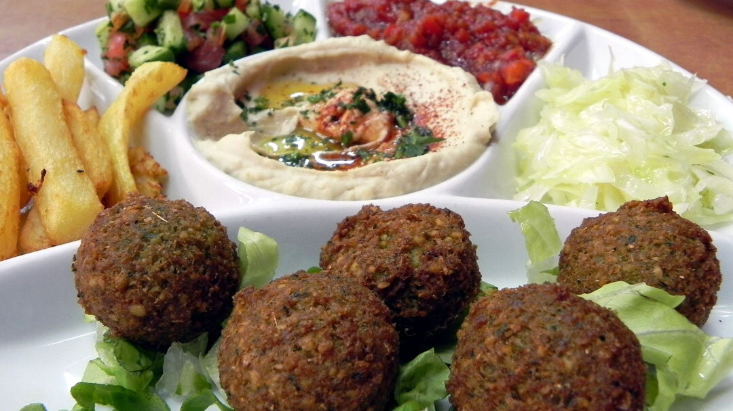
Traditional Breakfast in Jordan
Breakfast is my favorite meal of the day. What people eat for breakfast often also tells a lot about the culture of the place.
Manakish / Man’ousheh
Ka’ek & Eggs
Hummus & Falafel :
Known all over the world, Hummos, Foul, and Falafel are the staple diet of every home. This economical vegetarian delight is served most commonly for breakfast as it is rich on proteins.
Areas: Amman , Jordan.

Slide 6
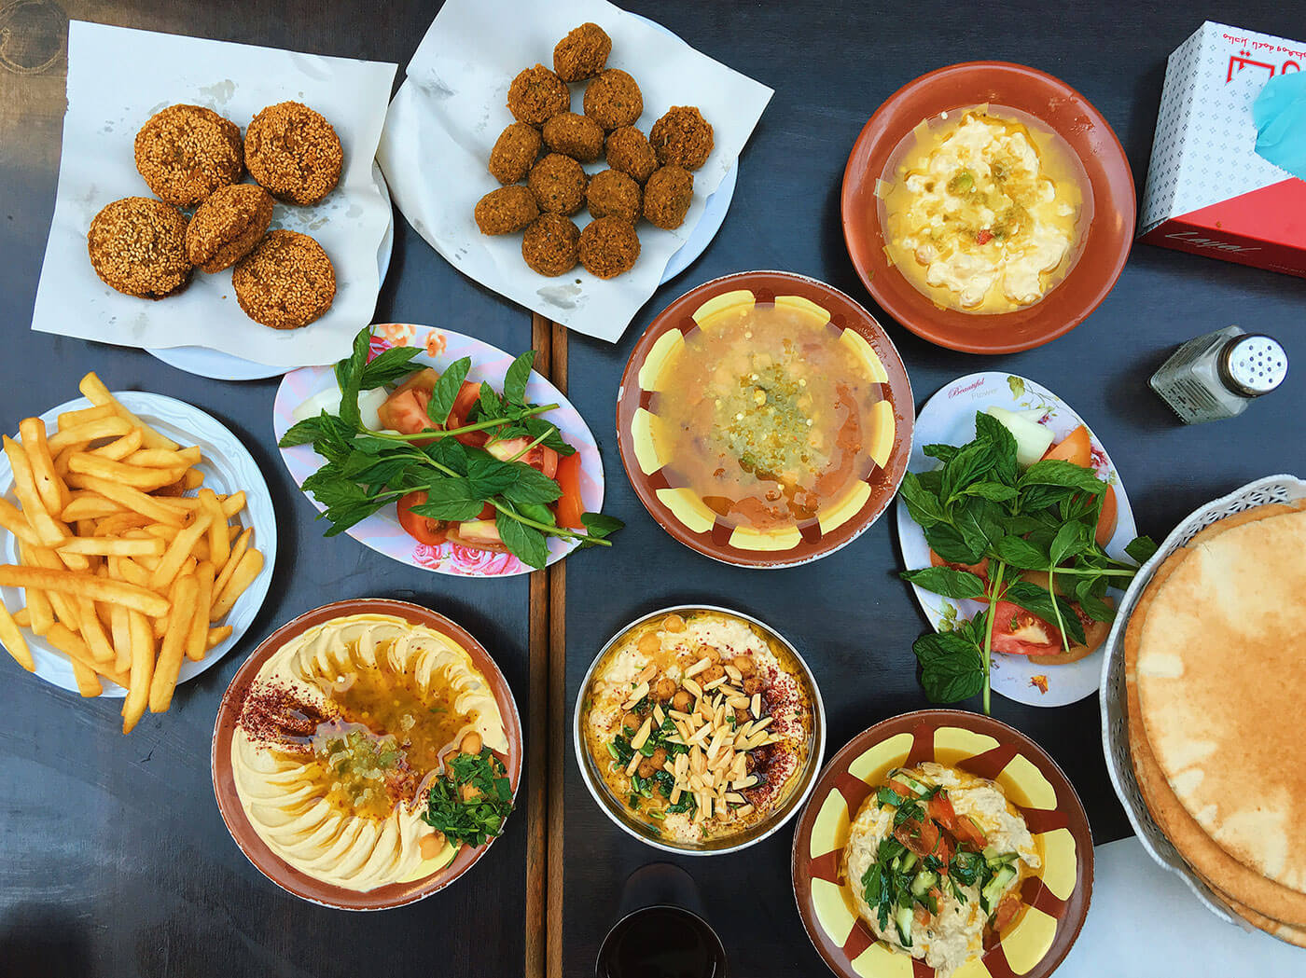
Do you know?????????!!!!!!!!!!
This breakfast spread below is the legendary Hashem Restaurant in Amman. Hashem is actually a very simple restaurant that may even qualify to be called street food, but it serves a feast fit for a King – Literally, as the Royal Jordanian family had been spotted casually having breakfast here.

Slide 7
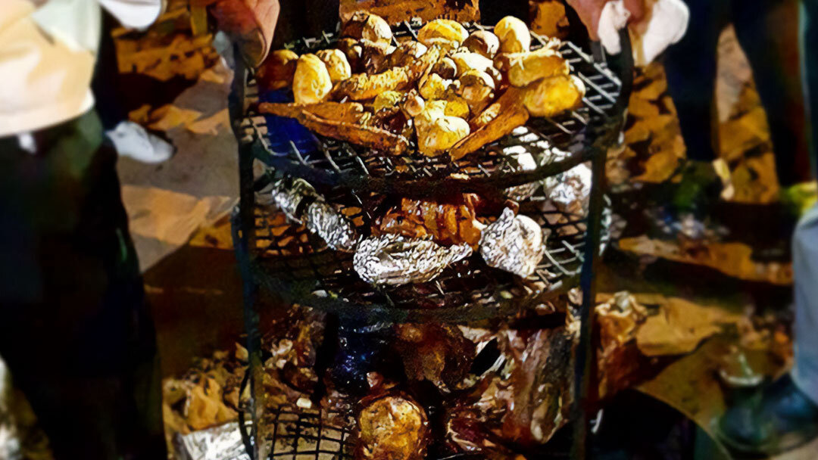
Zarb
This Bedouin is slow cooked for long hours in an underground pit giving it a unique smokey flavor from the hardwood used to generate the long lasting embers. With several variations, most will feature whole lamb, whole chicken, or cuts of both, seasoned and marinated, cooked over vegetables and rice.
Areas: Wadi Rum.

Slide 8
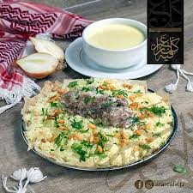
Mansaf
The traditional signature dish of Jordan, and source of pride for all Jordanians on who makes the best Mansaf.
A large platter of white rice over paper thin bread called “Shrak” topped with pull-apart lamb cuts, and soaked in a special sauce made from dried yoghurt called Jameed.
Areas: Amman, Kerak, Al Salt

Slide 9
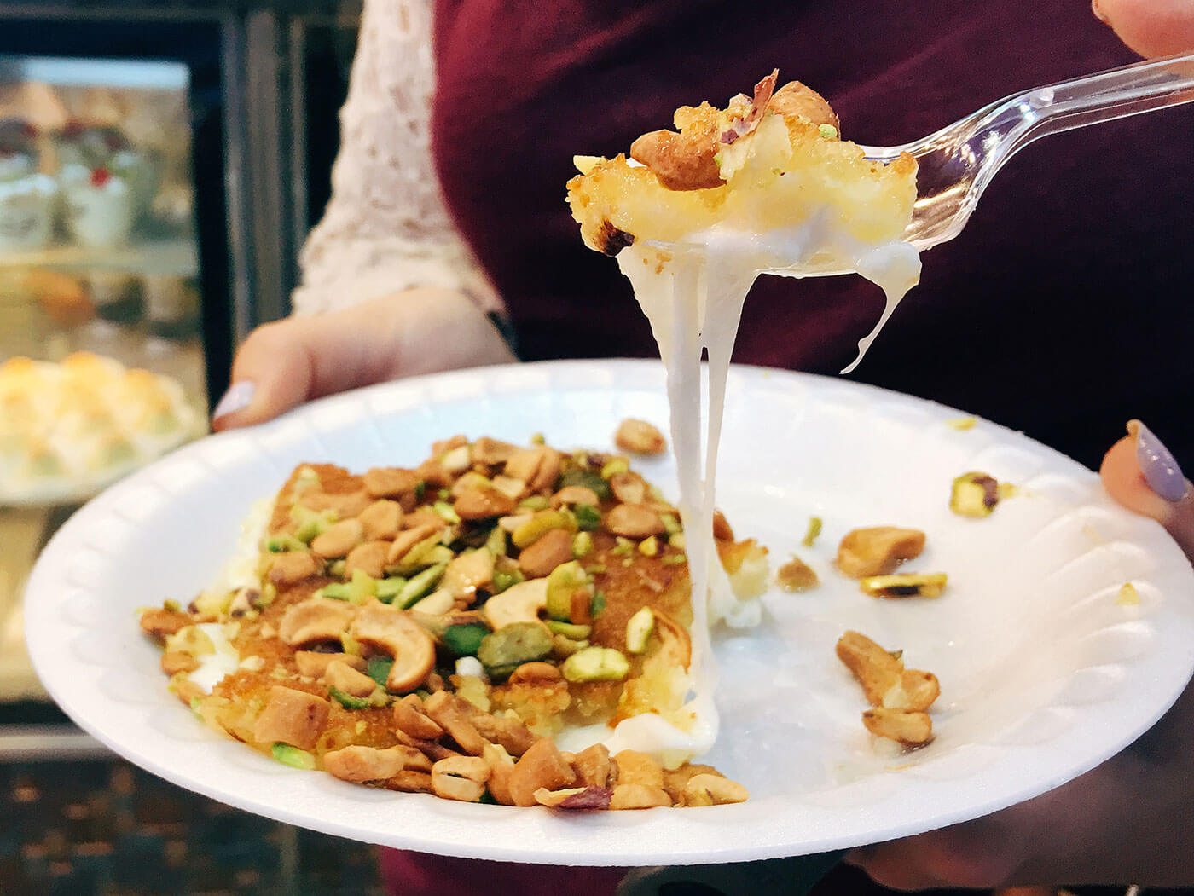
Knafeh
Knafeh is a dessert that is very popular in Arabic countries. It is made with white cheese, topped with crunchy pastry, then drenched in sweet syrup and topped with crushed-up pistachio and cashew.

Slide 10
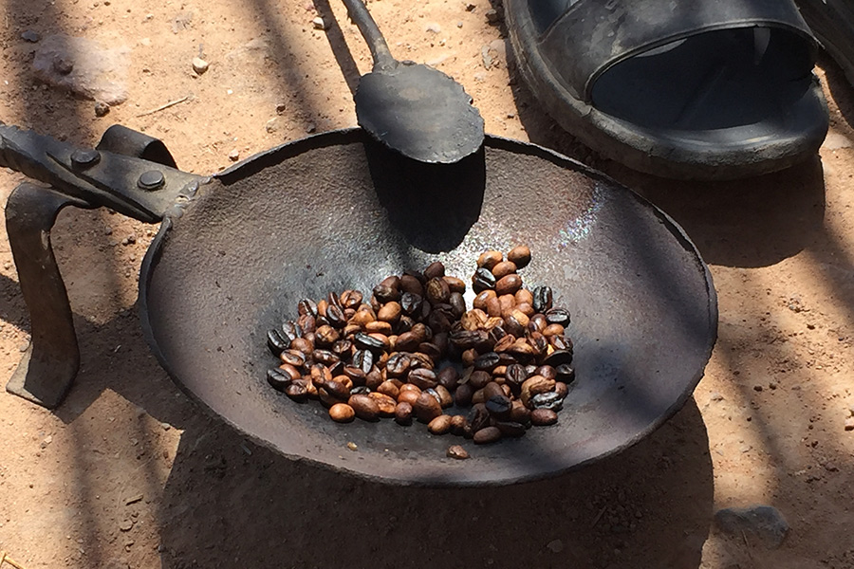
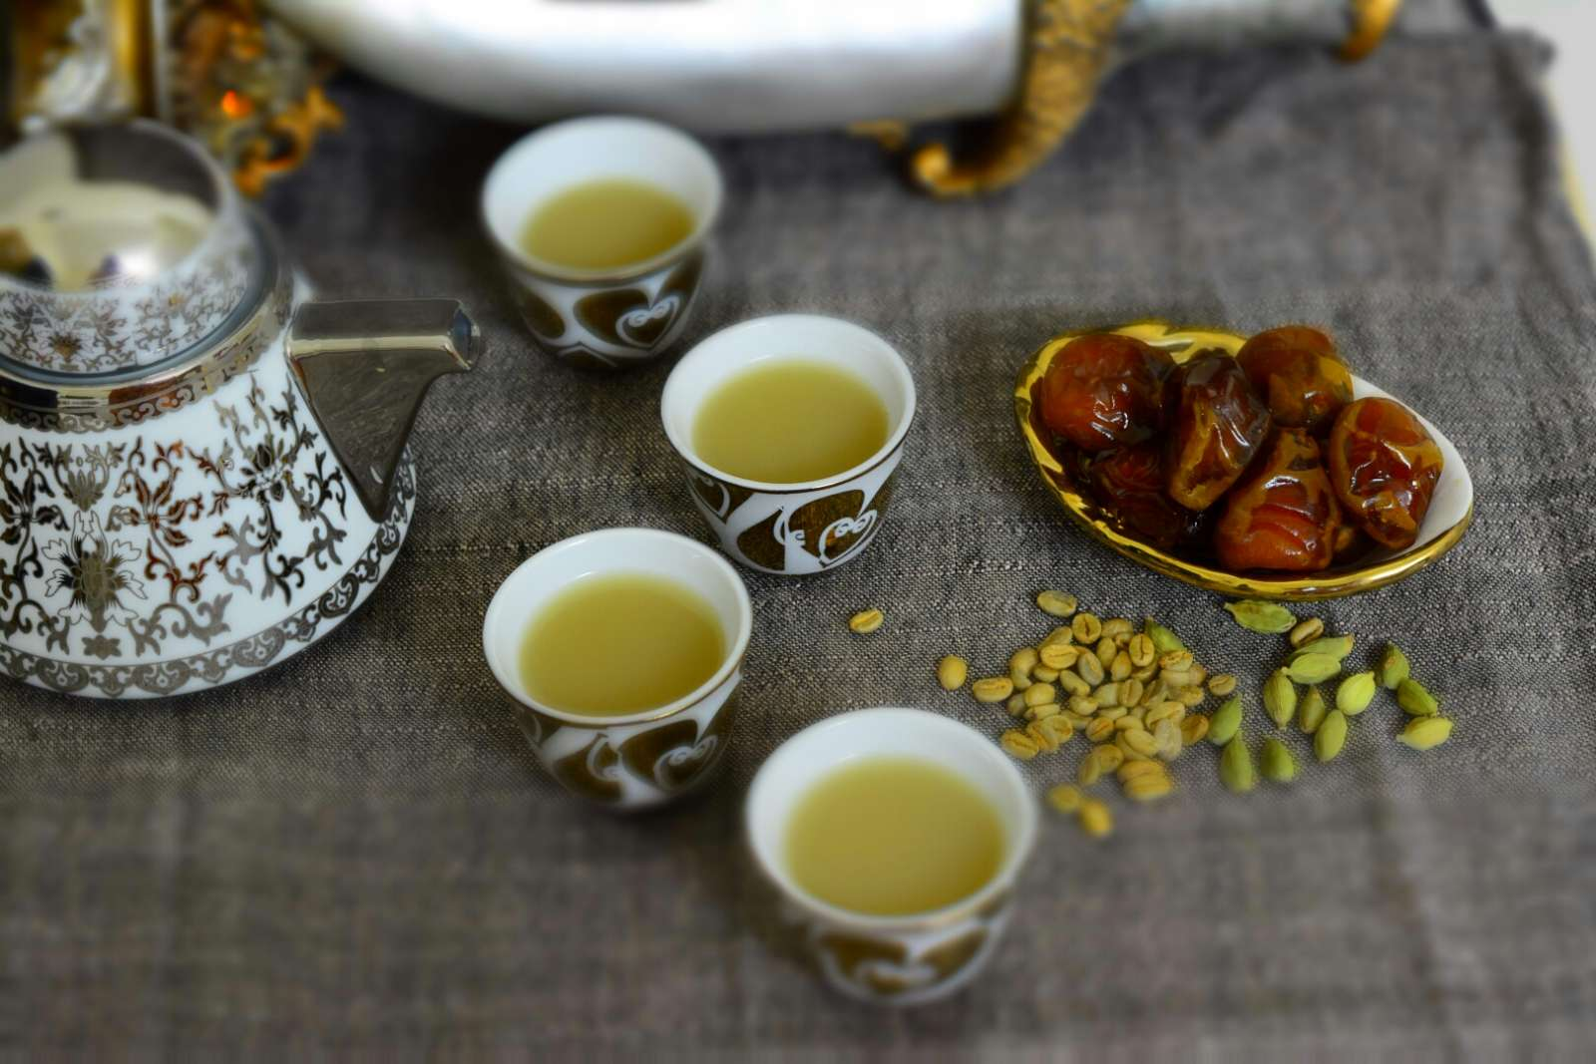
Arabic Bedouin Coffee / Qahwa
Serving Arabic coffee is an important aspect of hospitality in Arab societies and considered a ceremonial act of generosity. Traditionally, coffee is prepared in front of guests.
It is a symbol of hospitality and trust. It also plays an essential role in our way of doing business, negotiating, and discussing marriage.
The most important that oldest guest is served first, filling a quarter of the cup, which can then be refilled. Common practice is to drink at least one cup but not exceed three

Slide 11
Video of an interview made by Nadia Bro and her mother about one of the famous food tradition “Mansaf”….

Slide 12
Resources
https://girleatworld.net/jordan-food/
https://en.wikipedia.org/wiki/Jordanian_cuisine
https://togetherwomenrise.org/customsandcuisine/customs-and-cuisine-of-jordan/
https://ich.unesco.org/en/RL/arabic-coffee-a-symbol-of-generosity-01074
Thank you

