Slide 1
Traditional clothes in Jordan
By Own Izmigna-Faris Alrashdan - Mariam Ataui and Maya Abdellatif

Slide 2
An introduction for the traditional clothes in Jordan
The traditional outfit typically worn by men is made of one piece full length dress a , called a “Disdashah” or “thoub”, a white cap called “thagiyah” and a scarf–like head cover . The women’s national custom is a handmade full-length black dress embroidered with patterns in red.

Slide 3
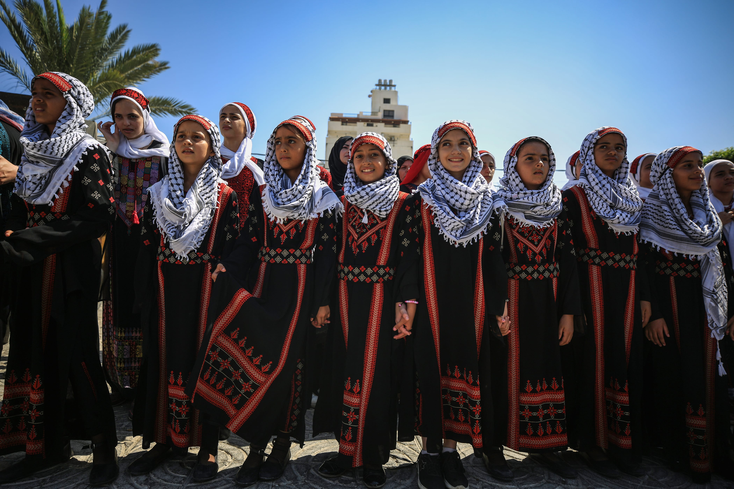
Traditional clothes in al-ramtha
The Ramthawi women have a special way of wearing clothes they are distinguished by their headdress and by wearing a head covering that distinguishes them from other women around the world.
This Photo by Unknown Author is licensed under CC BY-SA-NC

Slide 4
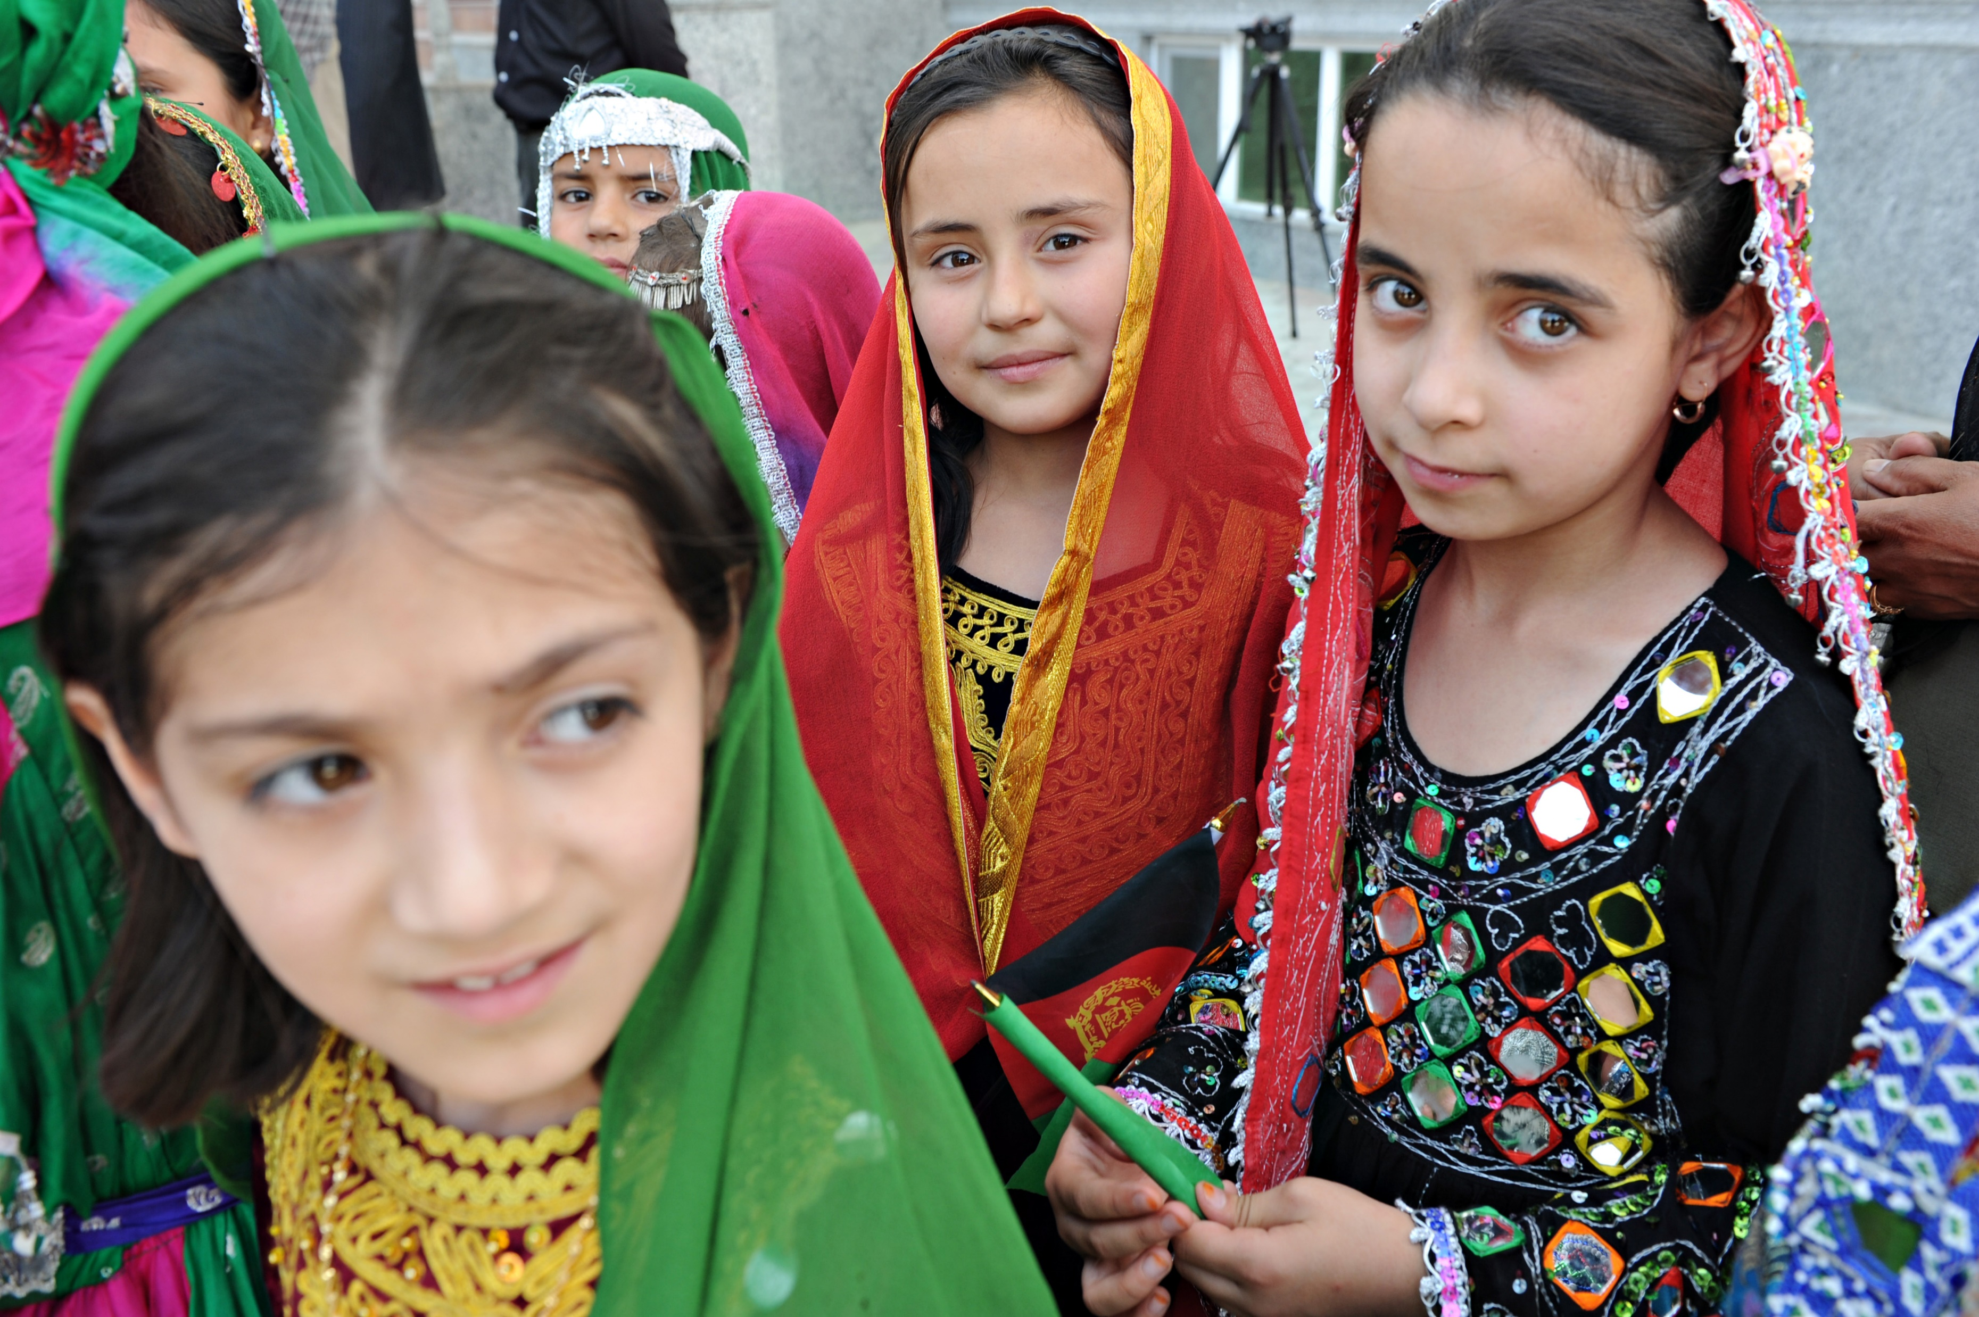
Traditional clothes in al-salt
Clothes of women in Al-Salt are different in shape,size and weight from the clothesof women in Joradan and Palestine.This dress is called by several names,including the sultan style (with the opening of the kha and lam) and the madragh,which they wore on private visits.
This Photo by Unknown Author is licensed under CC BY-SA

Slide 5
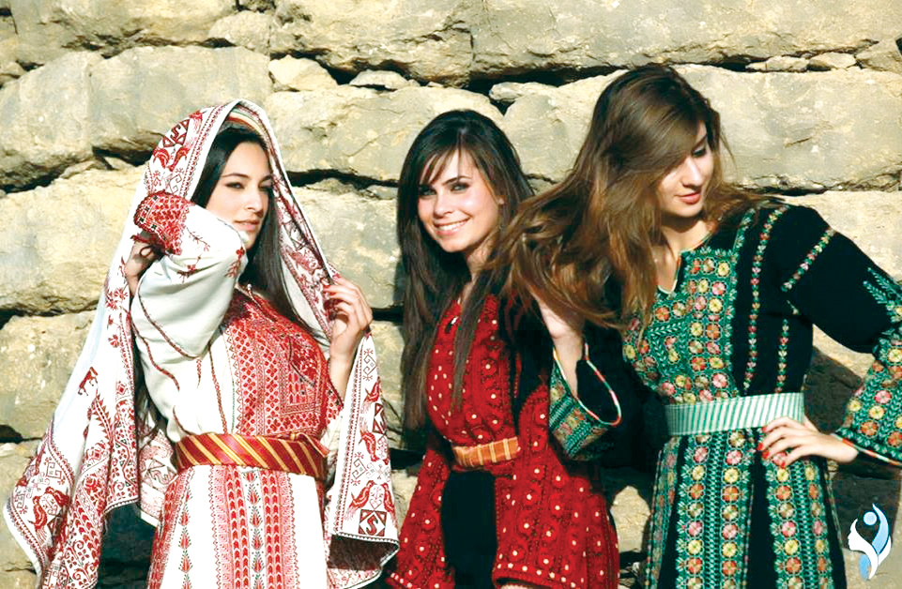
Traditional clothes in al mafraga
The traditional clothes in Al-mafraga is called(مدرقه) they wear a black dress with long sleeves and under it they wear a (كوفيه) T-shirt.
This Photo by Unknown Author is licensed under CC BY-NC-ND

Slide 6
Trusted websites
Folkculture.org
amideastedaboard.org
Jordan.un.org
Fashionrevolution.org

