Slide 1
Culture and Traditions in Jordan
Jordanian Traditional Weddings
Sami Nimri Group– 6F

Slide 2
Jordanian Traditional Weddings
Special in Jordan's culture: Jordanian weddings are unique and hold a special place in the heart of Jordanians. They are not just ordinary events; they are a significant part of the country's identity and history.
Focus on family and tradition: These weddings revolve around family. They bring relatives and extended family members together, reinforcing the bonds among them. The traditions followed during Jordanian weddings are deeply ingrained in the culture and have been passed down through generations. This emphasis on tradition showcases the country's commitment to preserving its heritage and values.

Slide 3
What to Expect in Traditional weddings
Families involved ( invite all the tribe and friends )
Lots of customs, traditional clothes ( Arabic dress)
Tasty Jordanian food, mainly (Mansaf)
Fun Jordanian music and dancing ( Dabkah)
Brings people together to celebrate. ( Taelelah for seven nights )

Slide 4
Jordanian Traditional weddings in different cities in Jordan
In different cities in Jordan, Jordanian weddings are all about traditional customs, music, and dance, making them special and full of cultural meaning. Each city adds its own flavor, making every wedding unique.

Slide 5
Jordanian weddings in Irbid
Mix of Old and New: In Irbid, they like a mix of old and new. They keep the old traditions but add a modern touch.
Cool Dance: They have a special dance called "Dabke" at Irbid weddings. Everyone, including the bride and groom, dances in a happy and rhythmic way.
Pretty Outfits: In Irbid, they want the bride to look beautiful in a dress with lots of pretty designs, and the groom wears special Jordanian clothes to keep their traditions alive.

Slide 6
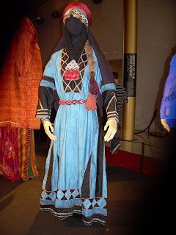
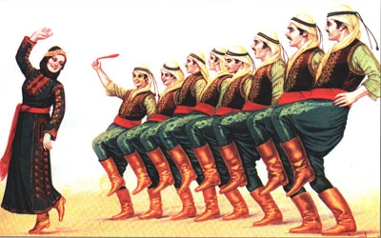
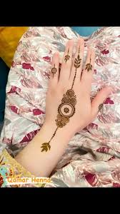

Slide 7
Jordanian weddings in Salt
Traditional Vibes: In Salt, they love their traditions. Weddings here are full of old customs and ways.
Henna Night: A big deal in Salt weddings, the henna night is when they put pretty henna designs on the bride's hands. Ladies sing and dance, making it a fun time.
Happy Parade: There's a special parade called "zaffeh" that takes the bride to the wedding place. People in the parade sing and dance in the Jordanian way, making it all lively and cheerful.

Slide 8
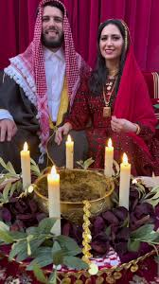
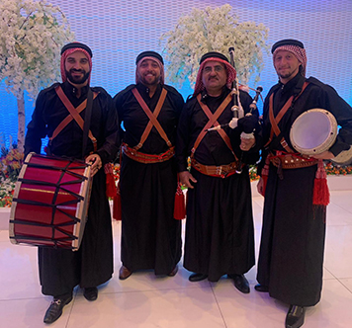

Slide 9
Jordanian weddings in Karak
History Matters: In Karak, they love their history. Some couples even have their weddings in a big old castle, making the day feel grand and special.
Sweet Music: They have a special kind of music with traditional instruments like the rebaba and mijwiz. It's all about keeping their traditions alive and authentic.
Elders' Blessings: In Karak, the older folks are important. They give their blessings at weddings, making sure everyone remembers the importance of family and history.

Slide 10
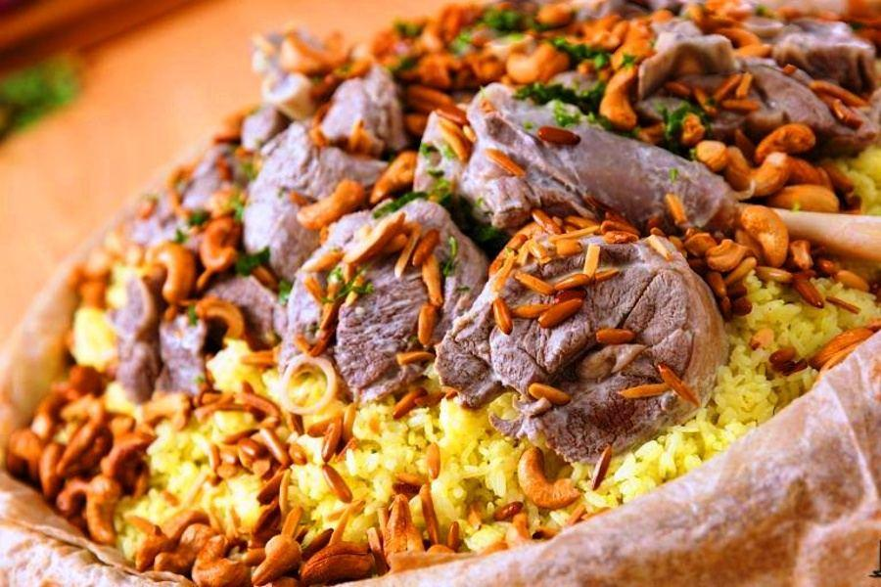

Slide 11
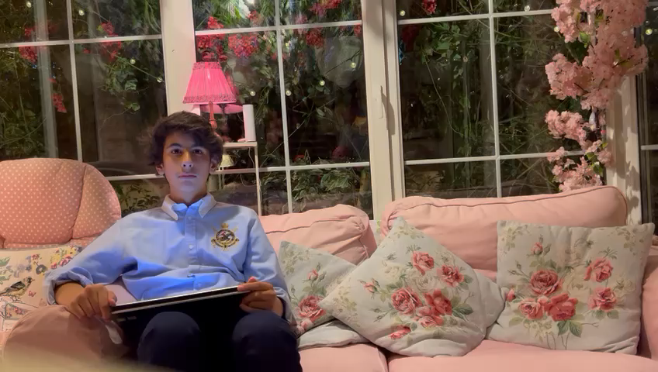
Interview video link

Slide 12
Resources
https://www.jordannews.jo/Section-134/The-Royal-wedding/Jordanians-celebrate-Royal-wedding-embracing-heritage-and-traditions-28970
Travel travel guide website:
https://www.responsibletravel.com/holidays/jordan/travel-guide

