Slide 1
Dance and Delight in Jordan
Lets Explore Traditional Jordanian Dancing

Slide 2
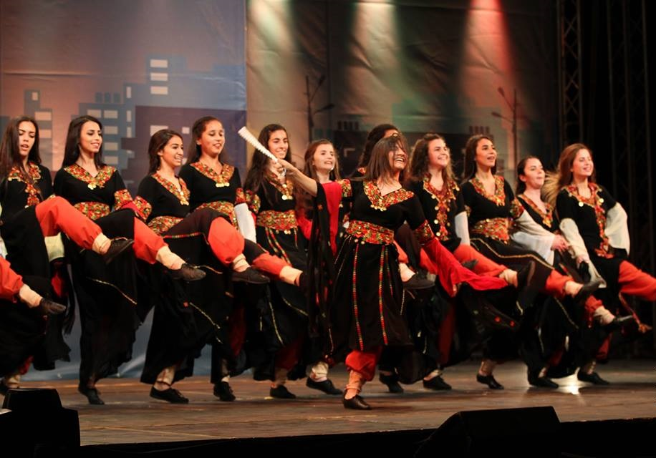
Meet Dabke!
Dabke is jordans special dance
Dabke is a lively traditional dance in Jordan, and “Belad Al-Sham”. Imagine a lie of people holding hands, moving to the beat, and stomping their feet in joy!

Slide 3
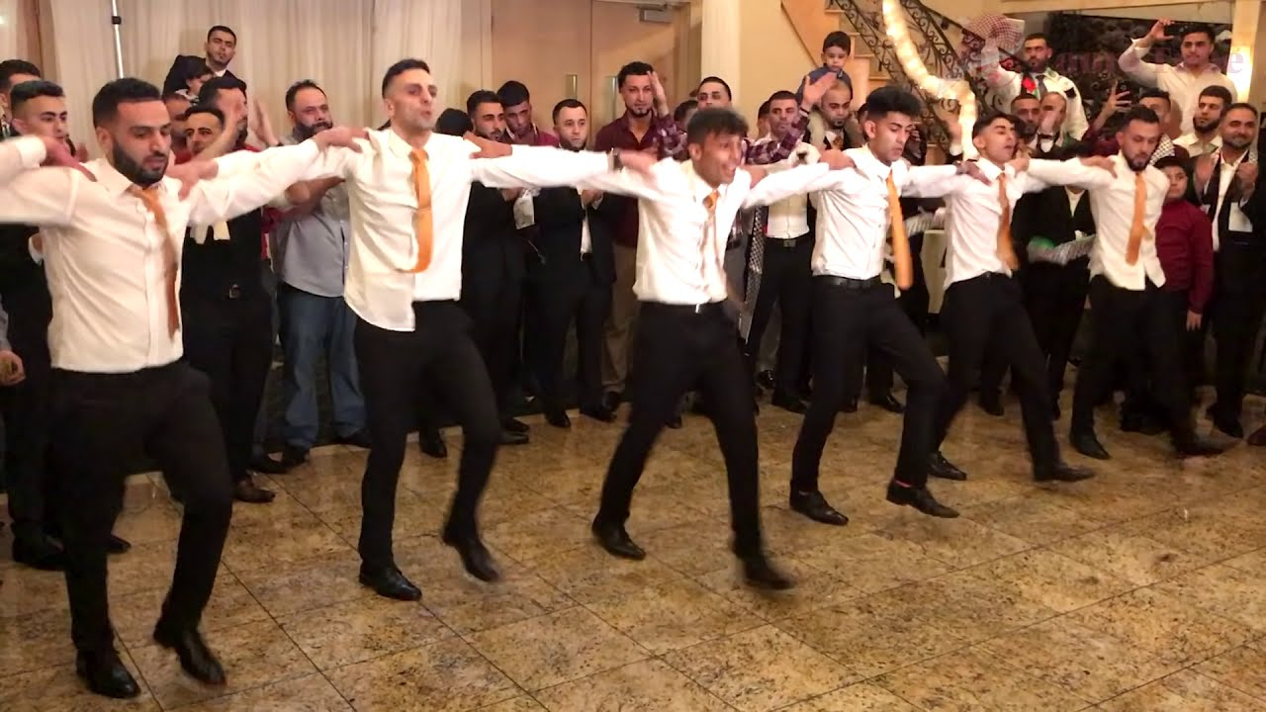
Dress Up and Celebrate!
People in Jordan usually wear colorful costumes when they dance. They dance during weddings, festivals, and special events to celebrate with joy and happiness.

Slide 4
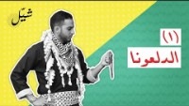
Join the Fun- Learn Basic Dabke Steps
Would you like to dance like Jordanians? Let’s Learn some basic Dabke steps together!

Slide 5
This presentation was done totally by us, there was no resources only 1 video.
Done by : Fahed , Yara , Hani , Haya

