Slide 1
Traditional Foods in Jordan
Done by:
Dina Almarie, Zeena Qutaishat
Mohammad Masood

Slide 2

Introduction
Food is a big part of the Jordanian culture seen in everyday life and celebrations. From street food to fine-dining, Jordanian food is inherently traditional, using authentic cooking methods and recipes passed down from generation to generation. Using local and regional ingredients and a multitude of fresh herbs and spices, tasting Jordanian food is one of the best ways to experience the country. Here are some main dishes in Jordan.

Slide 3
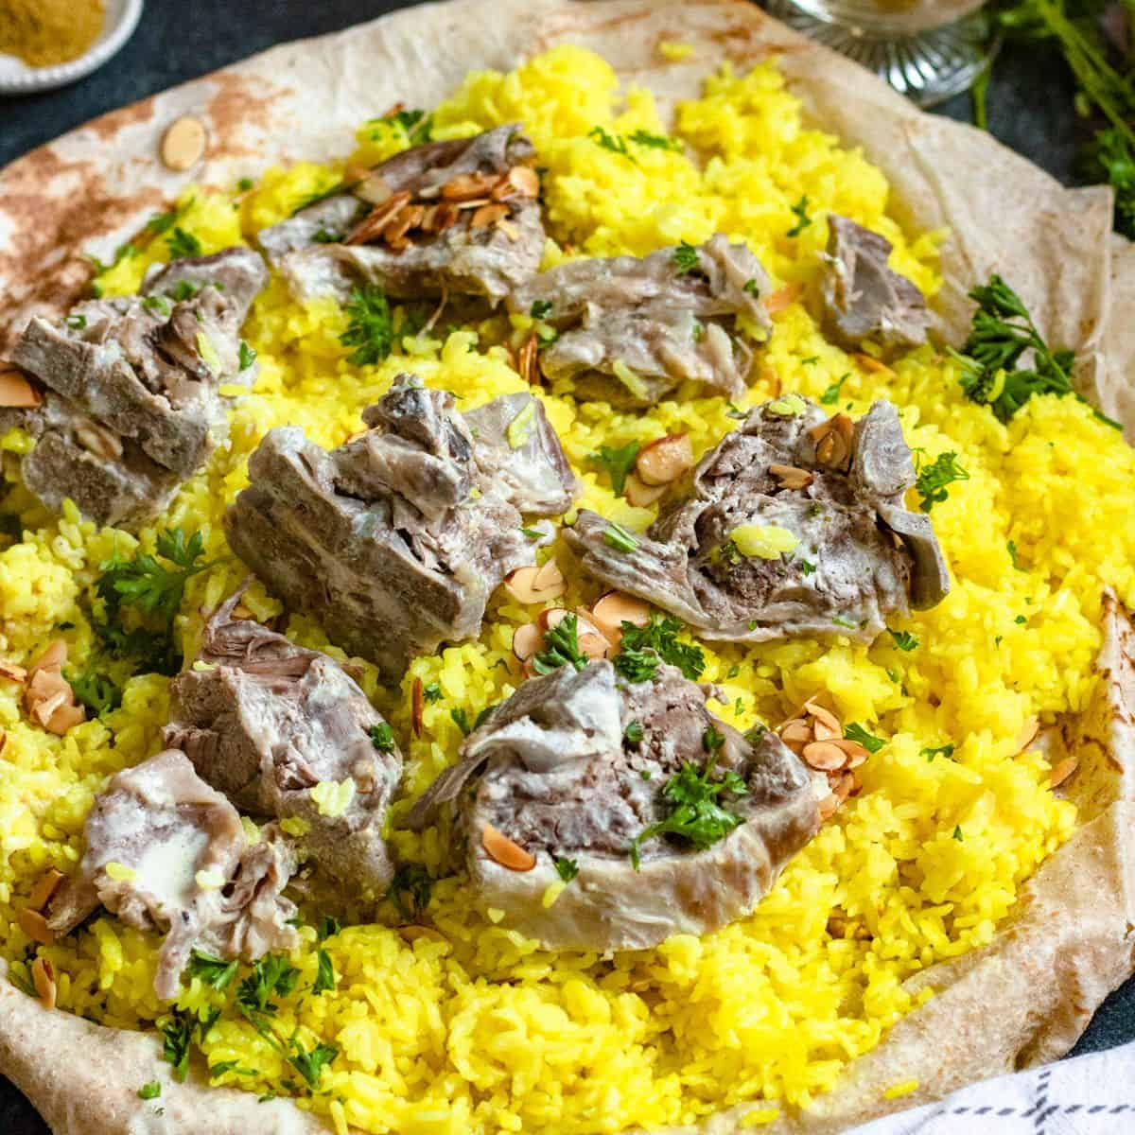
Mansaf:
Mansaf is the national dish of Jordan and known in all over Jordan, This is a traditional Arab dish made of lamb and rice, cooked in boiled yogurt, and topped with almonds.
Mansaf originated in Bedouin culture and many Jordanians still continue the tradition of eating this meal with their hands.
If you are attending a wedding or a big family gathering,
chances are high that Mansaf will be served!

Slide 4
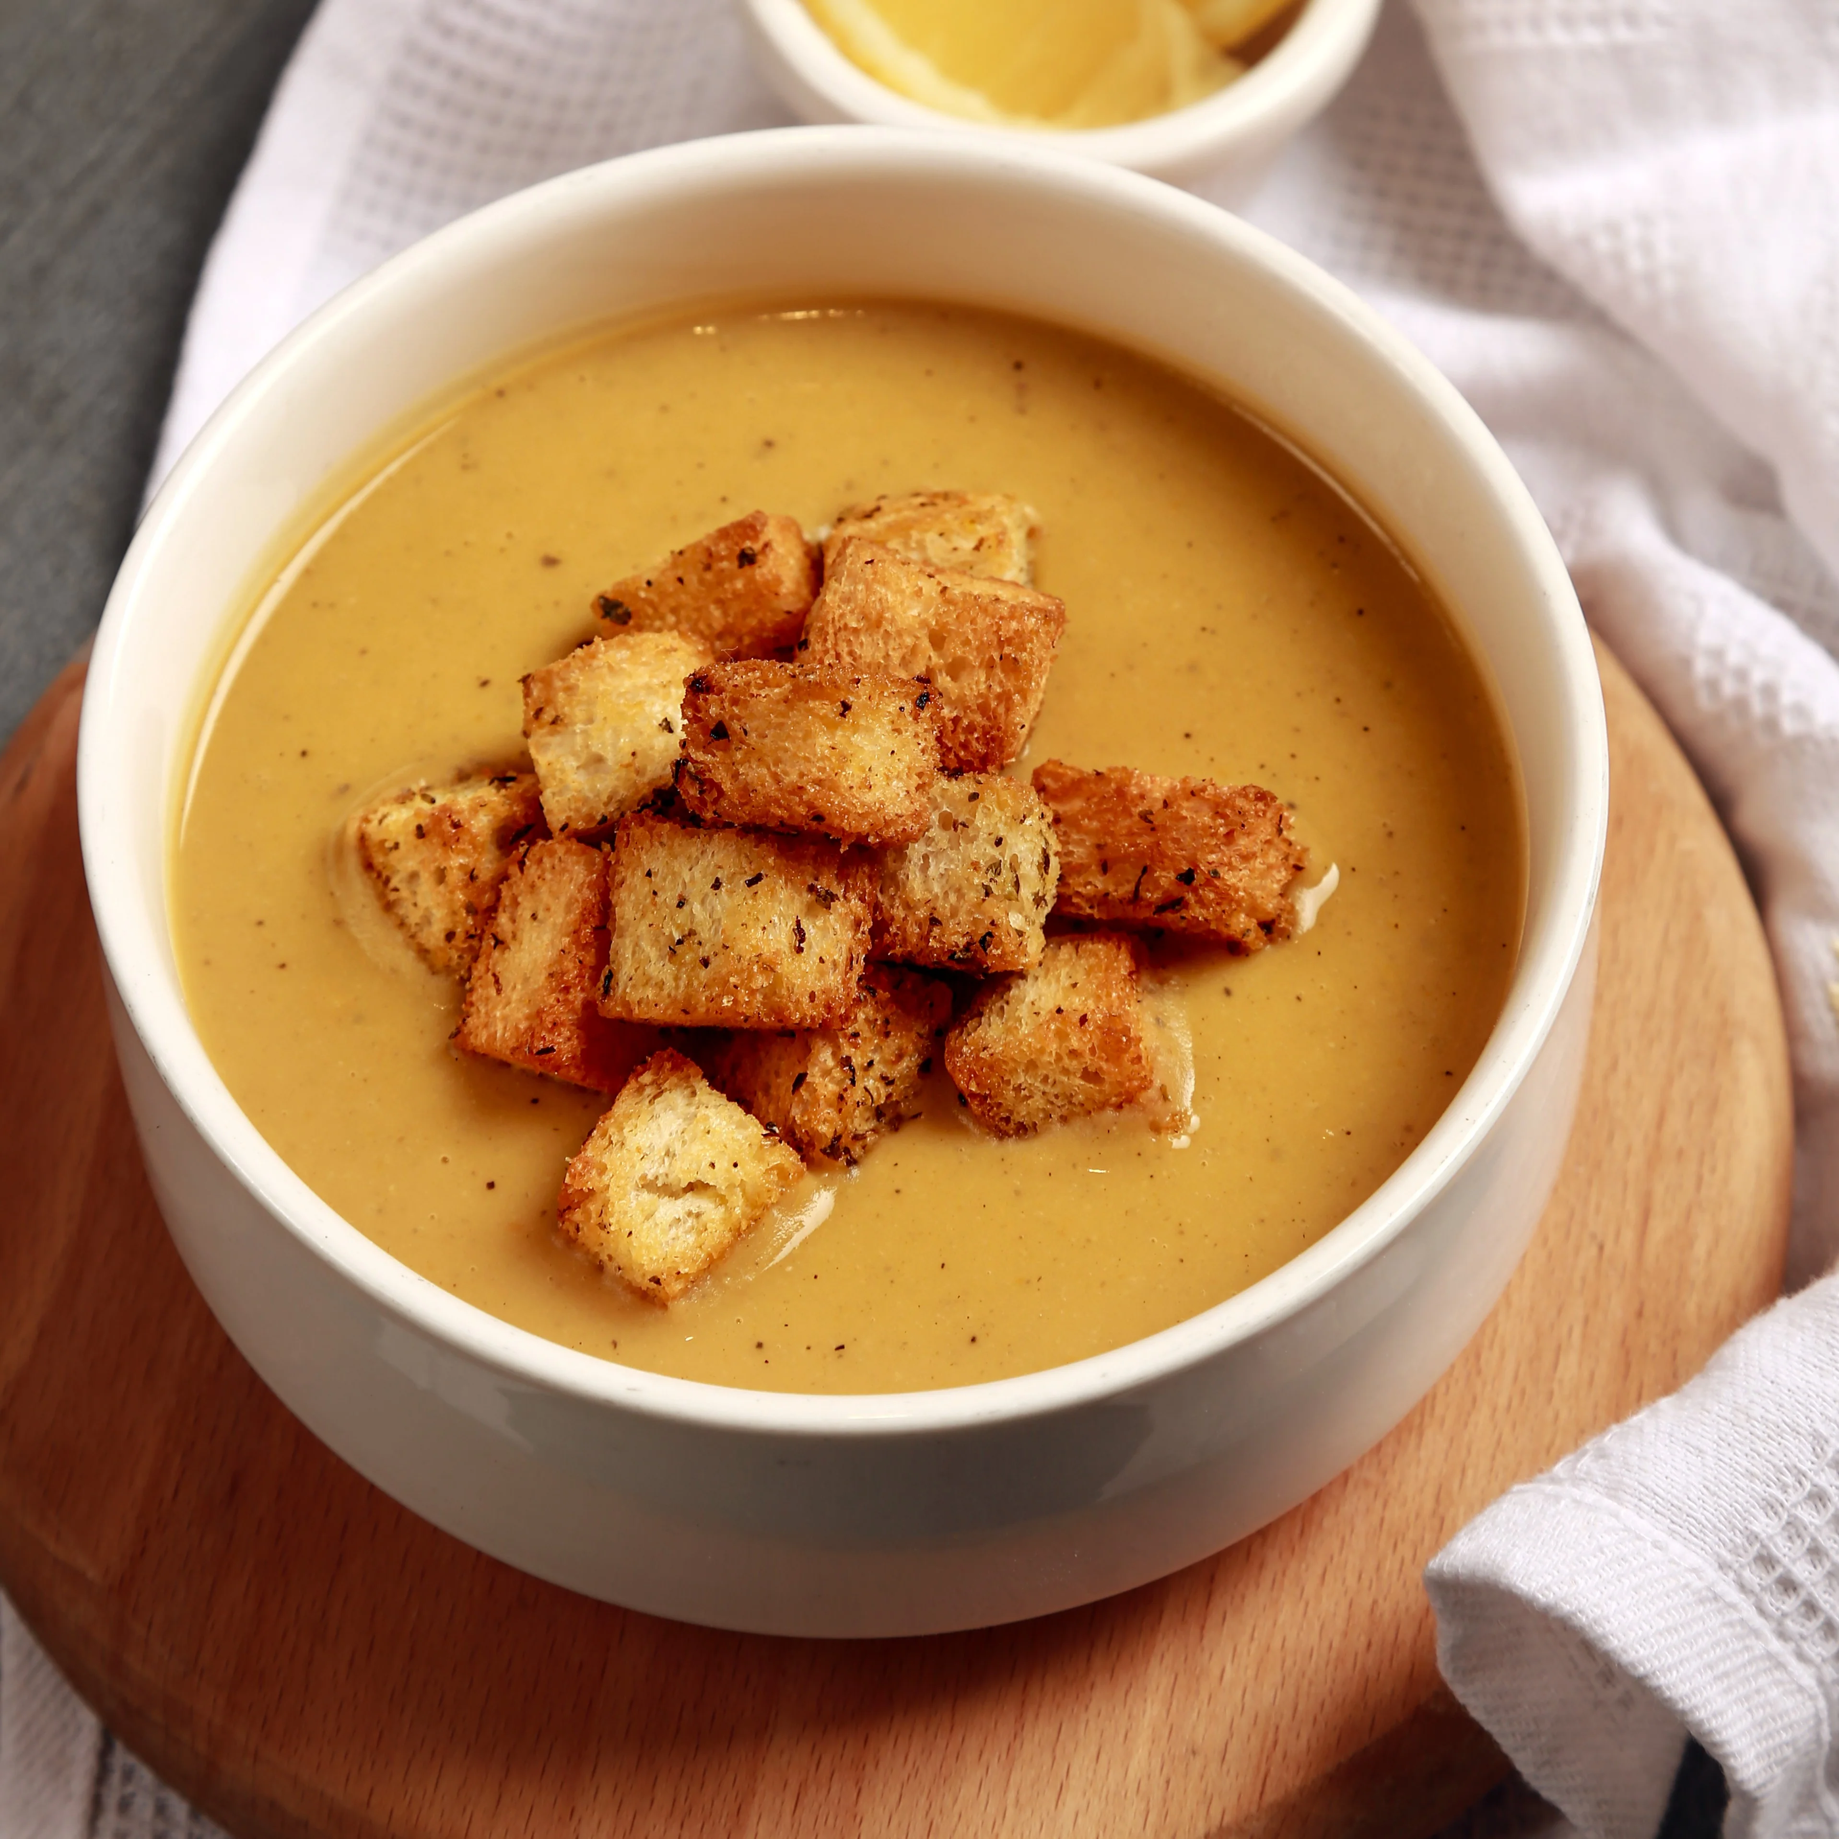
Lentil Soup:
On chilly days in Amman, Lentil soup is very common in Jordan. It usually contains various Middle Eastern spices, lemon juice, and is served topped with crunchy croutons!

Slide 5

Makmoura
This is an old Jordanian-oriented dish, eaten mostly by people in North Jordan like Irbid. Some Jordanians might not even recognize it, nonetheless, it is a traditional Jordanian dish deeply rooted to the country life. Makmoura, meaning buried, is exactly what it sounds like. Boiled chicken and onions are buried under a thick blanket of dough and cooked in the oven until well-done. It is later served in triangle pieces, exactly like cake

Slide 6
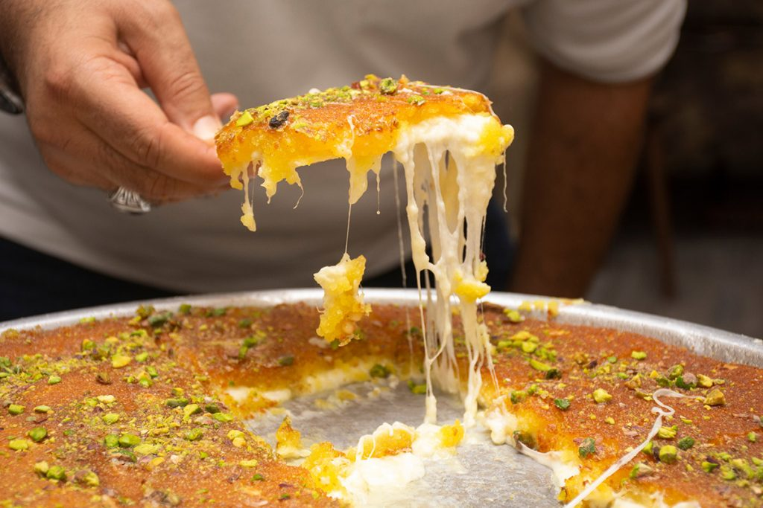
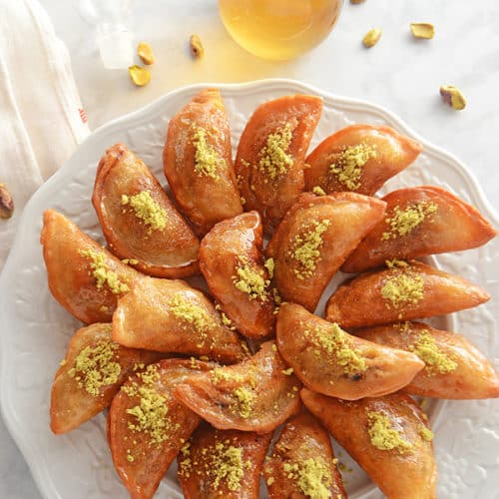
Jordanian sweets
Knafeh is a sweet and savory dessert that's made from shredded phyllo dough, cheese, and a syrup made from rose water and orange blossom water. The dish is topped with crushed pistachios and is typically served warm. Knafeh is a popular dessert in Jordan, especially during holidays and special occasions
Qatayef is a sweet and delicate pastry that's typically filled with a mixture of cheese or nuts and drizzled with syrup. The pastry is shaped like a half-moon and can be fried or baked. Qatayef is a popular dessert during the Muslim holiday of Ramadan.

Slide 7
Interview (video)
Click here and enjoy the Video for Information about our country’s famous traditional dishes ☺

Slide 8

Resources:
Jordanian Food | Main Dishes in Jordan (touristjordan.com)
https://www.ciee.org/go-abroad/college-study-abroad/blog/have-sweet-tooth-jordan-has-you-covered
https://www.amideastedabroad.org/home/pcolar-blog4
10 Traditional Jordanian Dishes You Need to Try | Culture Trip (theculturetrip.com)
This Photo by Unknown Author is licensed under CC BY-SA

