Slide 1
Traditional Jordanian Food
names: Natalie Elissa, hala halaseh,sanad hijazin , moneer bosheh

Slide 2
Traditional foods in Jordan
There are many popular dishes in Jordan that the Jordanian people always eat that are considered the basis of the Jordanian trip. It can be prepared in an easy way in a short time with simple ingredients and it is a complete meal rich in nutrients

Slide 3
Makmoora
Makmoora is a Jordanian chicken pie, where chicken and vegetables are stuffed in a thick dough and baked for hours. It is also an old and popular Jordanian dish known in the rural areas of northern Jordan, such as Ramtha, Huwwara, and Irbid.

Slide 4
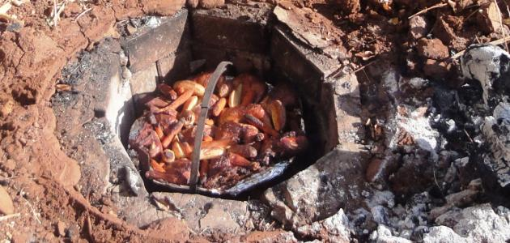
Zarb
Ingredients to make Zarb:
chicken cut into four parts
A cup of sliced ​​onions
A spoonful of minced ginger and garlic
Half a cup of curd
Half a kilo of potatoes
Cumin, cardamom, and mixed spices, half suspended
Five tablespoons of oil
Two and a half cups of rice
Saffron, table salt and black pepper
Zarb is a Jordanian Bedouin dish, and it is one of the ancient dishes famous in southern Jordan, such as Wadi Rum.

Slide 5
Mujaddara
Mujaddara is one of the famous dishes in central Jordan, such as Madaba. It is made from lentils and rice and is characterized by its high benefits and low cost. Lentils are considered one of the richest legumes and contain a high percentage of iron.

Slide 6
Trusted resources
https://daqaeq.net/%D8%A3%D8%B3%D9%85%D8%A7%D8%A1-%D8%A3%D9%83%D9%84%D8%A7%D8%AA-%D8%B4%D8%B9%D8%A8%D9%8A%D8%A9-%D8%A7%D9%84%D8%A3%D8%B1%D8%AF%D9%86
akhbaralaan.net
https://ar.m.wikipedia.org/wiki/%D9%85%D9%83%D9%85%D9%88%D8%B1%D8%A9_(%D8%B7%D8%B9%D8%A7%D9%85)#:~:text=%D8%A7%D9%84%D9%85%D9%83%D9%85%D9%88%D8%B1%D8%A9%20%D9%87%D9%88%20%D8%B7%D8%A8%D9%82%20%D8%A3%D8%B1%D8%AF%D9%86%D9%8A%20%D9%85%D9%86,%D9%88%D8%AD%D9%88%D8%A7%D8%B1%D8%A9%20%D9%88%D9%82%D8%B1%D9%89%20%D8%B4%D9%85%D8%A7%D9%84%20%D9%85%D8%AD%D8%A7%D9%81%D8%B8%D8%A9%20%D8%A5%D8%B1%D8%A8%D8%AF.
https://www.amideastedabroad.org/home/host-family-cookbook
https://holycowvegan.net

