Slide 1
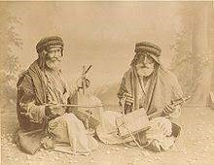
Traditions in Jordan (Music)

Slide 2
What is music in Jordan ?
Many singing colors have characterized the Hashemite Kingdom of Jordan
which are closely linked to the life cycle of the Jordanian person from his birth until his death, as each stage of his birth witnesses a specific color and style, and features that distinguish each stage from the other,relying in on originality
derived from its artistic composition is part of the heritage of the Jordanian people , which is transmitted orally from generation to generation.

Slide 3
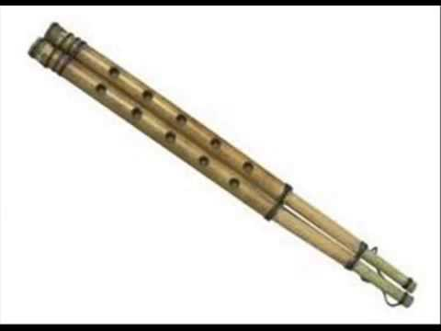
Some of Jordanian musical instrument

Slide 4
Rabab
it is a lute-like musical instrument and originated in central Afghanistan
it’s name was derived from the Arabic language which means “played with a bow”. The rebab spread across most of North Africa, South Asia, the Middle East, and parts of Europe via Islamic trade routes
It is one of the first known bowed instruments, dating back to the 8th century.
The rebab is employed in a wide range of musical groups and genres. Its body varies from being ornately carved as in Java, to simpler variants, such as the 2-string Egyptian fiddle of the Nile which may have a body.

Slide 5
Mijwiz
Meaning “dual” in Arabic , is a traditional Middle Eastern double-pipe , single-reed woodwind instrument.
it is made of two small bamboo pipes of similar length with reed tips joined together.

Slide 6
There are many types of dances that called (dabak)
Here is a video of the ramthar dabak: https://www.youtube.com/watch?v=ar4aoKbUEBs
A ma’an dabak:
https://www.youtube.com/watch?v=l00f0XqboOY
And also aqaba dabak:
https://www.youtube.com/watch?v=D3j_Y21ocas

Slide 7
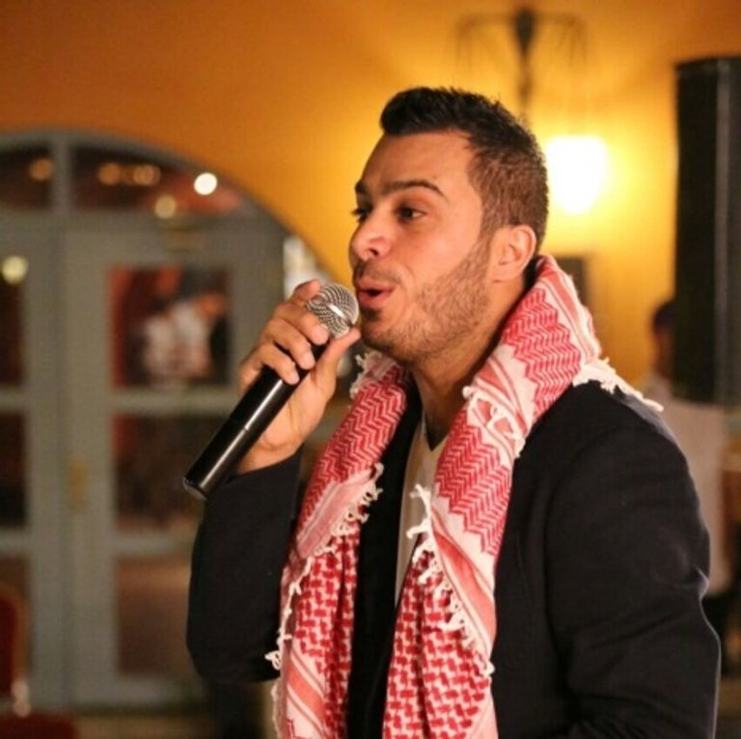
Jordanian artists
حسين السلمان عمر العبداللات عيسى السقار

Slide 8
The Conversation with the student Saba Haddad

