Slide 1
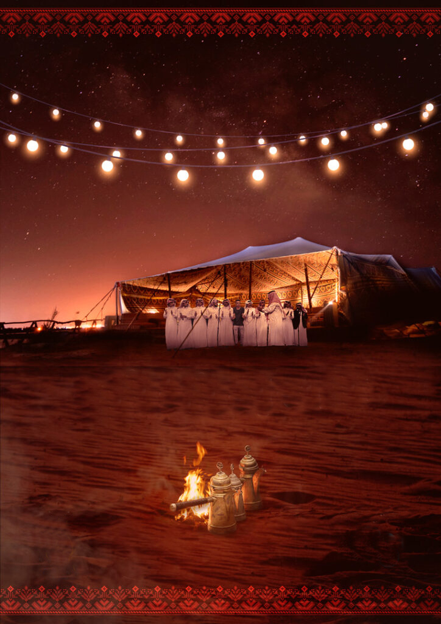
The Bedouin Wedding

Slide 2
Introduction
Marriage have always been an important social gathering in our culture, where new couples can unite and rejoice after their engagement period ,and regarded as one of the most important social rituals in human societies due to its role in organizing relationships within communities and perpetuating these communities. This ritual reveals how a society thinks, and reflects its inherited customs, attitudes and cultural traditions. It also reflects the society’s perspectives on social interaction, existential concepts and world.
The concepts of marriage and its customs vary among societies. This is due to the differences in culture. Jordanian society, like other societies, contains different classes, cultural and religious authorities. The celebrations vary from one region to another, even between villages in the same city.
Bedouin marriage is in fact the correct and the original tradition of marriage in Arab-Islamic countries without the influence of foreign countries on it as modern marriage.
Just Married Bedouin Couples

Slide 3
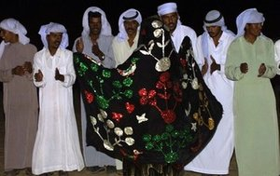
Within Jordanian society from north to south , there are common marriage traditions, but we find similarities extend to general practices and traditions, but not to the details and with all its classes and cultural and religious differences, Jordanian society is committed to marriage as a social system.
The Bedouin wedding is a cultural activity ,it is rich in signs and symbols, which represents cultural values and customs that make up a distinctive identity. With this in mind, the aim of Bedouin weddings is to establish a new family but also to preserve tribal unity and the extended family that protects its members, safeguards their interests and defends their goals and aspirations.
Jordanian Bedouin marriage rituals have remained faithful to inherited traditions for many generations. The Bedouin tribes stick to these traditions to show their loyalty and to preserve their authenticity. Such traditions preserve the social fabric, because the tribe is a cohesive social structure with members that show absolute loyalty and allegiance.
Bedouin Wedding in Jordan

Slide 4
How it starts ?
Bedouins favor weddings between cousins in order to keep properties (mostly lands) in the family. Bedouin men and women enjoy the freedom of choosing their partner. Nevertheless, parents can put sufficient pressure on their children to arrange their marriage.
The men’s family initiates marriage directly by the family themselves or through mediators. The marriage is affected through a legal contract which stipulates, the amount of the Paid Dowry and Deferred Dowry and any other things were requested by the bride’s family.
Their families arrange a date for “ AL- Jaha” . If there is no father to speak for the girl/woman , a brother or other male relative will speak for her. If a male from the family doesn’t agree with the choice of a spouse for his daughter, sister or even cousin, he is able to stop the wedding according to Bedouin Law. This also applies for the groom.
This day all men from both families gathered in one place and an agreement is sealed over a cup of Bedouin coffee and a Dessert like (Knafah) is served .

Slide 5
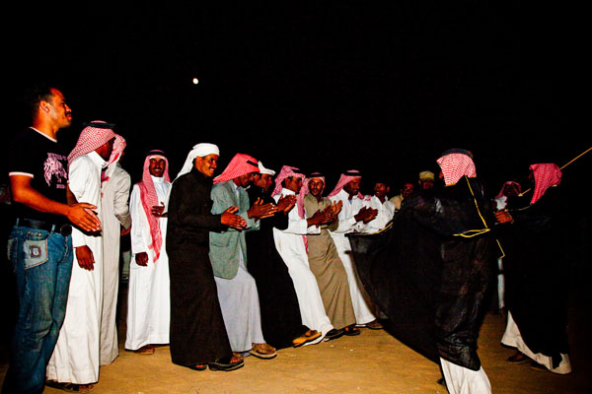
The wedding festivity lasts between 5 to 7 days, they grow in size as the days pass by and can be as large as you can imagine, sometimes accommodating hundreds or even thousands of people. They can also be small and humble, if the need arises. Men gather in the groom’s tent where they dance and shoot with their rifles, and women in the bride’s whereon the last night they paint her hands with henna.
On the day of the wedding, the bride is taken to the groom’s tent, and after seven days of marriage his family dresses and grooms her as to announce that she is officially a married woman and part of their family.
Henna Design
Bedouin men celebrating the wedding

Slide 6
https://jordaninsider.wordpress.com/2015/04/19/jordanian-social-events-traditions/ https://www.thebedouinway.com/bedouin-blog/2014/5/11/bedouin-weddings https://folkculturebh.org/en/?issue=26&page=article&id=846 https://ab-mediapro.com/project/bedouin/ https://bedawi.com/Bedouin_Culture/family/marriage#:~:text=For%20Bedouin%20marriage%20legalizes%20sexual,the%20Bedouin%20code%20of%20honor.
Resources :

Slide 7
Second month project
Name : Luay Laith Al-Natur
Subject : Global Perspectives
Project Name: My Tradition
Class : Grade 6

