Slide 1
Wedding in Jordan
Done by Karam Hijazeen

Slide 2
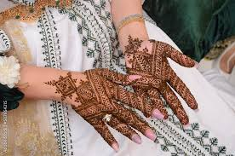
Henna

Slide 3
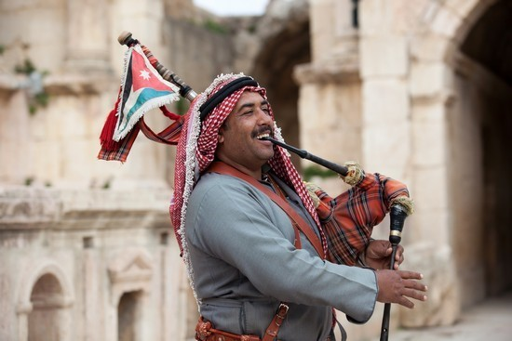
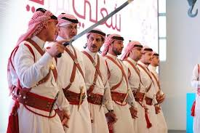
Dabkeh

Slide 4
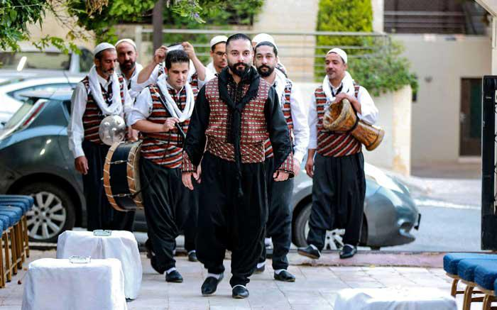
Zafeh

