Slide 1
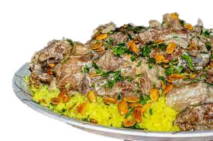
Culture and Tradition
Global Perspective
By:
Rakan Sawalha
Ramez Fanek
Evan Hanania
Fadi Qdies

Slide 2
Would you eat dinner in lunch time?
Do you eat meat? Chicken or is Fish your favorite?
Do you eat rice? Or Pasta? Maybe potatoes?
Food is eaten for sustenance, but what and how it's eaten is part of a country’s culture!

Slide 3
Food Traditions in Jordan
Food is an important part of any country in the world. It can unite and strengthen community bonds and helps to maintain a common identity among a group of people.
Food is a core components of human heritage. Hence, culture and food traditions play a central role in society and in shaping human behavior.
Lets dig deeper into Food Traditions in our beloved Jordan!

Slide 4
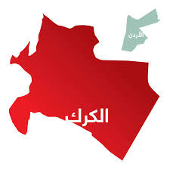
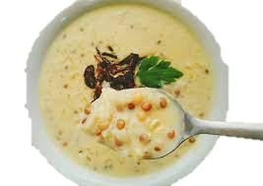
Food Traditions in Karak!
Mansaf
The national dish of Jordan is Mansaf: lamb seasoned with aromatic herbs, cooked in yoghurt, and served with huge quantities of rice.
Rashouf
Adding the same yogurt essence used in cooking mansaf to a blend of lentils, groats, and wheat.

Slide 5
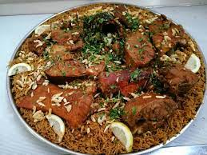
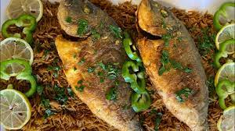
Food Traditions in Aqaba!
Sayadieh
Also known as rice and fish, made with warm spices, caramelized onions, and fried white fish.

Slide 6
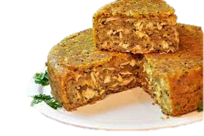
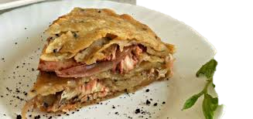
More Foods in Irbid!
Makmourah
Because it depends heavily on olive oil, its mainly prepared during specific seasons. It is cooked with local flour and meat with mashed onions and olive oil, in many layers.

Slide 7
Video

Slide 8
References
https://www.betterhealth.vic.gov.au/health/healthyliving/food-and-celebrations
https://www.fao.org/agroecology/knowledge/10-elements/culture-food-traditions/en/?page=27&ipp=5&tx_dynalist_pi1%5Bpar%5D=YToxOntzOjE6IkwiO3M6MToiNyI7fQ%3D%3D
http://www.kinghussein.gov.jo/facts3.html
https://girleatworld.net/jordan-food/
https://www.almayadeen.net/reports/%D8%A7%D9%84%D8%AC%D8%B9%D8%A7%D8%A8%D9%8A%D9%84:-%D8%A3%D8%B4%D9%87%D8%B1-%D8%B7%D8%A8%D9%82-%D9%81%D9%8A-%D8%B9%D8%AC%D9%84%D9%88%D9%86-%D8%A7%D9%84%D8%A3%D8%B1%D8%AF%D9%86%D9%8A%D8%A9

