Slide 1
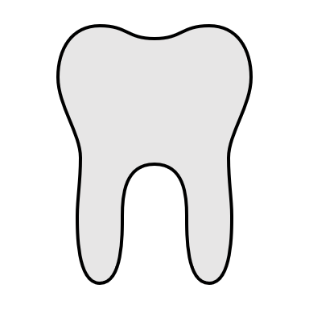
ORAL HYGIENE

Slide 2
ORAL HYGIENE

Slide 3
What is oral hygiene?
Good oral health helps you enjoy life. It lets you: speak clearly; taste, chew, and swallow delicious and nutritious foods; and show your feelings through facial expressions such as smiling ☺ .
If you protect your oral health with good oral hygiene practices (brushing and flossing), the odds are in your favor you can keep your teeth for a lifetime.

Slide 4
What is the effects of poor oral hygiene
Oral health is an important part of overall health and wellbeing at all stages of your life. Keeping a healthy smile is also an important part of social and emotional health.
Poor oral health is linked to diabetes, heart disease, adverse pregnancy outcomes, stroke and respiratory conditions. The main diseases that affect oral health are tooth decay, gum disease and oral cancers. However, these conditions are largely preventable.
DON’T WORRY!!
You can easily prevent these harmful diseases!

Slide 5
How can you prevent diseases caused by poor oral hygiene?
The key steps to a healthy smile are:
practicing good oral hygiene with regular brushing and flossing
eating and drinking healthy foods low in sugar!
having regular dental check-ups!
if you smoke, quit to improve your oral health and general health!

Slide 6
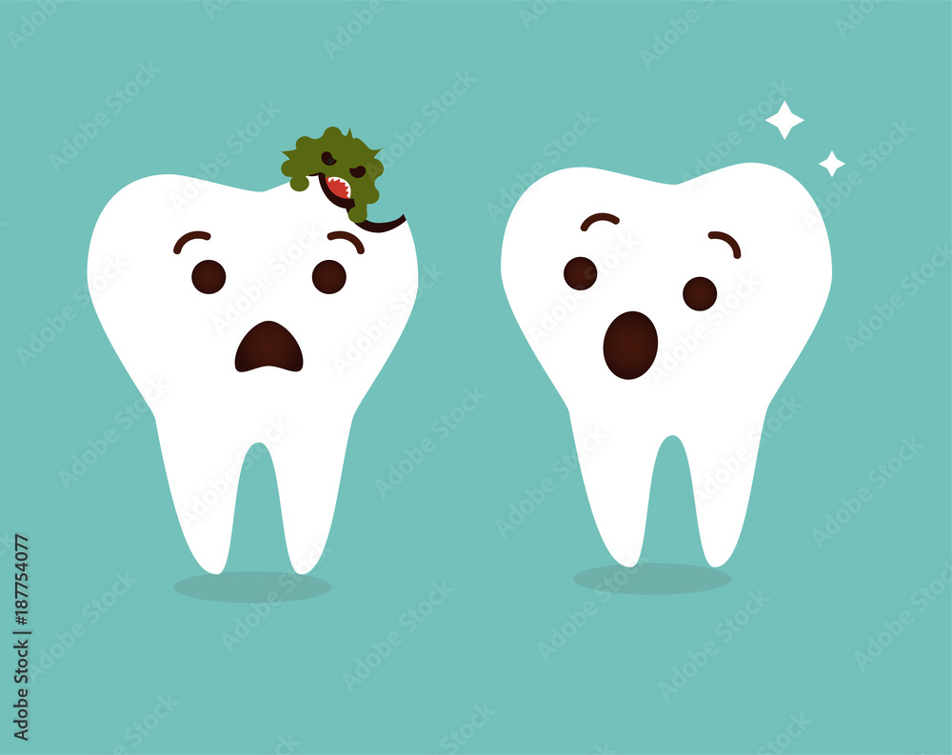
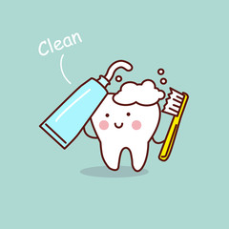
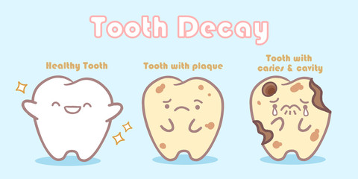
Before we tell you more about oral hygiene, remember cavities are caused by one to many things, let us show you how a cavity gets made in your teeth!

Slide 7
Remember, oral hygiene is very serious, it can cause life changing effects, its your decision whether you want it to be a positive change or a negative way. We advise you to take care of you teeth. They are sensitive, fragile, and permanent , as proof to you, we would like to inform you about some actions we spotted in public that can effect the wellness of oral hygiene!

Slide 8
Observation 1
Chapter 9 cafe um uthaina
at 11:30 am, everyone was smiling with their clean white teeth, eating healthy food, one was eating a fruit salad, it contained some oranges, apples , strawberry and orange juice with pomegranates as a base, however, there was an approximately 6 year old child eating pancakes with nutella, her teeth were good, but it was obvious she had a cavity, she would cry about the pain in her teeth, im sure she didn't brush her teeth well. overall, the majority had clean, white teeth, this result had to do with the type of food they ate.

Slide 9
Observation 2
The tooth fairy dental office
on the 29th of october, at 2:00, i had a dentist appointment, i observed a lot of things, i specifically noticed people's teeth, there was a girl my age, who also had braces, although, she had a lot of broken brace brackets, and she had yellow teeth, as she came in to fix all he broken brackets, and get a clean and small polish as she obviously wasn't brushing her teeth properly, i came in for just a monthly checkup, i noticed that i see that girl a lot, since we go almost always on the same days, although the difference between my teeth and hers led me to believe that she has poor dental hygiene, and doesnt take care of her teeth.

Slide 10
Observation 3
on the 3rd of October, at 4:00 pm I went to the restaurant, triple seven , and I looked around and noticed that some people around me had white and pearly teeth, although other were quite the opposite, they had yellow stained teeth full of plaque, and they were eating things like chocolate, or unhealthy meals, I noticed how even the slightest differences like eating healthier effect teeth's growth and stability, they also cause pearly white teeth!

Slide 11
Citations!
https://my.clevelandclinic.org/health/treatments/16914-oral-hygiene
Cross checking
https://www.nidcr.nih.gov/health-info/oral-hygiene
https://www.qld.gov.au/health/staying-healthy/oral-health/good-oral-health/oral-health-and-general-health#:~:text=Poor%20ora%l20health%20is%20linked,These%20conditions%20are%20largely%20preventable.
Cross checking
https://west85thdental.com/10-health-issues-caused-by-bad-oral-health/

