Slide 1

Traditional food in Jordan
By Ibrahim and Adriana and Talal and Emily

Slide 2
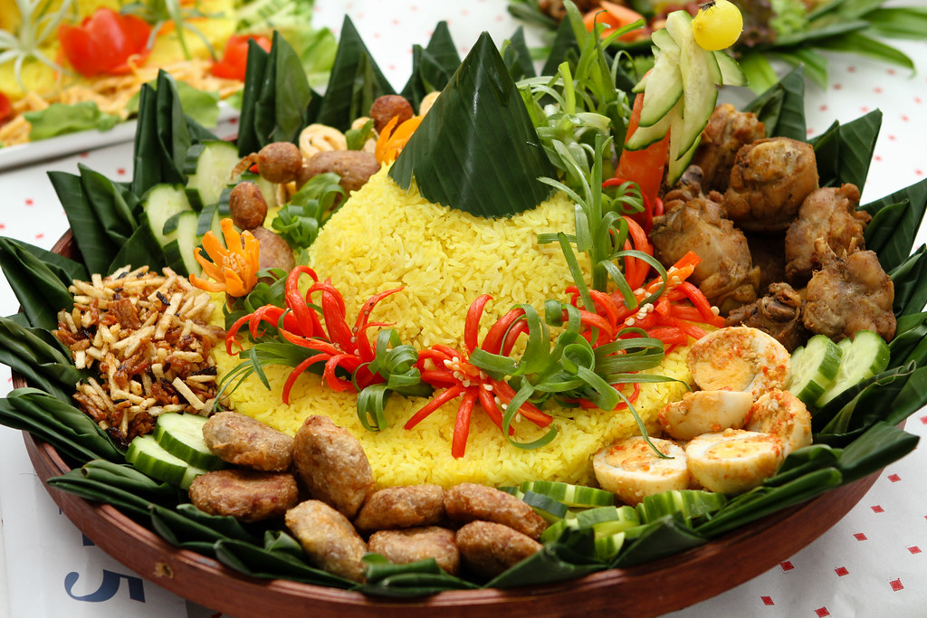
Aqaba
They can start with the famous Sayadiya, a popular Aqabawi dish made of fish and flavored rice. You can replicate the dish at home by purchasing all the spices from Al Baba spice shop. Another traditional dish is the famous Jordanian mansaf, the only dish you must try in Jordan. For those who want to try some traditional dishes,

Slide 3
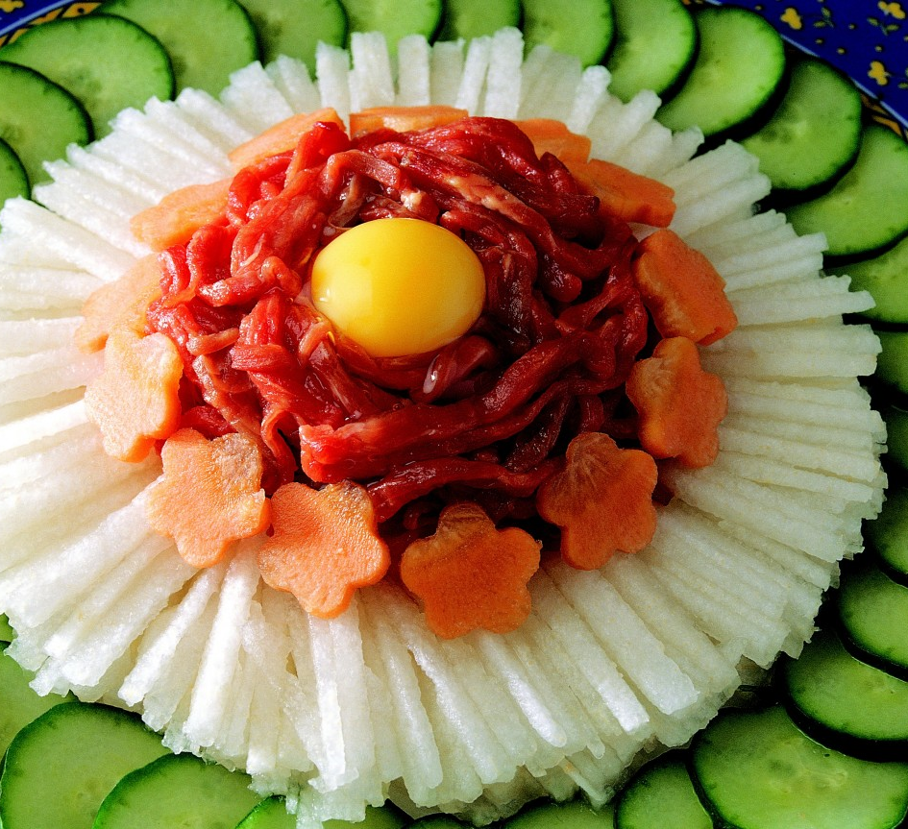



Slide 4
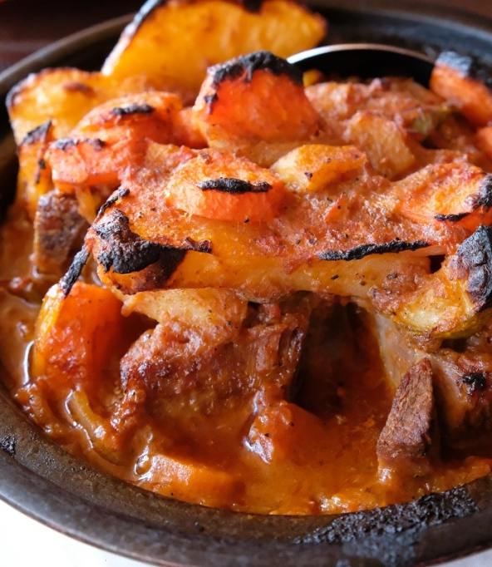
Wadi rum
Zarb. It is like an Arabian barbecue originating from the delicious treasury of Bedouin culture. An oven with charcoal is prepared before cooking meat and vegetables. Chicken/goat/sheep meat is cleaned, chopped, and marinated before being allowed to rest for flavor absorption. Vegetables are then chopped if required and finally, the barbecue rack is topped with two to three layers of meat and vegetables and then barbecued. Salad, hummus, and rice may be used as a side dish.
This Photo by Unknown Author is licensed under CC BY-NC-ND

Slide 5



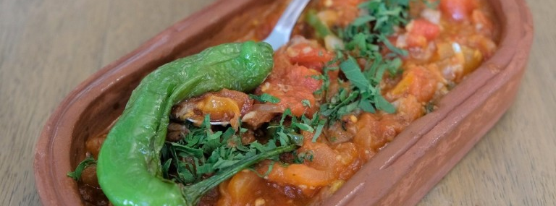

Slide 6
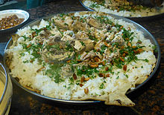
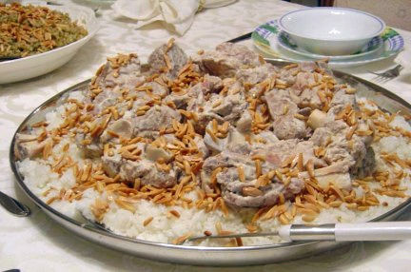
karak
mansaf. It is like an Arabian barbecue originating from the delicious treasury of Bedouin culture. An oven with charcoal is prepared before cooking meat and vegetables. Chicken/goat/sheep meat is cleaned, chopped, and marinated before being allowed to rest for flavor absorption. Vegetables are then chopped if required and finally, the barbecue rack is topped with two to three layers of meat and vegetables and then barbecued. Salad, hummus, and rice may be used as a side dish.

Slide 7
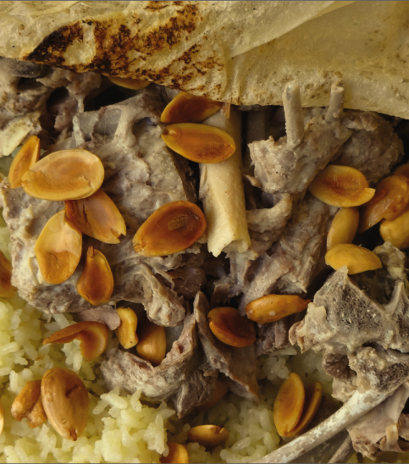

Slide 8
interview

Slide 9

Thank you for watching this EPIC PowerPoint

