Slide 1
Personal Hygiene
Made By:Raya Akkawi,Carol Alamat,Rita Qsuous
8D

Slide 2
What is Personal Hygiene?
Personal hygiene is how you take care of your body
It includes
washing your hand with soap and water
Showering everyday
Brushing your teeth twice a day
Cover your mouth and nose when sneezing or coughing

Slide 3
4 of the most Important self hygiene points
1.General Hygiene: Daily showers help remove dirt, sweat, and bacteria from a child's skin, promoting good hygiene.
2. Skin Health: Regular showers can prevent skin conditions and keep the skin clean and moisturized.
3. wear clean clothes: clean clothes is important for maintain self hygiene, preventing spread of germs and bacteria that cause illness.
4. Routines: It can setup a routine that teaches children the importance of self-care and personal hygiene.

Slide 4
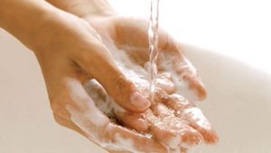
1. General hygiene
1.Washing your hands frequently
Wet your hands with clean water and apply soap.
Lather your hands by rubbing them thoroughly with soap.
Scrub your hands for at least 20 seconds.
Rinse your hands well.
Dry your hands with a towel or air dry.
This Photo by Unknown Author is licensed uder CC BY

Slide 5

General hygiene
2.Bathe
Cleaning your body washes away dead skin cells and dirt and helps fight the spread of disease. For older adults, it’s recommended to shower or take a bath at least twice a week to achieve the positive effects
3. Brush Your Teeth Twice a Day:
Make sure you are brushing your teeth twice a day, once in the morning and once at night, to maintain good oral hygiene along with regular dental checkups.

Slide 6
2.Skin health
1.Wash up. Bathe in warm not hot—water; use mild cleansers that don’t irritate; and wash
gently—don’t scrub.
2.Block sun damage. Avoid intense sun exposure, use sunscreen, and wear protective clothing.
3.Avoid dry skin. Drink plenty of water, and use gentle moisturizers, lotions, or creams.
4.Reduce stress. Stress can harm your skin and other body systems.

Slide 7
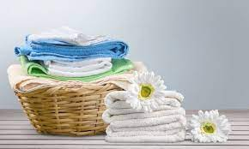
3.Wearing clean clothes
After you wear your clothes, wash them with a detergent and dry them immediately upon rinsing, dirty clothes can harbor bacteria that could lead to body odor or even skin irritations.

Slide 8

Having routines
Whatever your progress may be to maintain good personal hygiene, make either a mental checklist or write it down, this way you'll remember to keep up with the steps you need to stay clean and healthy such as the points already mentioned.

Slide 9
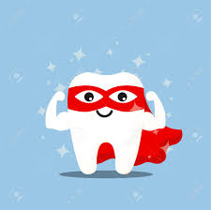
In conclusion self hygiene is important because it helps our bodies healthy and prevents the spread of germs and illnesses, by washing our hands, brushing our teeth, and taking care of our personal cleanliness, we can stay happy and strong!

Slide 10
Cross-checking
https://www.sanex.co.uk/skin-knowledge/skin-health/importance-of-personal-hygiene
Brushing your teeth: How often and when? - Mayo Clinic
Washing clothes and bedding - Housing for Health - the guide

