Slide 1
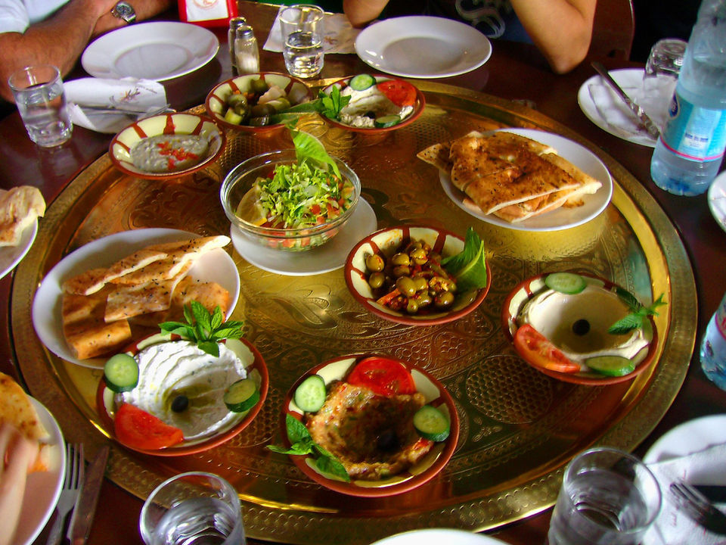
Traditional Food In Jordan
By Farouq, Saif, Lia,Maria
6 G

Slide 2
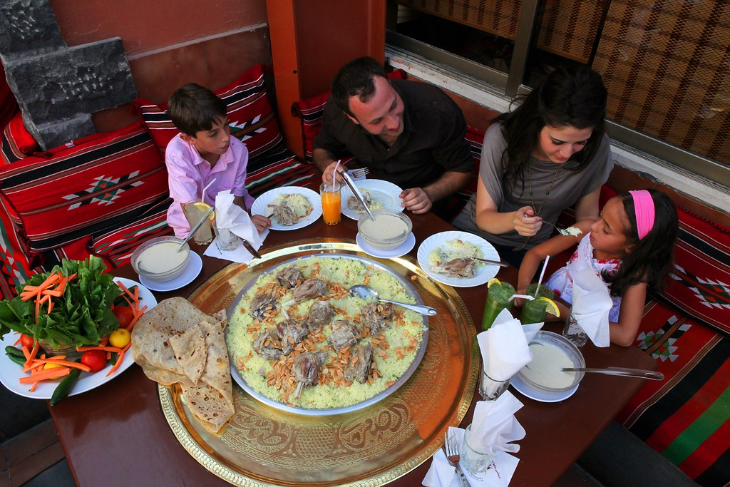
Traditional Food In Jordan
Food is a very important aspect within the Jordanian culture. In most villages, meals are a community event with the immediate and extended family present. In addition, food is commonly used by Jordanians to express their hospitality and generosity.

Slide 3
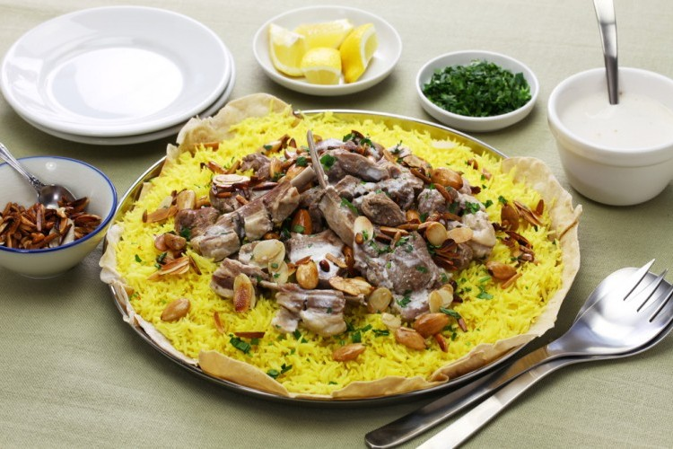
Mansaf
منسف
Mansaf is a dish of rice, lamb, and a dry yoghurt made into a sauce called jameed. It’s not only one of the the most beloved Jordanian foods, but it’s also considered the national dish of Jordan.
Al Salt and Al Karak are popular to make the best Mansaf in Jordan

Slide 4
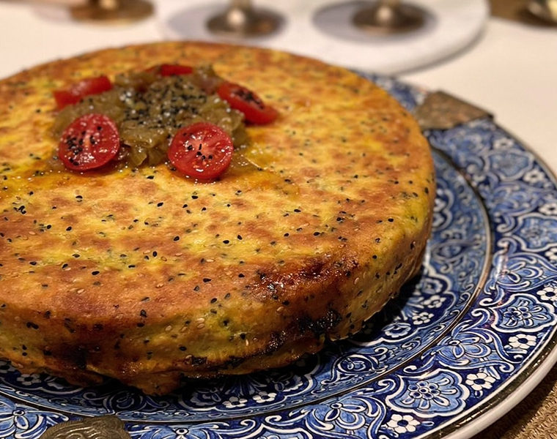
Makmoura
مكمورة
Makmoura is prepared by alternating layers of dough with lamb or chicken, onions and an array of seeds and beloved regional spices such as sumac and cumin.
Makmoura is one of the old and famous popular dishes in nourthern Jordan, Ramtha and Irbid.

Slide 5
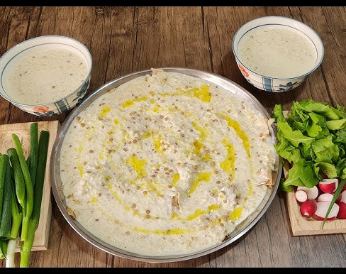
Al-Rashoof
الرشوف
Al-Rashoof is a traditional Jordanian soup that is typically made with a combination of green lentils, fried onions, jameed (dried goat's or ewe's milk yogurt), yogurt, water, and chicken stock.
Al-Rashoof is a winter dish, and very popular in Al-Salt City

Slide 6
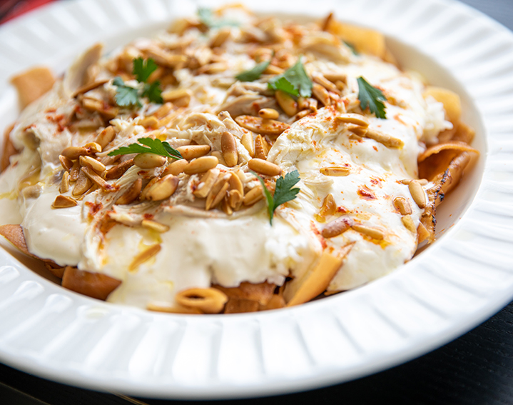
Al-Fateet
الفتيت
Al-Fateet is a popular dish spread among the Bedouins of the Jordanian desert , from the center, north, and south.
It is similar to mansaf except that it does not contain rice, and its contents are meat cooked with milk and shrak bread only.

Slide 7


Slide 8

Resources
en.m.wikipedia.org
ich.unesco.org
kinghussein.gov.jo
reachtheworld.org
Thank You

