Slide 1
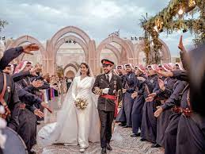
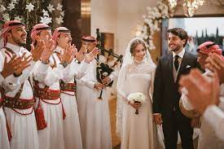
Jordanian weddings
  By:laith, kamil and samir

Slide 2
Introduction to Jordanian weddings
Engagement: The marriage process usually begins with the engagement stage, the engagement is exchanged in front of witnesses and relatives from both families, gifts and food are exchanged while maintaining simplicity and respect for both families.
The (Henna) ceremony: THE Henna ceremony is usually celebrated before the wedding party Henna is applied to the bride's hands and feet, and women from family and friends usually participate in it. The body is decorated with unqiue and beautiful designs using natural henna

Slide 3
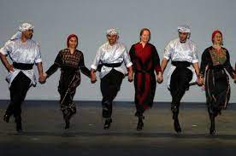
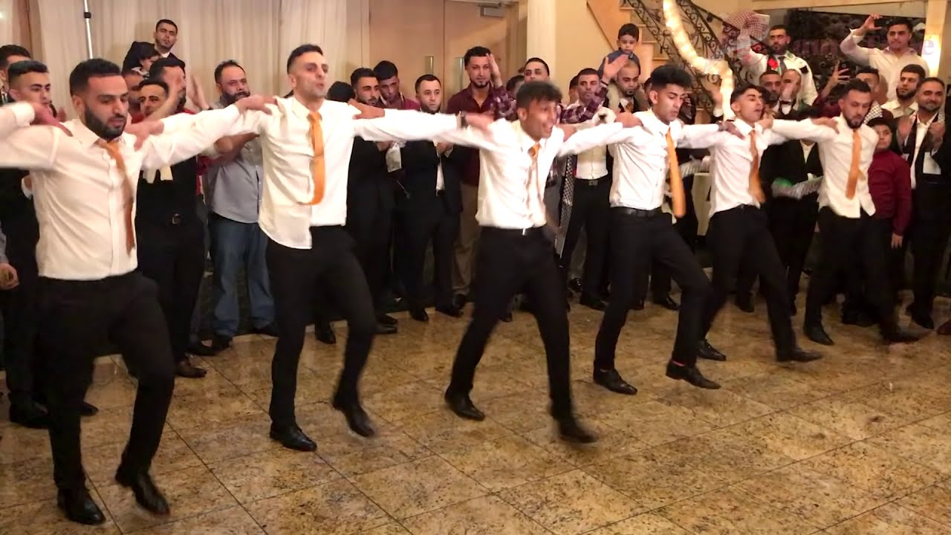
The Dabke
another mainstay of Jordanian weddings is(dabke)a folktale dance Performed by professionals before guest ultimately join in the fun

Slide 4
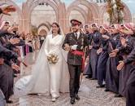
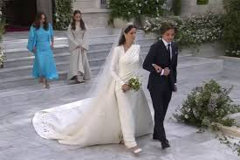
The dress code in Jordanian weddings
The secret dress code of ground prince Hussain and rajou alsaif’s royal wedding in Jordan. The dress code for the royal wedding between crown prince alhussain bin Abdallah altani of Jordan and his bride the Saudi architect rajon alsaif was simple black tie, no tiaras.

Slide 5
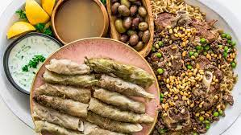
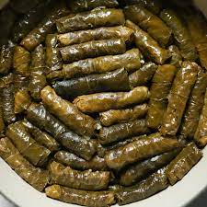
Jordanian wedding reception
Jordanian receptions are known for their delicious food.
Guests can accept to enjoy a variety of traditional dishes such
As mansaf,kibdeh and stuffed grape leaves(warak dawali).
Beverages usually include tea and coffee

Slide 6
The songs in Jordanian wedding
Drums(darbuka), horns, bagpipes and sometimes men carrying swords also feature in the traditional procession
SONGS PLAYED IN JORDANIAN WEDDINGS
ZAFENTA
OmarAl-abdallat
3alli al koufiya
https://www.youtube.com/watch?v=abQpYd-KPiE&list=PL4s3K12wKPA9S5wVyvRKe5fAamSCaMC5G&index=2

Slide 7
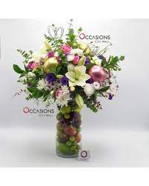
The Gifts
The groom gifts the brides a valuable mahr or gift. The couple must agree on the contestants or the marriage contact in front witnesses who are known to pious. There has to be public announcement of the marriage before an official ceremony

Slide 8

Thank you for listening

