Slide 1
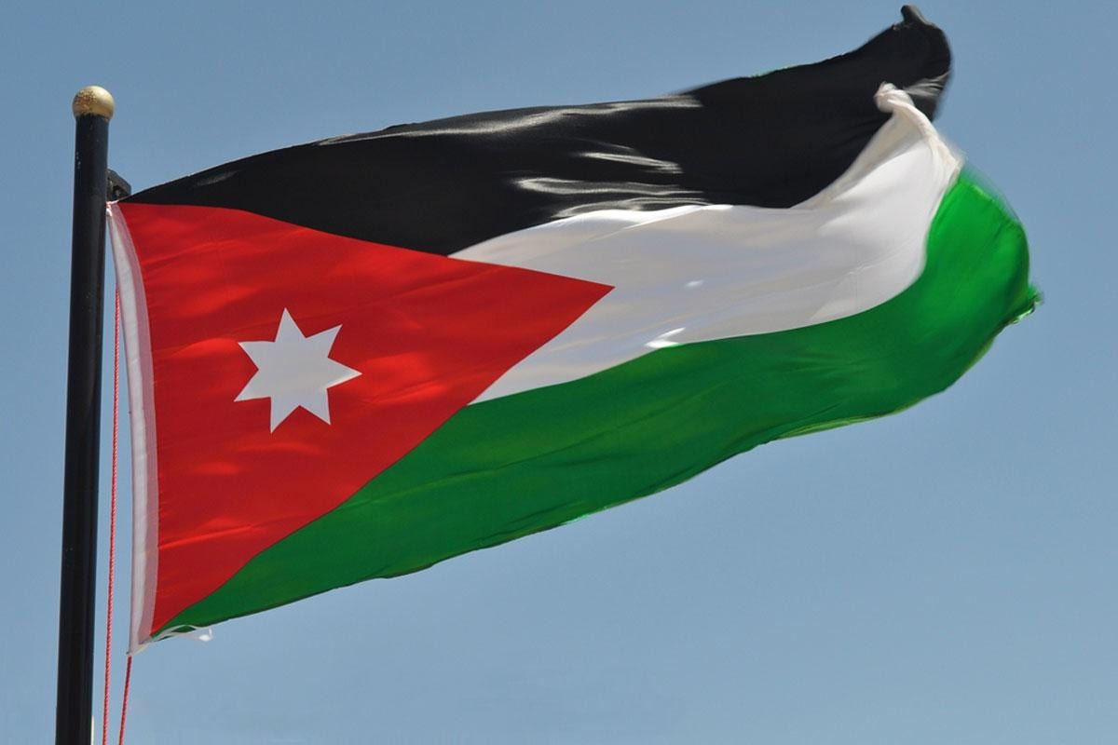
Traditional Dishes in Jordan
By Daud Nijmeh/ ghazi Shoukokani / Hamza Abdallat / Faisal khleifat

Slide 2
Food in Jordan
Food is a big part of the Jordanian culture seen in everyday life and celebrations. From street food to fine-dining, Jordanian food is inherently traditional, using recipes passed down from generation to generation. tasting Jordanian food is one of the best ways to experience the country. Here are some main dishes in Jordan.
Recognized as the national dish of Jordan, Mansaf is traditional and authentically Jordanian. This dish consists of cooked lamb which is prepared in a fermented yogurt sauce. The meat is then served over rice. There are many recipes, one thing is certain a visit to Jordan means eating Mansaf is a must.

Slide 3
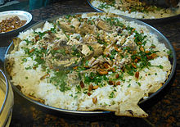
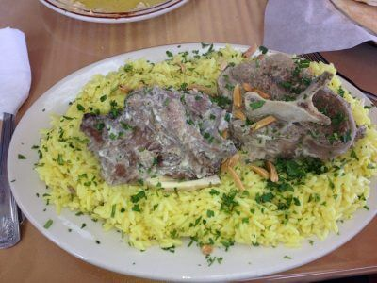
Mansaf
Mansaf should be eaten with the use of a person's right hand only while the left is behind the person's back. The hand is used to create balls of rice and then the ball is placed in the mouth through the use of three fingers. It is frowned upon to blow on the ball of rice, no matter how hot.

Slide 4
Traditional Food in Irbid
Jordan’s Irbid is renowned for its rich history, vibrant culture, and delicious cuisine. One of the many delicious foods is Makmoura, it stands out as a local favorite. Makmoura is a traditional dish that has come to represent the Irbid region’s cultural legacy.
It is possible to trace the origins of Makmoura back to the ancient city of Irbid. Each family has added its own special touch to the recipe as it has been handed down through the decades. This meal is frequently made for special events, family get-togethers, and neighborhood festivals. This is a traditional Jordanian meal that is mostly consumed in North Jordan. Makmoura, which means “buried,” means exactly how it says. Under a substantial layer of dough, boiled chicken and onions are covered and baked in the oven until tender.

Slide 5
Makmoura
Makmoura is a combination of lamb roasted to perfection, and the onions are slowly caramelized to bring out their natural sweetness. The spices used in Makmoura are a perfect blend of traditional Jordanian flavors, including cardamom, cinnamon, and cloves, which provide a unique and complex taste to the dish. The 18 layers of dough used in Makmoura are thinly rolled and expertly layered to form a beautiful pattern.

Slide 6
Traditional dishes in Mafraq
The origin of Zarb dates back to ancient times when Bedouin tribes traveled across the harsh desert landscapes of Jordan. They developed this unique cooking technique that utilized the natural resources around them, making Zarb an integral part of their culinary tradition and lifestyle.
Zarb was traditionally prepared in the desert, modern adaptations now see it being cooked in home ovens or outdoor pits in the backyard. The addition of za'atar to the marinade represents a contemporary twist to this age-old recipe, introducing a robust herbaceous and tangy flavor.

Slide 7
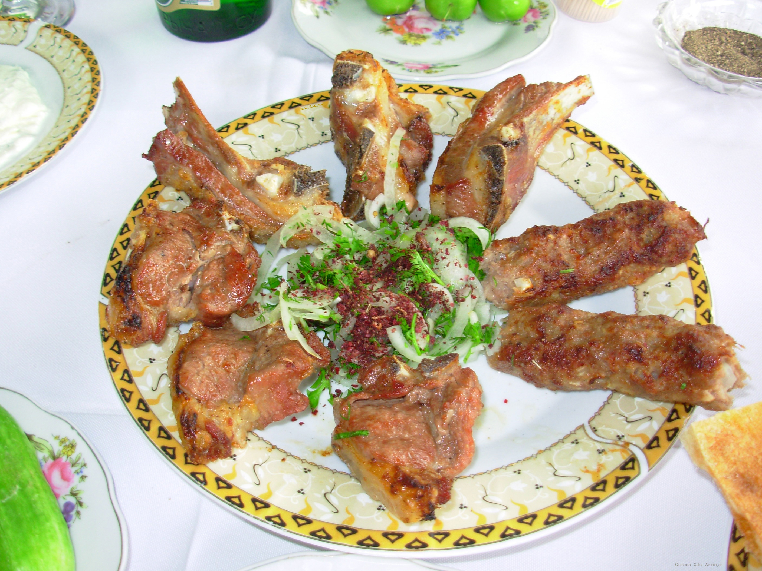
Ingredients To Making Zarb
1 2 lbs of lamb or chicken pieces
2 2 onions, quartered
3 4 carrots, cut into large chunks
4 4 potatoes, cut into large chunks
5 4 cloves of garlic, crushed
6 2 tablespoons of olive oil
7 1 tablespoon of za'atar
Salt and pepper to taste

Slide 8
Traditional Dishes in Ma’an
Al-Rashoof is a traditional Jordanian soup that is typically made with a combination of green lentils, fried onions, jameed yogurt, water, and chicken stock. Bulgur wheat, crushed wheat, or groats are often added to the combination.
A common winter staple, this hearty soup is generally accompanied by sour pickles and vegetables on the side. Al -rashoof is typically associated with the cuisine of Ma’an, and especially with the cities located at higher altitudes, such as Salt.
This soup is often served alongside mansaf, Jordan's national dish, which also contains jameed.

Slide 9
Ingredients to making Al-Rashoof
1.5 cups. Green lentils.
4 cups. Water.
1.5 tbsp. Vegetable oil.
2 Smalls. Onions, finely chopped.
1 Medium. Onions, finely chopped.
0.5 cup. Water.
2 cups. Whey (Jameed)
1 cup. Low fat yoghurt.

Slide 10
Video

Slide 11
https://www.touristjordan.com/jordanian-food-main-dishes-in-
jordan/#:~:text=Mansaf,in%20a%20fermented%20yogurt%20sauce.
https://www.arabamerica.com/makmoura-irbid-citys-famous-dish/
https://www.munchery.com/blog/zarb-jordan's-iconic-bedouin-barbecue-dish/#:~:text=The%20origin%20of%20Zarb%20dates,their%20culinary%20tradition%20and%20lifestyle.
https://www.tasteatlas.com/al-rashoof

