Slide 1
Social Anxiety
Done by: Elena, Reine, Qais, Adam

Slide 2
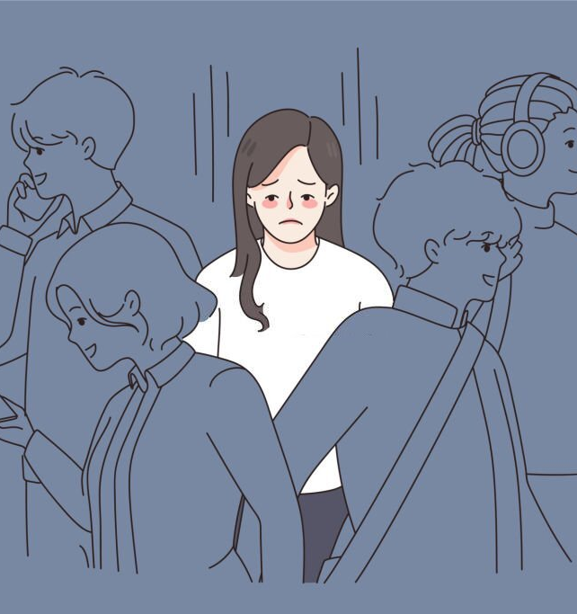
What is social anxiety?
Social anxiety is a type of anxiety. People with this anxiety fear being watched and judged by people. It's a fear that does not go away and affects everyday activities, self-confidence, relationships and work or school life.

Slide 3
Percentage of people who know what social anxiety is
After a survey, we found out that 96.8% of people know what social anxiety is.

Slide 4
Symptoms of social anxiety
Rapid heart rate when speaking Infront of people.
Avoid places where there are other people.
Difficult to make eye contact with people.
Be timid or shy or Speaking in a low voice in front of a large group.

Slide 5
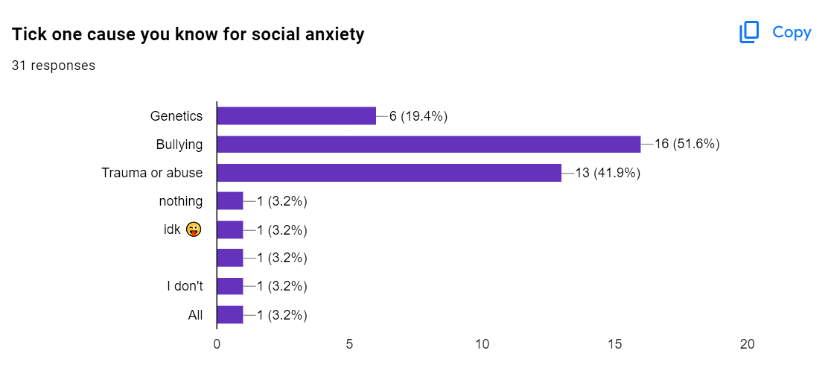
Causes of social anxiety
Since people with social anxiety have the fear of being judged or embarrassed the causes are:
Genetics
Bullying
Trauma or abuse
After a survey, the results show the
most known cause for social anxiety
is bullying.

Slide 6
Consequences of social anxiety
Loneliness
Affect schoolwork.
Depression
The results show that loneliness is the most known consequence of social anxiety

Slide 7
What's the most common age to have social anxiety?
The most common age to have social anxiety is teenage years. Usually, 13-17

Slide 8
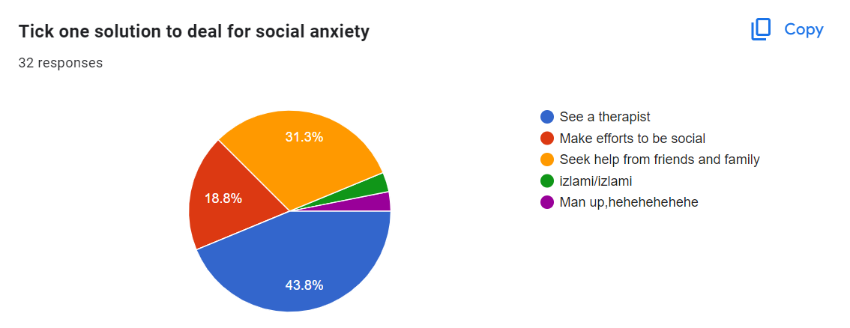
how to deal with social anxiety?
There are many methods to help you deal with social anxiety,
See a therapist.
Take medication prescribed by a doctor.
Learn about your disorder.
Seek help from friends or family.
The most common solution for social anxiety is to see a therapist as shown in the graph.

Slide 9
IN CONCLUSION:
social anxiety is the Intense fear of interacting or talking with stranger or even talking in front of a large group of people. The most common age to have social anxiety is in the teenage year specifically 13-17. There are many consequences but many solutions.

Slide 10
THANK YOU

