Slide 1
Traditional Food in Jordan
By Natalie Nino, Jena Halteh, Fadi Abu-Mariam, Reena Nahas, 6D

Slide 2
Introduction
Are you looking for some epic food to try?
Well if you are, then we have just the thing.
Go to Jordan and explore the wonders of food everywhere!!
In Karak, Amman and Irbid you can find some amazing and new dishes to try.

Slide 3
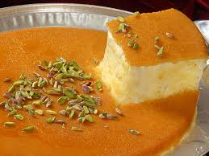
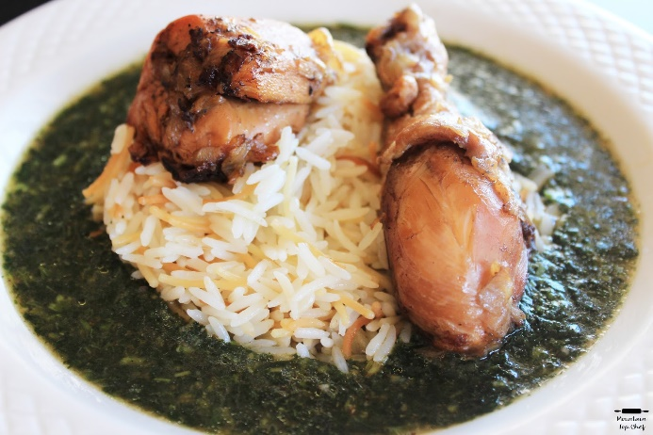
Amman
Amman is the capital of Jordan, and it’s Famous for it’s:
Warak Enab
Mlukieyeh
Hummus and Falafel
And for desserts there is:
Knafeh
Hareeseh

Slide 4
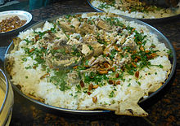
Karak
Karak falls in the south of Jordan, and for food we have:
Mansaf
Rashouf
AlMjallaleh
Chicken Fateereh
Most of the dishes above contain jameed, because Karak is very famous for it’s Jameed.

Slide 5
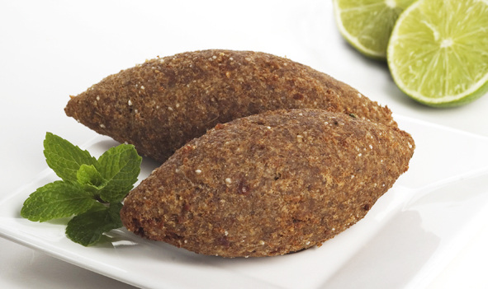
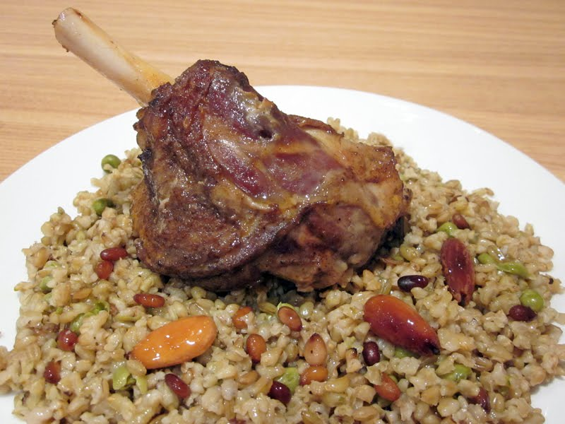
Irbid
Irbid falls in North Jordan,And it’s known for these dishes:
Al-Makmoura
Jaajil
Kubeh
Freekeh

Slide 6
Interesting Facts
Amman: Did you Know That Amman has one of the oldest falafel restaurants in Jordan? Hashem Restaurant in the city center (AlBalad) was established in 1956. this small restaurant never closes, it’s open 24/7.
Irbid: Did you know that in Irbid the Makmoura is made with loads of olive oil, from the olive trees in Irbid?
Karak: Did you know that Mansaf in Karak is served when the lamb’s head put on the top, though it’s inpolite to eat it, because if you do it means that the meat finished?

Slide 7
This Here is the video

