Slide 1
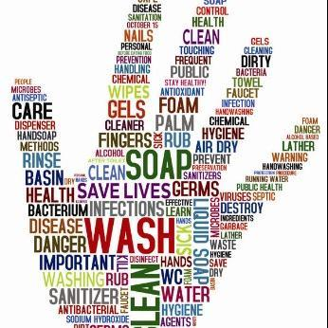
Personal Hygiene
By Eyad Jumaian, Bana Al Qudah, Lara Hamarneh and Noaf Sawalha

Slide 2
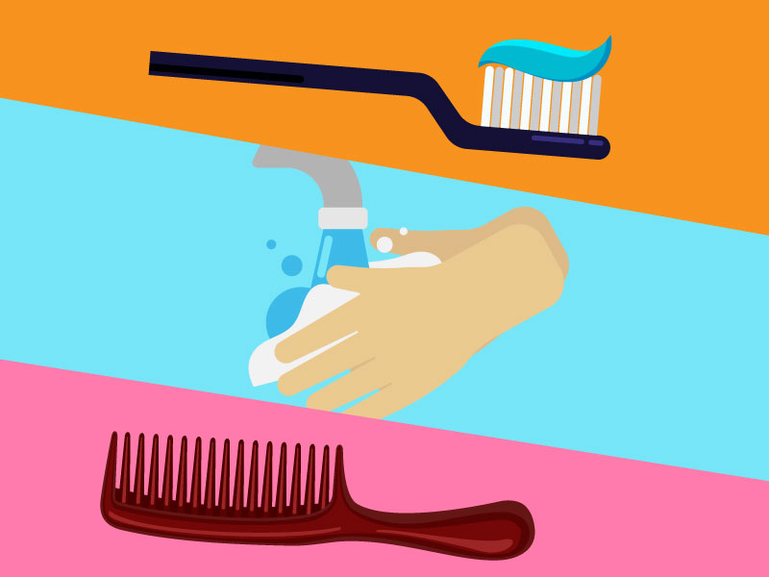
What is personal hygiene?
Personal hygiene is maintaining physical health to keep your body healthy and strong. It is how you care for your body. It refers to a set of practices performed in order to maintain or preserve good health. Habits such as showering, washing your hands, and brushing your teeth are all important factors to stay healthy.

Slide 3
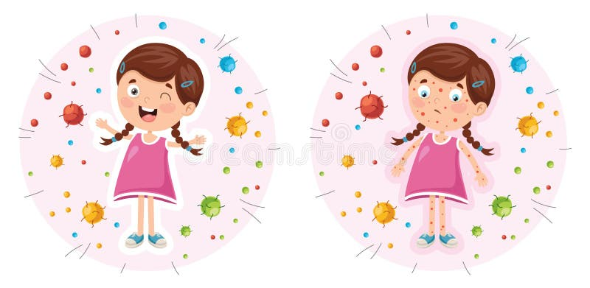
What causes symptoms of bad personal hygiene?
Symptoms of low personal hygiene include:
Unnatural yellow teeth
Body odor, from not showering regularly
Dandruff/lice, from unwashed or disheveled hair
Tooth decay and gingivitis
Bad breath

Slide 4
Consequences of bad personal hygiene
Sickness and disease
Increased risks for heart disease and hypertension
Respiratory infections
Poor physical appearance
Trachoma, an eye infection which can lead to blindness
Scabies
Health problems
Social rejection and may also lead to bullying, low confidence and low self-esteem

Slide 5
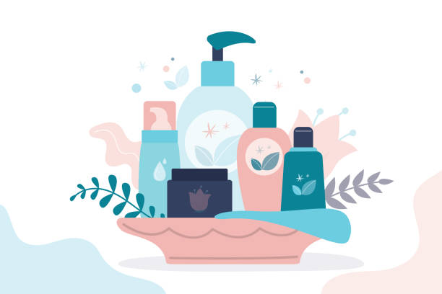
How to maintain personal hygiene
Shower regularly
Wash your hands frequently
Trim your nails
Clean your nose and ears
Wear freshly cleaned clothes
Brush your hair
Use mouthwash
Floss daily
Re-apply deodorant

Slide 6
Citation!
Here are some websites we used to get this information:
https://www.healthdirect.gov.au/personal-hygiene
https://www.bromley0to19.co.uk/11-19-years/health/personal-hygiene-and-handwashing
https://www.betterhealth.vic.gov.au/health/conditionsandtreatments/personal-hygiene

Slide 7
Cross Checking
https://www.cdc.gov/hygiene/disease/index.html

Slide 8
Cross Checking
https://trainingexpress.org.uk/basic-personal-hygiene-habits-to-practice-in-daily-life/

Slide 9
Cross Checking
https://www.stopnursinghomeabuse.org/blog/2018/july/the-health-consequences-of-poor-hygiene/

Slide 10
Thank you

