Slide 1
Wedding Traditions
By Michael Baramakian , Kamil Qsous, Hala Haddadin, Tala Mdanat
Global Perspectives – 6 C

Slide 2
Introduction
Weddings and celebrations are part of how we express joy, courage, and generosity forming a rich heritage of songs and dances that stir emotions and infuse feelings.
Weddings are celebrated differently across the kingdom of Jordan showcasing our traditions heritage customs and pride.
Today we will show you the difference between a bedium wedding (practiced in the south – Ma’an) and the village weddings (practiced in the north -Irbid)

Slide 3
Introduction
Dabkeh and Dahiya are traditional wedding dances practiced in weddings, holidays and other occasions however the dabkeh is mainly practiced in the north of Jordan (IRBID) and Dahiya is practiced in the south of Jordan (Ma’an).
Dahiya dance is a Jordanian dance similar to the dabkeh and symbolizes solidarity in both aspects. It is very famous in the south and is practices in past wars to arouse enthusiasm among members of the tribe. ¹
Jordanian dabkeh is an important part of the Jordanian wedding accompanied by a musical instrument like tablah and oud.

Slide 4
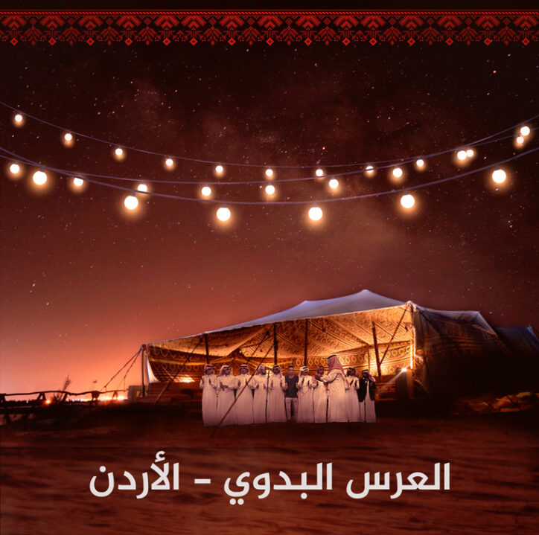
Village style vs Bedouin style weddings
Weddings practices differ across Jordan, but there is two types of weddings Village style and Bedouin style
The village style uses the “dabkeh and is a very popular dance all through the country and happens on a friday traditionally.
The bedwin style lasts for over a week and starts on Thursday for dinner then Friday is the FARIDA which is when the groom goes to the bride’s house .

Slide 5
Dabkeh vs dahiyah
Dabkeh : is a line of men standing next to each other and holding hands while moving and kicking their feet in same motion and direction.
Dahiyah : when men line up in one to two row facing each other and the music is a hijani repeating words while clapping the hands.

Slide 6
Northern weddings vs Southern weddings
Northern wedding are village weddings that include the lunch of the family and relatives in a small village and “a hamam el arees “ shower of the groom is done the day before as a symbol of getting the groom ready .
Southern wedding are more Bedouin style traditionally made in tents and sheep and camels are surrounding the tent .

Slide 7
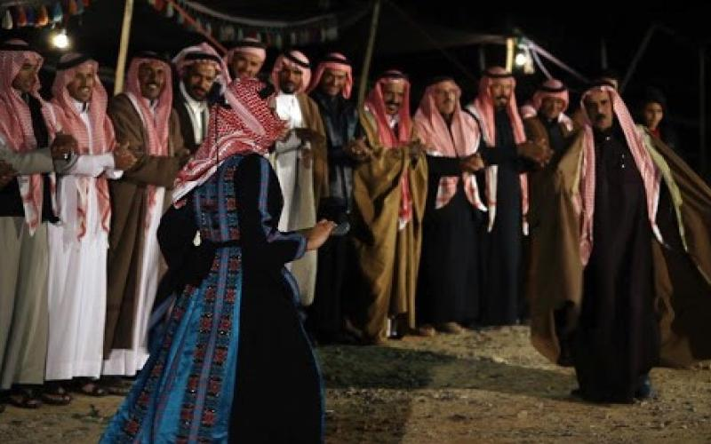
Interview with Hazim Al Shawabkeh

Slide 8
Resources
Jordan news agency-Jordanian folklore ¹
Live interview recorded with Mr. Hashim Shawabkeh
https://ab-mediapro.com/project/bedouin/
Amman Net – Jordanian wedding

