Slide 1
Traditional Food in Jordan
Tina Jabari, Tia Rabadi, Omar Bataineh, Saif Sarraf
6 E

Slide 2
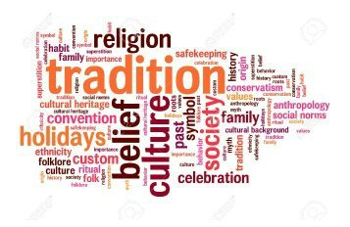
What is a Tradition
A belief, or way of acting that people in a particular society continued to follow for a long time⁽¹⁾.

Slide 3
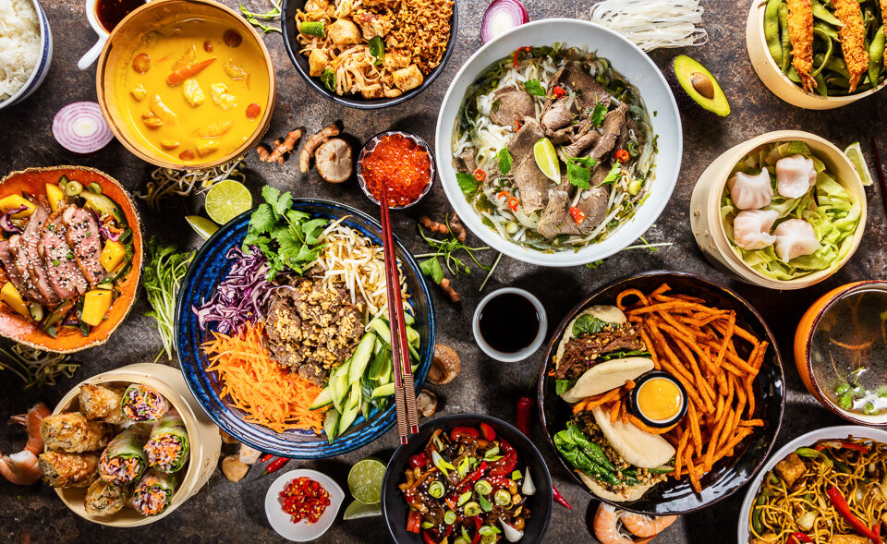
What is the meaning of traditional food
Traditional foods are those foods that have been eaten for centuries and even millennia. They are the foods that your great-great-great-great-great grandmother and grandfather would have eaten⁽²⁾

Slide 4
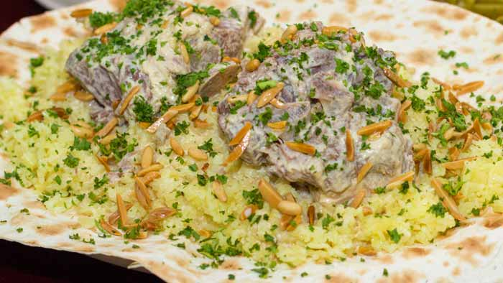
Mansaf⁽³⁾
One of the most popular dishes in the Arab world. It is the traditional signature dish of Jordan , and source of pride for all Jordanians on who makes the best Mansaf.
The layers of bread, rice and meat are arranged on a platter and garnished with fried almond.

Slide 5
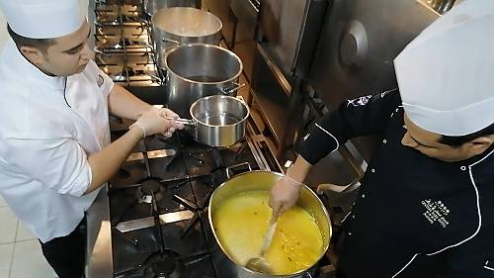
Mansaf ⁽³⁾
Mansaf is made of lamb cooked in a sauce of fermented dried yogurt and served with rice and nuts.
Mansaf is a symbol of deep sense of identity and social cohesion in Jordan.
The preparation itself is a social event, with cooks discussing common concerns, telling stories and singing.

Slide 6
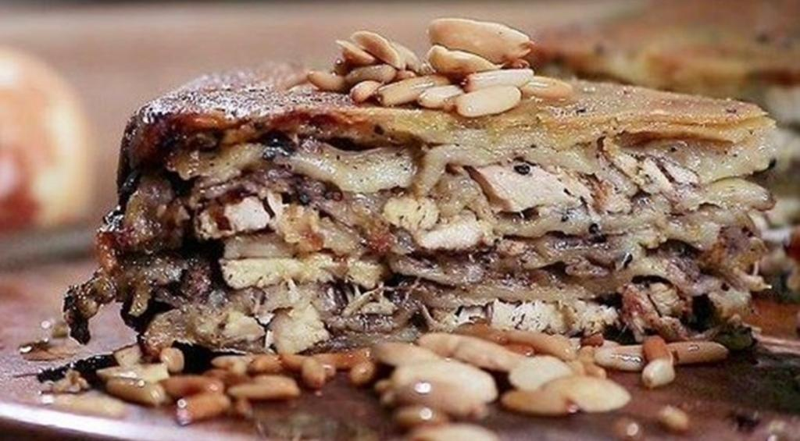
North of Jordan: Makmoura ⁽⁴⁾
Jordan's northernmost city, Irbid, is renowned for its rich history , vibrant culture , and delicious cuisine. One of the many delicious foods to come out of this area. Makmoura, stands out as a local favorite .

Slide 7
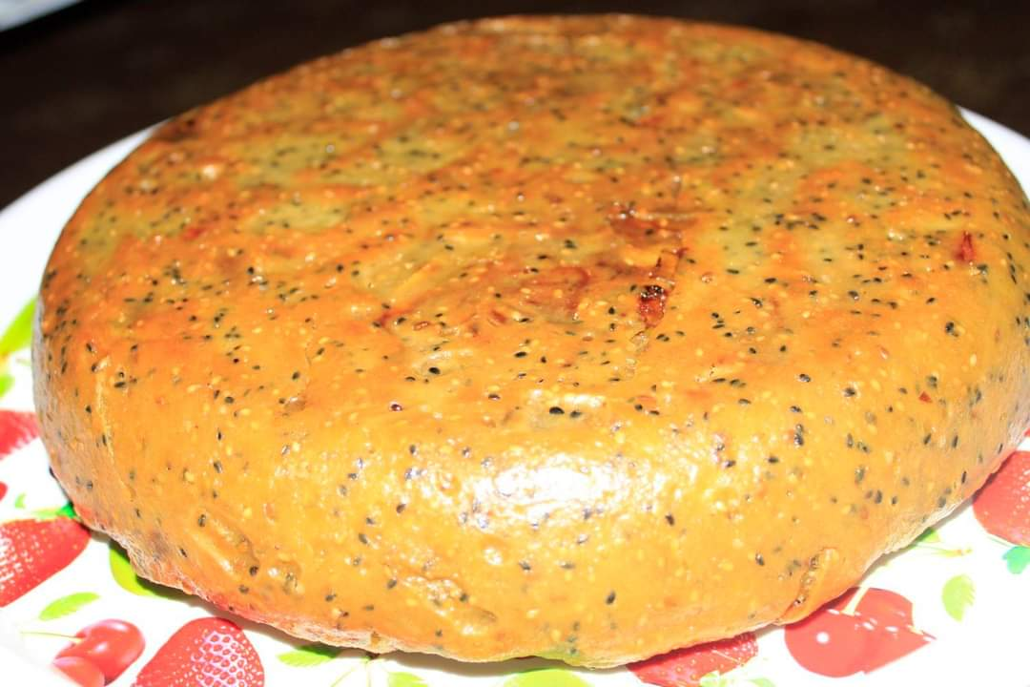
North of Jordan: Makmoura ⁽⁴⁾
Makmoura translates as 'buried' and is prepared by alternating layers of dough with lamb or chicken, onions and an array of seeds and beloved regional spices such as sumac and cumin.

Slide 8
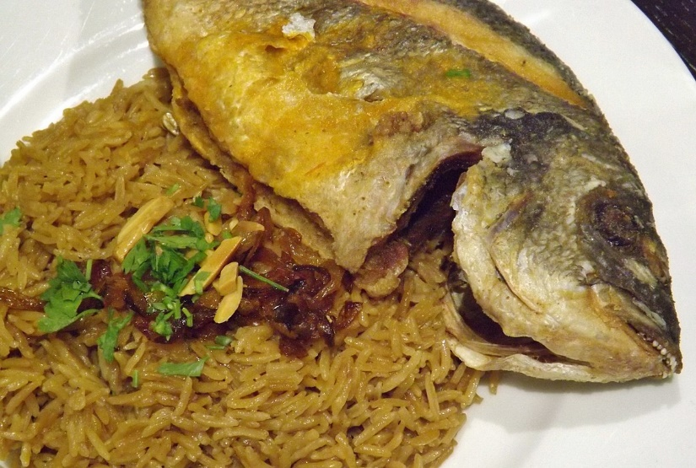
Aqaba: Sayadieh ⁽⁵⁾
Sayadieh is a heavenly meal of spiced rice and fish that is popular in Jordan’s port city , Aqaba especially that fish is fresh in this city that is located near the Red Sea.
Its main ingredients are (fish, delicately spiced, served with rice in an onion and tahini sauce).

Slide 9
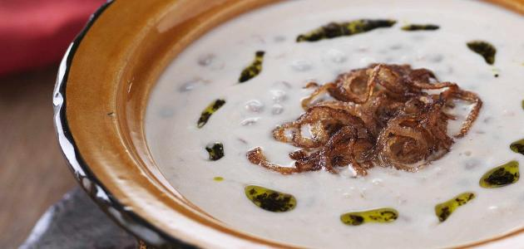
Rashoof⁽⁶⁾
Al-rashoof is a traditional Jordanian soup that is typically made with a combination of green lentils , fried onions, jameed ( dried goats or ewes milk yogourt)

Slide 10
Interview with a Family Member
Omar Bataineh and his mom: traditional food in Irbid
https://www.youtube.com/watch?v=SP_41JBZzag

Slide 11
Interview with a Family Member
Saif Sarraf and his brother: How to prepare Mansaf?
https://youtu.be/U6wFt90hDrc

Slide 12
Resources
https://dictionary.cambridge.org/dictionary/english/tradition#google_vignette
https://www.academia.edu/31464154/Definitions_of_Traditional_Food_Cuisine_With_a_special_interest_in_traditional_production_preparation_and_consumption
https://ich.unesco.org/en/RL/al-mansaf-in-jordan-a-festive-banquet-and-its-social-and-cultural-meanings-01849
https://ar.wikipedia.org/wiki/%D9%85%D9%83%D9%85%D9%88%D8%B1%D8%A9_(%D8%B7%D8%B9%D8%A7%D9%85)
https://en.wikipedia.org/wiki/Sayadieh
https://en.wikipedia.org/wiki/Jordanian_cuisine

