Slide 1
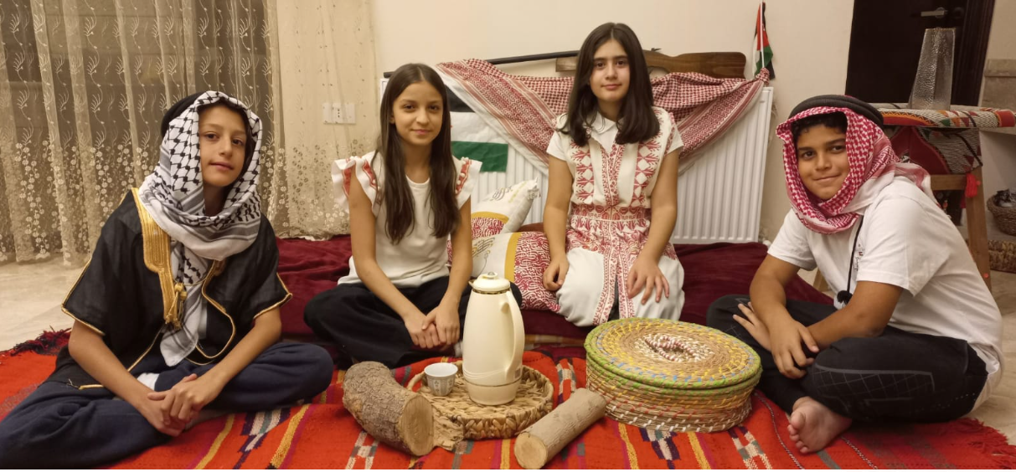
My Traditions
Hosting Guests in Jordanian Traditions
Group 6E
Awn AL Radaideh | Costa Bosheh
Maya Abdul Razik | Laure Al- Kawalit

Slide 2
Introduction to Jordanian Hospitality
Hosting guests in Jordanian Traditions

Slide 3
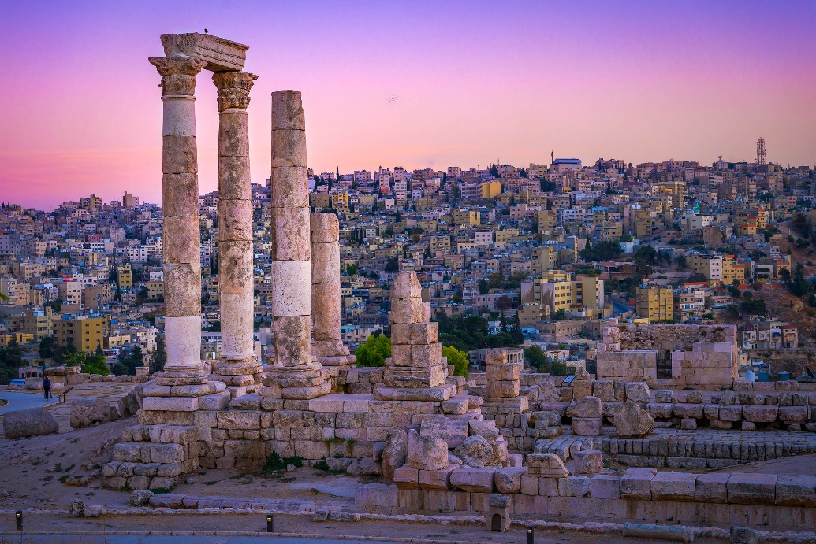
Hosting Guests in Jordanian Traditions
The art of hospitality is a major part of the Jordanian culture, as Jordanians are hospitable people by nature. So whether you are visiting a tourist attraction or being welcomed into a family’s home, you are guaranteed a warm reception.

Slide 4
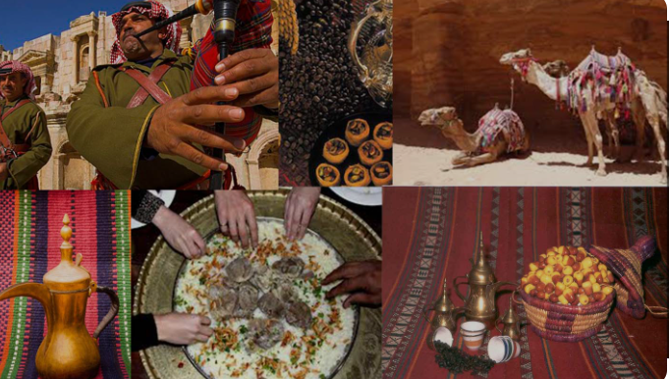
Jordanians commonly express their generosity and hospitality through a series of acts and actions.
Starting from the greeting and welcoming the guests, followed by a rich meal with warm and welcoming conversation.

Slide 5
More about Jordanian Hospitality
Hosting guests in Jordanian Traditions

Slide 6
1- The Greeting
In daily interaction, the people of Jordan greet each other by saying peace be upon you.
If you are being received in a person’s home or place of business you are met with “Ahlan W Sahlan” which means “you are welcome”.
It is customary to stand up when being introduced to someone new.
Sometimes it is acceptable to shake hands between the same genders.

Slide 7
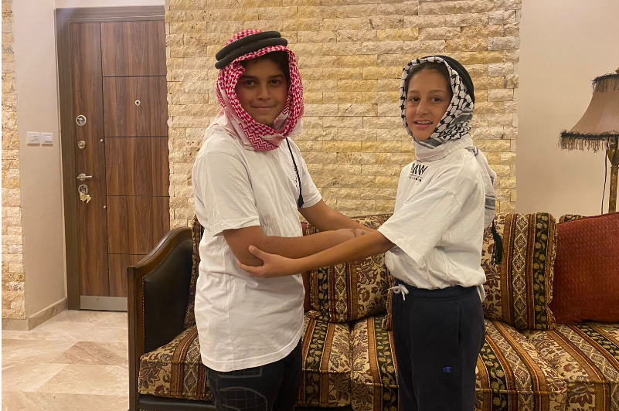
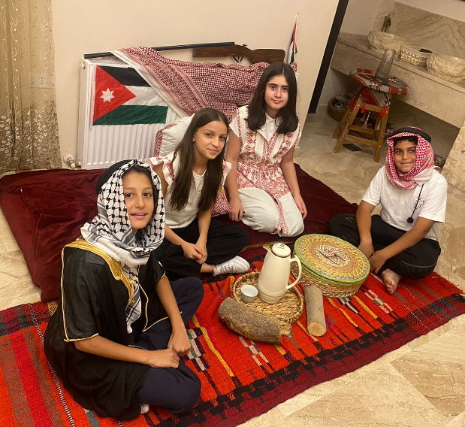
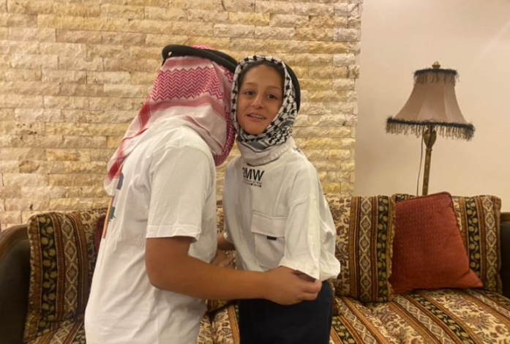

Slide 8
2- Welcoming Guests
The guests are always offered the best seat in the house, which is usually at the right of the host. Guests can expect to receive Arabic Coffee, dates and sometimes sweets.
It is a good gesture to bring a small gift for the household with you. Flowers, Chocolate and Arabic pastries are good examples.

Slide 9
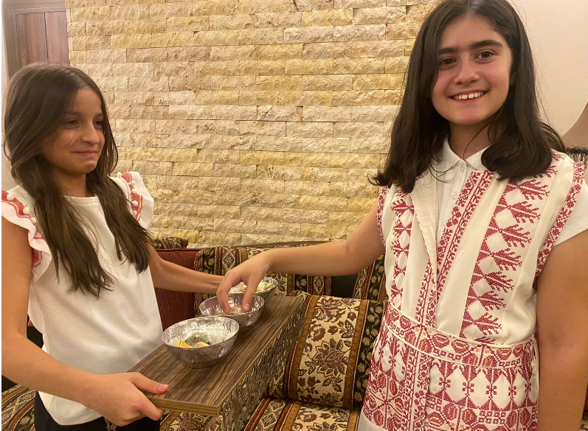
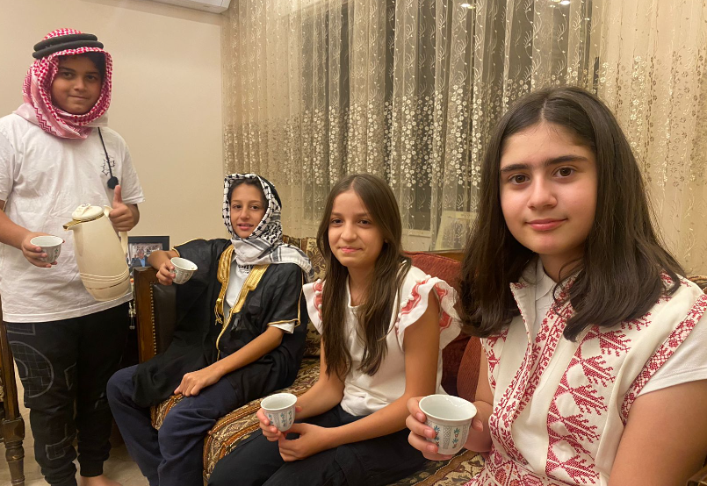

Slide 10
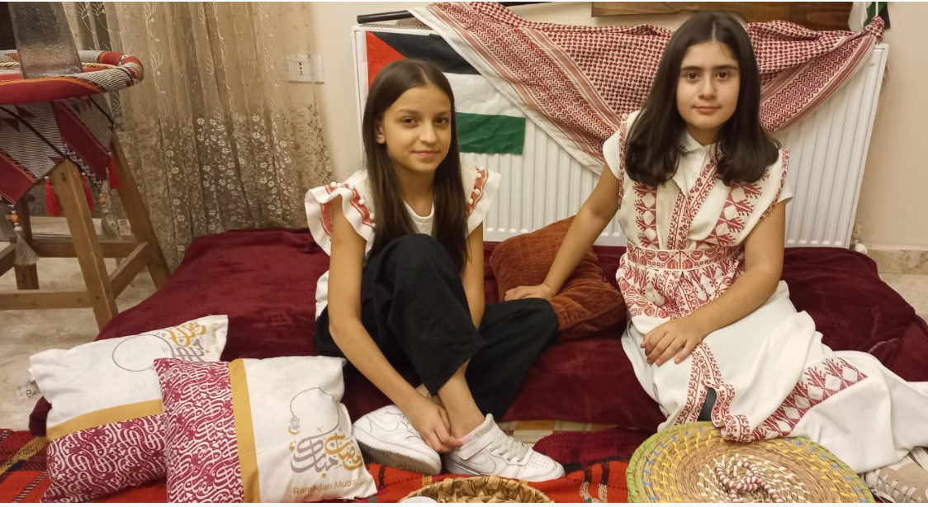
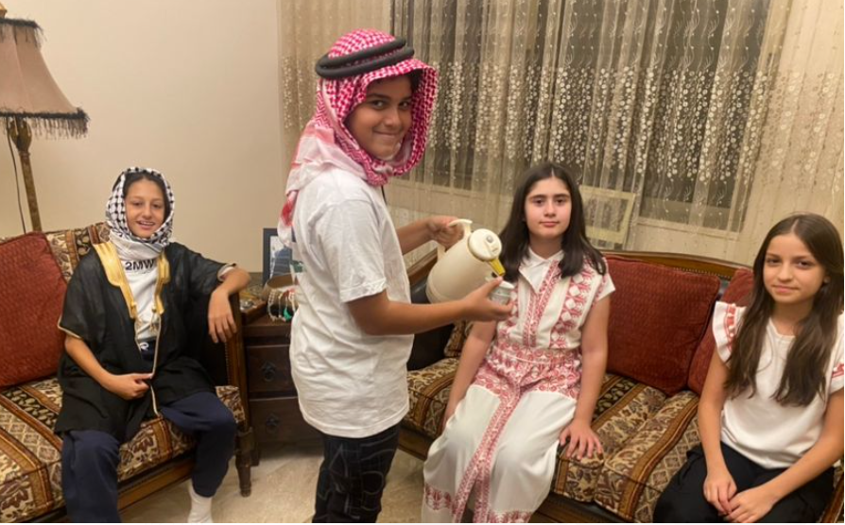

Slide 11
3- The Meal
Jordanians commonly express their generosity through food.
Mansaf is the most famous traditional dish in Jordan. It is the gold standard of gracious hosting.
Other regions in Jordan have their own special dishes. This includes Rashoof in Al-Salt and Cha’acheel in Irbid.
The feeding never stops and a Jordanian might even give you food to take home.

Slide 12
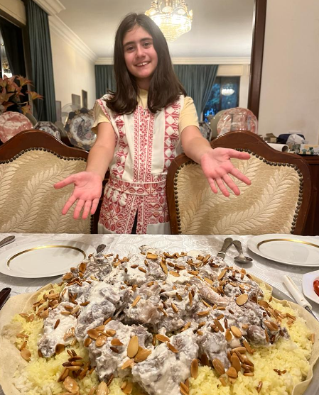
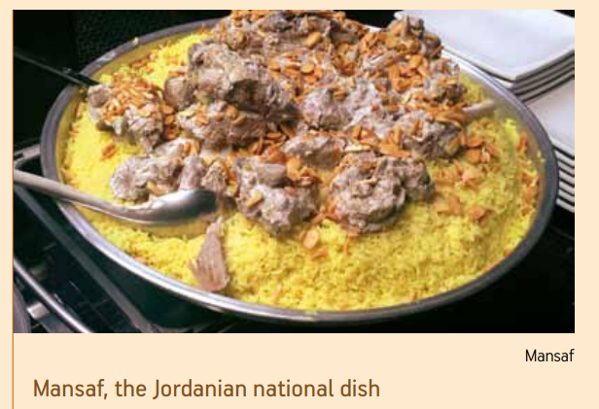
Mansaf, the Jordanian National Dish
Mansaf is the most famous traditional dish for Jordan. Everyone in Jordan and Middle East as well as people worldwide enjoy having Mansaf when they visit Jordan. Usually, if you want to greet somebody you invite him to eat Mansaf.

Slide 13
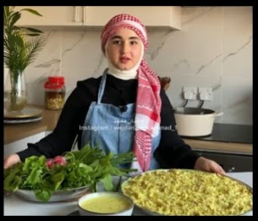
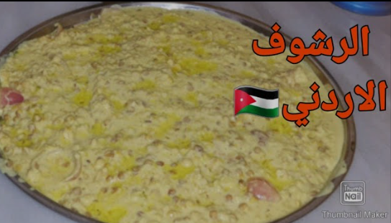
Rashoof Al-Salt
Rashoof is another traditional dish from Al Salt. It is a dish that is cooked mainly in winter.

Slide 14
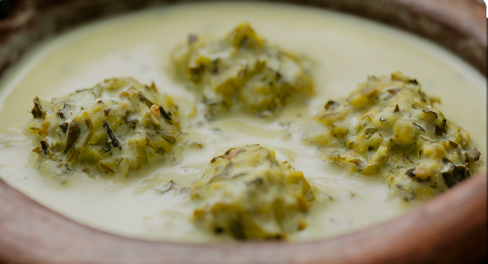
Cha’acheel Irbid
Cha’acheel is a local dish found only around the Rosan area in Irbid. It is made of green leaves known as loof that have anti-cancer properties.

Slide 15
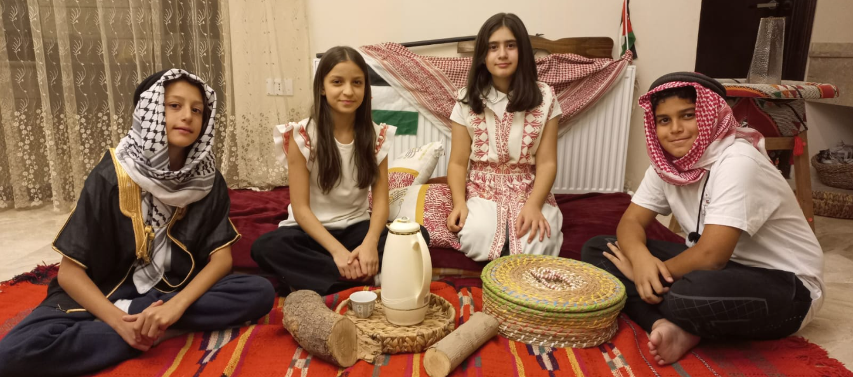
4-Good Conversation
Being invited to a house in Jordan is not usually a quick visit. Guest are showered with attention for many hours.
Communication during hosting is polite and respectful.
The host will often ask about their guests and entertain them with stories and advice.

Slide 16
The Video

Slide 17
Resources Citation
https://umayyad.eu
https://www.visitjordan.gov.jo
https://www.jstor.org
https://www.enicbcmed.eu

Slide 18
Thank You

