Slide 1
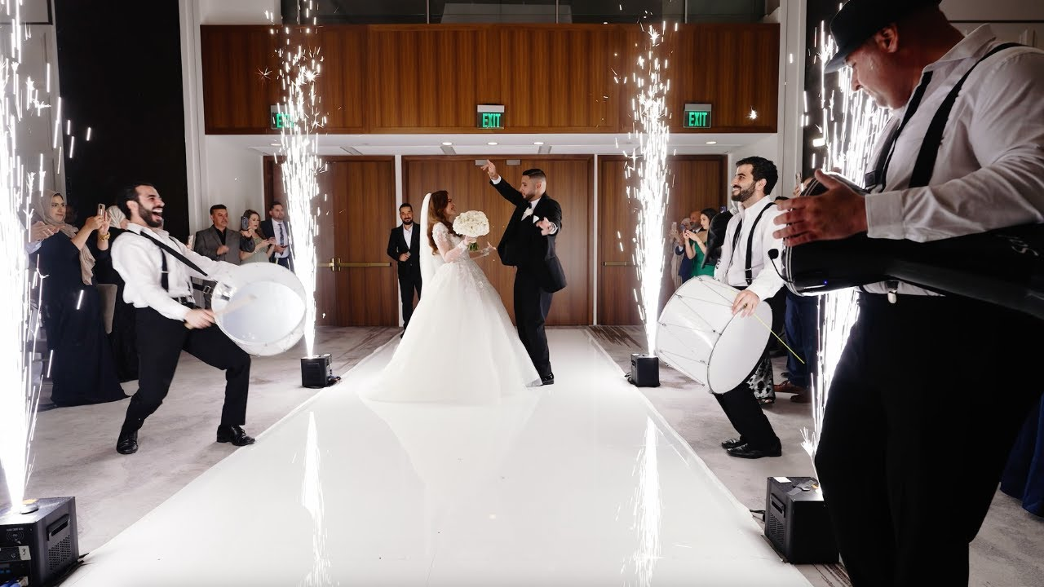
Traditions in Jordanian weddings

Slide 2
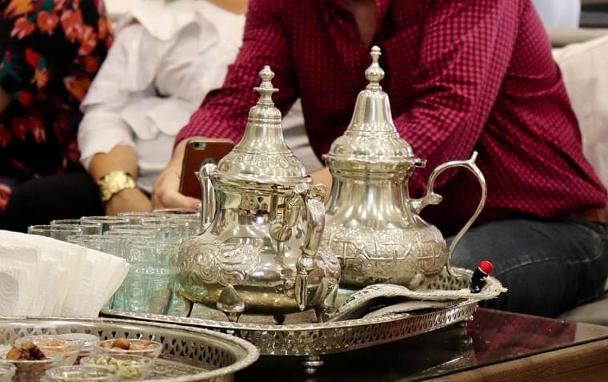
Asking Parents’ Permission (Tulba)
The tulba is the event in which the groom officially asks the bride’s parents for their permission to marry their daughter.

Slide 3
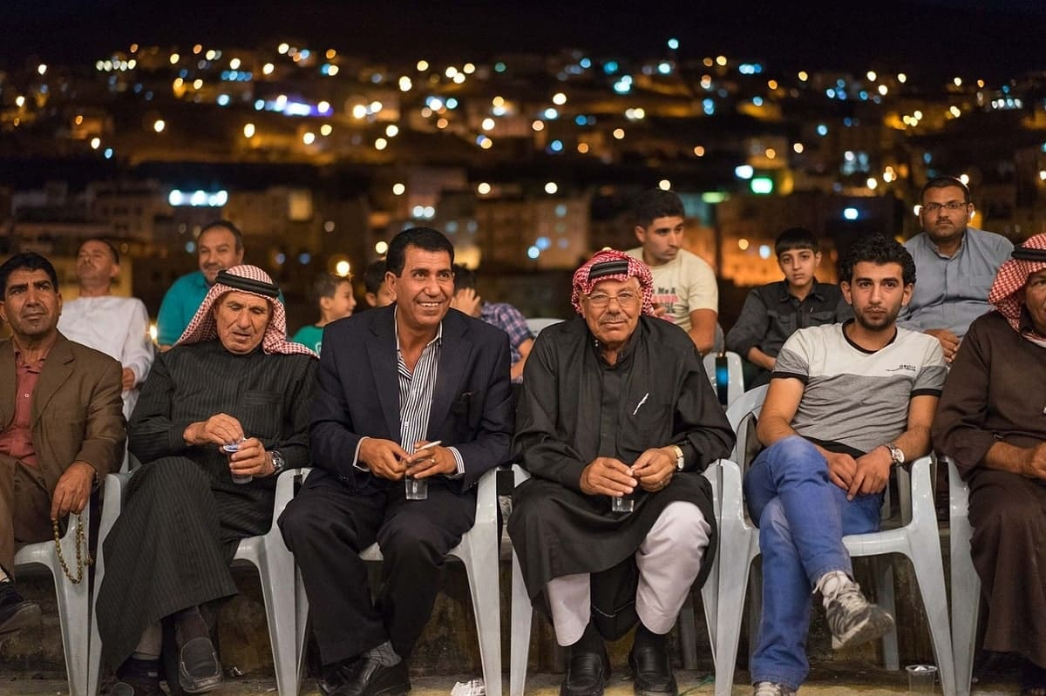
Visiting the Bride’s Home (Jaha)
Following the tulba, there comes a second round of visiting the bride’s home to seek permission. This time with the extended family (and sometimes close friends).

Slide 4
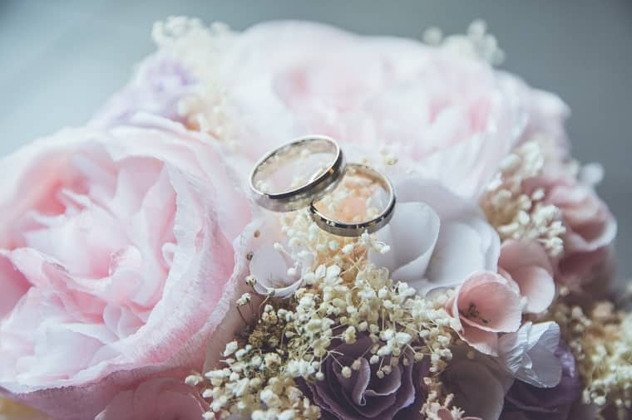
Engagement
In Jordanian culture, it’s still very customary to have a formal engagement. The engagement follows the jaha and usually takes place in the form of a small party.

Slide 5
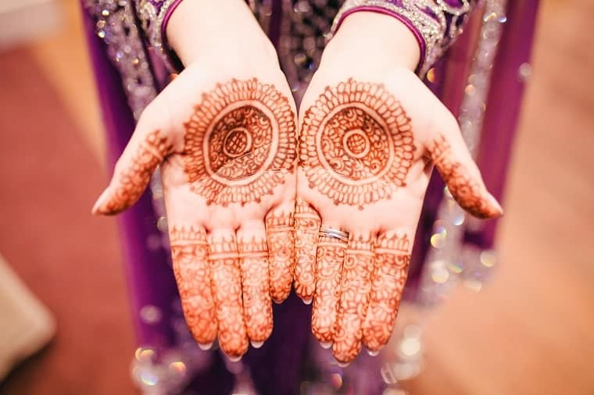
Henna Night
Henna night is a gathering that usually takes place at the bride’s home the night before the wedding. During this event, women from both the bride’s and groom’s families gather to celebrate.

Slide 6
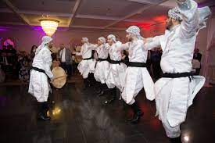
Zaffa
Zaffa is a wedding parade with drums and bagpipes carried out by professional musicians. There will be dabke dancers or belly dancers to welcome the newly weds into the venue.

Slide 7
Congratulations!

Slide 8
Links
Zaffa
https://www.youtube.com/watch?v=Dj2X1b-ZU7A
Henna
https://www.youtube.com/watch?v=bHWLBWBiwAg

