Slide 1
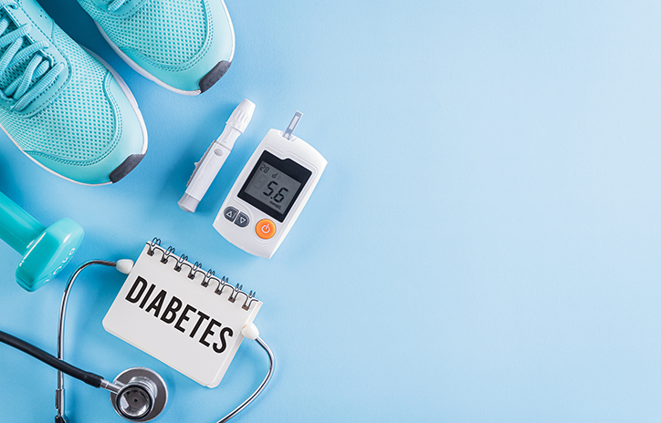
Diabetes
Done by: Nayefa AL- Batarseh ,Raina Barhomah, Celina Sabat, Saif Hijazin and Fawaz Al Lama.
Grade 8 Section A

Slide 2
Before we start lets talk about diabetes in general
With diabetes, your body doesn't make enough insulin or can't use it as well as it should. When there isn't enough insulin or cells stop responding to insulin, too much blood sugar stays in your bloodstream. Over time, that can cause serious health problems, such as heart disease, vision loss, and much more.

Slide 3
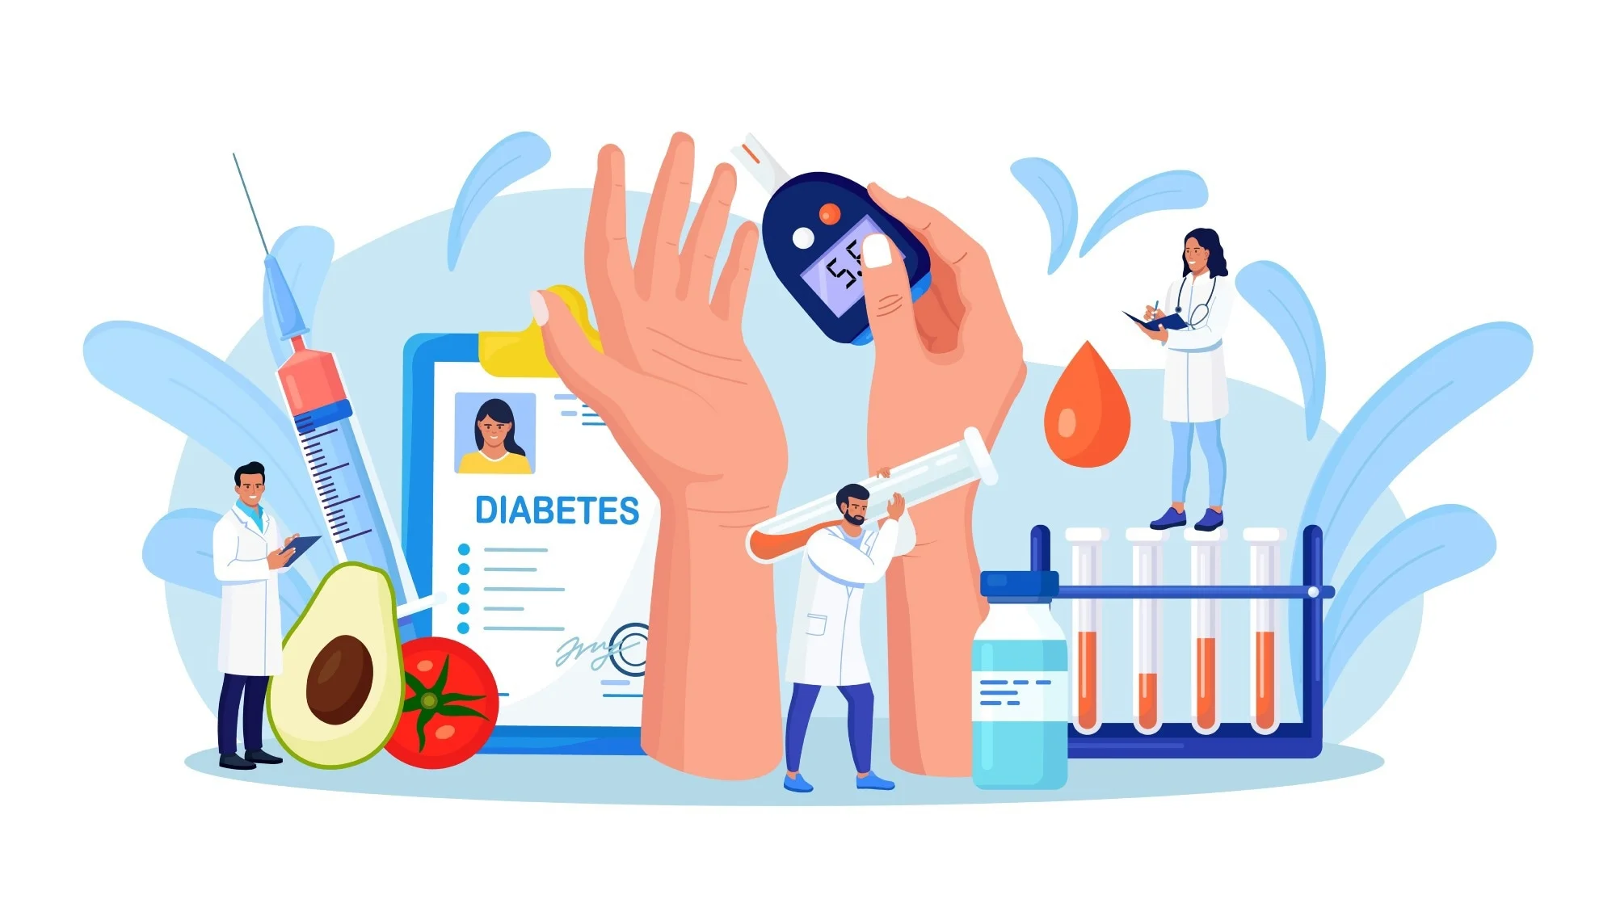
What is Diabetes?
Diabetes is a chronic long- lasting health condition that affects how your body turns food into energy.

Slide 4
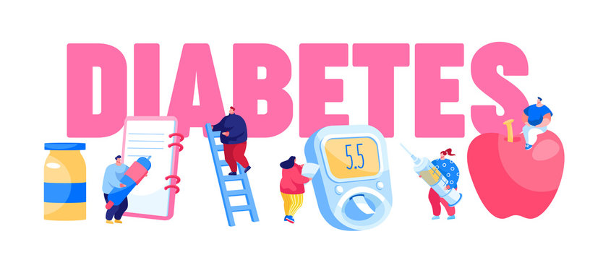
What are the types of diabetes?
There are three main types of diabetes:
Type 1.
Type 2.
Gestational diabetes.

Slide 5
Type 1
It is a chronic condition. In this condition, the pancreas makes little or no insulin. Insulin is a hormone the body uses to allow sugar (glucose) to enter cells to produce energy.

Slide 6
Symptoms of type 1
Feeling more thirsty than usual
Feeling very hungry
Feeling tired and weak
Having blurry vision

Slide 7
Type 2
It is a condition that happens because of a problem in the way the body regulates and uses sugar as a fuel. That sugar also is called glucose. This long-term condition results in too much sugar circulating in the blood.

Slide 8
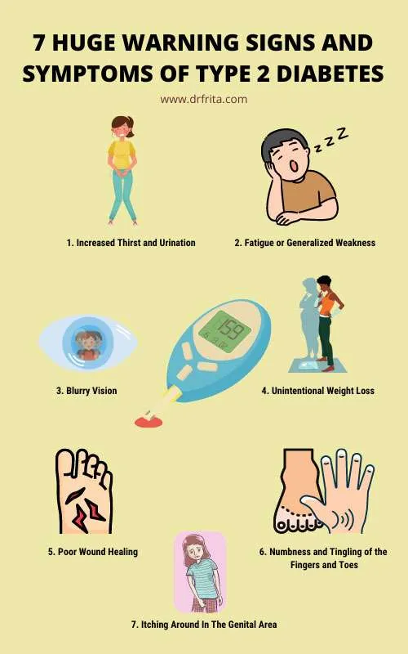
Symptoms of type 2
passing more urine
feeling tired
feeling hungry
having cuts that heal slowly

Slide 9
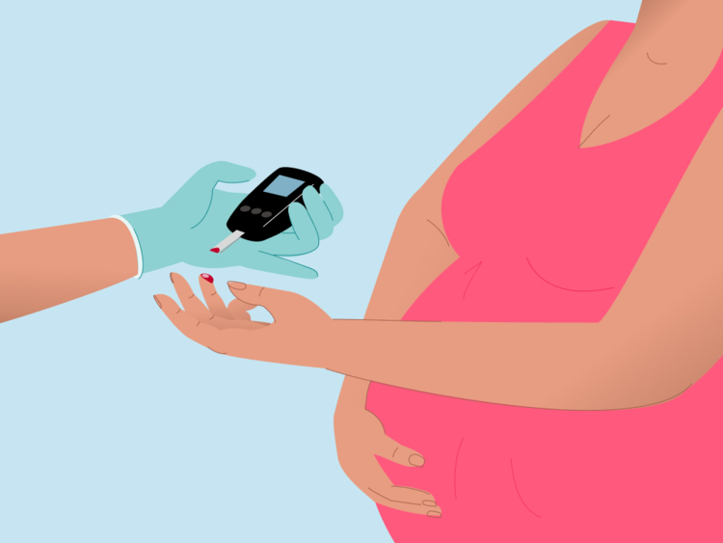
Gestational diabetes
It is a condition in which a hormone made by the placenta prevents the body from using insulin effectively. Glucose builds up in the blood instead of being absorbed by the cells.

Slide 10
Symptoms of Gestational diabetes:
increased thirst.
needing to pee more often than usual.
a dry mouth.
tiredness.

Slide 11
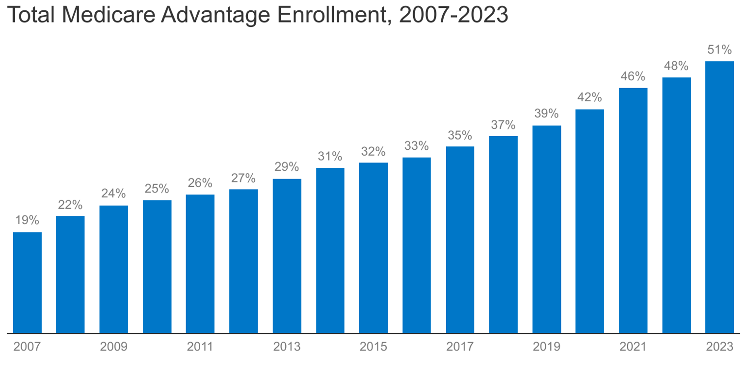
How common diabetes are in Jordan in 2023?
The percentage of people with diabetes among Jordanian adults (over 18 years of age) is about 20%,with a number of two million Jordanians. The main reason for Jordanians suffering from diabetes is obesity, as about 80% of Jordanians suffer from obesity.

Slide 12
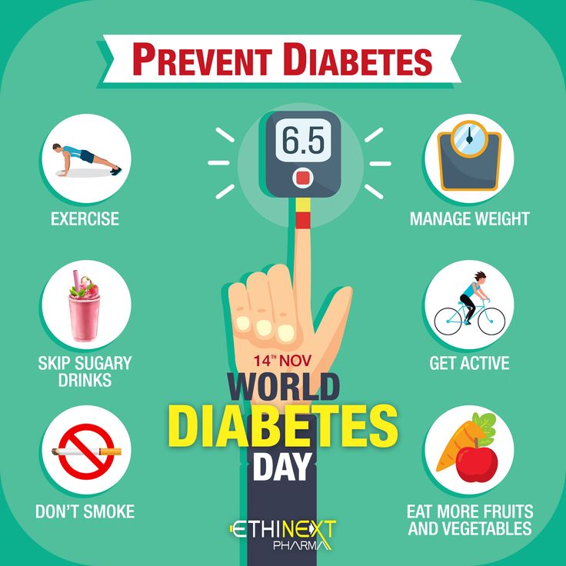
How to

Slide 13
Now before we end our presentation you will be watching a short video about diabetes
https://youtube.com/watch?v=d86DofYpkrY&feature=shared
Video time

Slide 14
www.cdc.gov
www.niddk.nih.gov
www.my.clevelandclinic.org

