Slide 1
Food Around Jordan
By:
Calla Malky
Ayah Abualhaj
Jad Almassis
Sufian Bebe

Slide 2
Introduction
Presenting 3 traditional Jordanian dishes:
Mansaf
Rashouf
Kabab Al-Ramtha

Slide 3
Mansaf
Mansaf is the most famous traditional Jordanian dish which is made of meat cooked in dried yogurt sauce.
The key of any tasty Mansaf is in the dried yogurt and karak city has the tastiest and most famous dried yogurt which is called Jameed.
The traditional way to eat Mansaf from the big plate is by making big rice and meat balls with one hand.

Slide 4
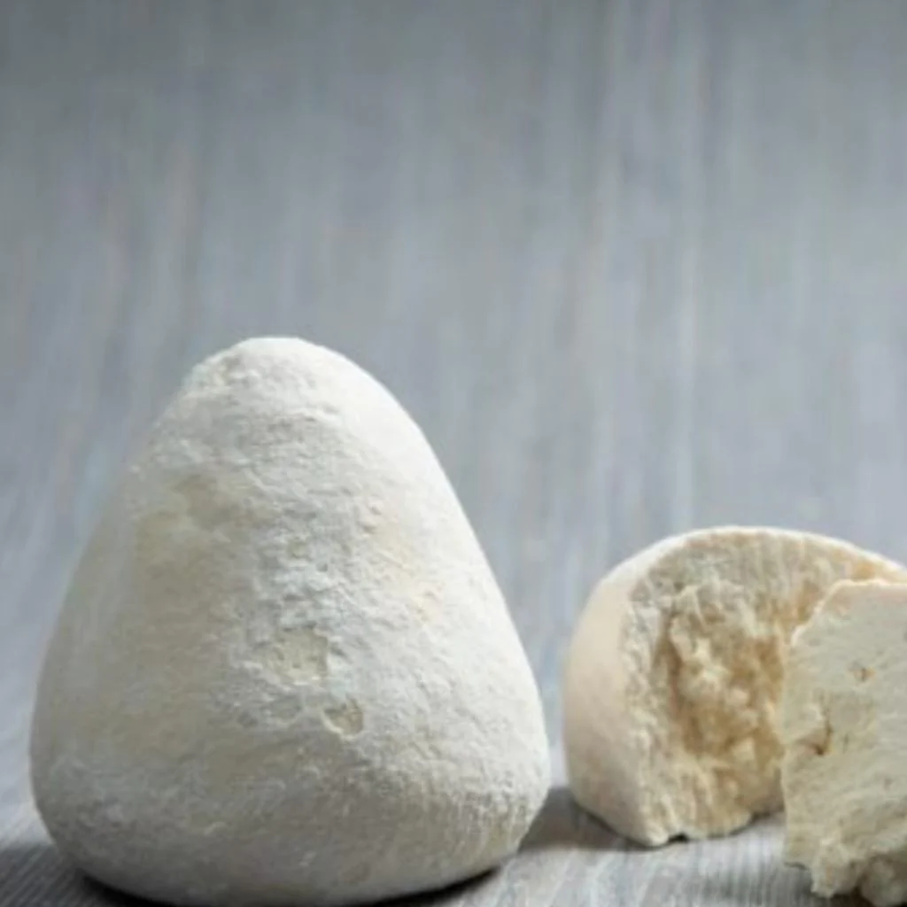

Slide 5
Rashouf
Rashouf is a traditional Jordanian soup that is typically made with a combination of lentils, fried onions, Jameed (dried yogurt) cooked with rice or wheat.
Rashouf is considered a winter dish which gives us energy and heat plus a delicious taste.
Al Salt city in Jordan is famous for its great Rashouf.

Slide 6
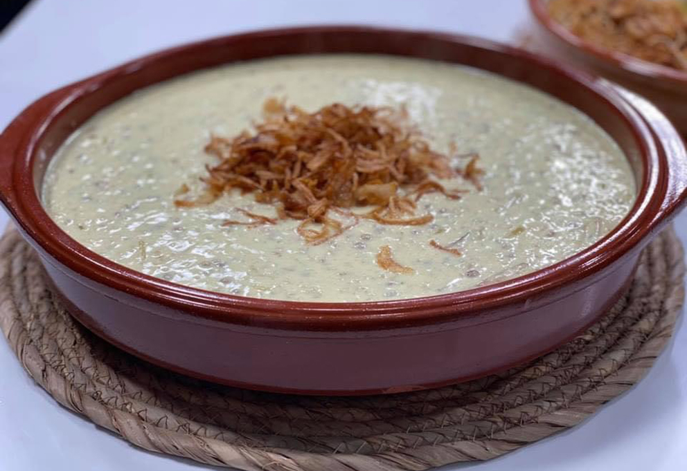
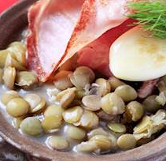
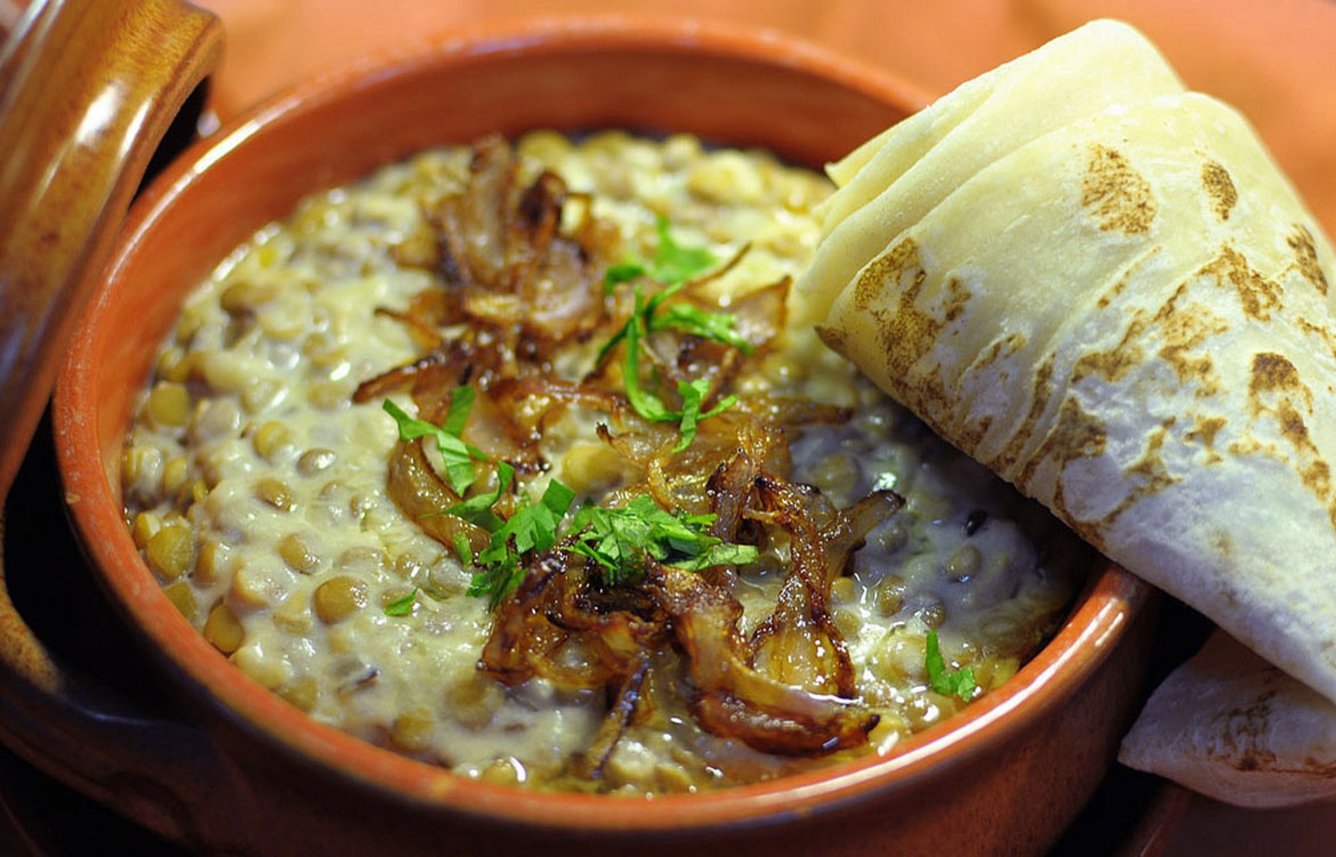
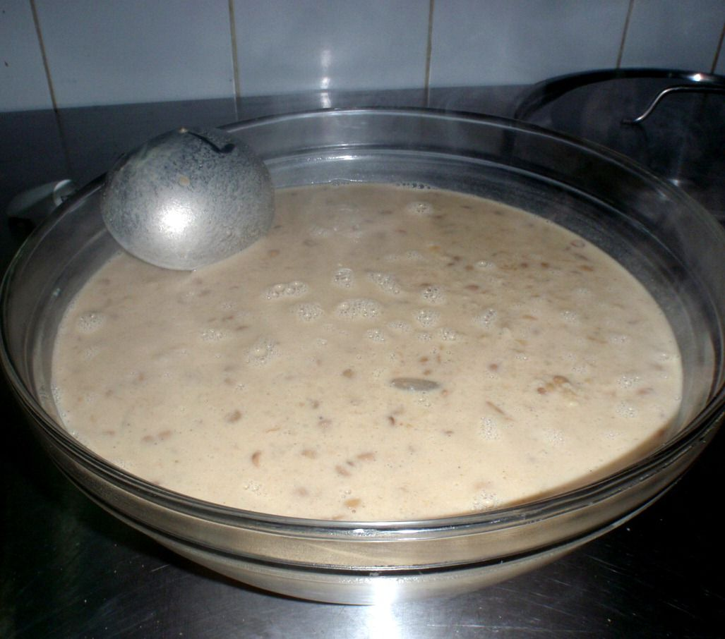

Slide 7
Kabab Al Ramtha
Kabab Al Ramtha is a kind of Kabab which is one of the most famous kinds of meat in Jordan, but Al Ramtha city, added its own additions to it to give it a special flavor.
It has minced meat, wheat, cumin, black pepper, olive oil.

Slide 8
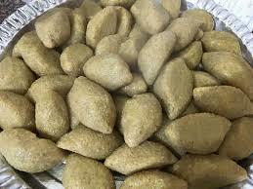
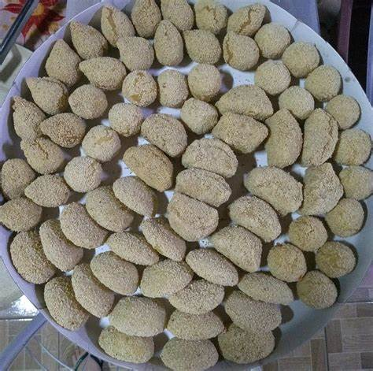
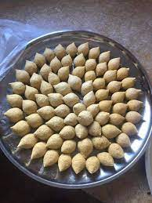

Slide 10
References
https://www.amideastedabroad.org/home/pcolar-blog4
https://www.just.edu.jo/iso/Pages/Cuisine.aspx
http://www.kinghussein.gov.jo/facts3.html
https://www.enicbcmed.eu/discover-culture-and-traditions-jordan-med-pearls-project
https://www.afsusa.org/countries/jordan/
https://ich.gov.jo/node/55695?TSPD_101_R0=08463bc795ab20007d36f551d1bf59718d6d4f2d1136fc75ce7d2a5cdda3843dc9cf0be24f1fe00308b2cbfd7b1430007a2d7cfe6b5a80d9c181456f7f471b2627270ca1adc9b13069d7f465d90db5148cbbbf6ad12289eedf301b06d1bd7d53

