Slide 1
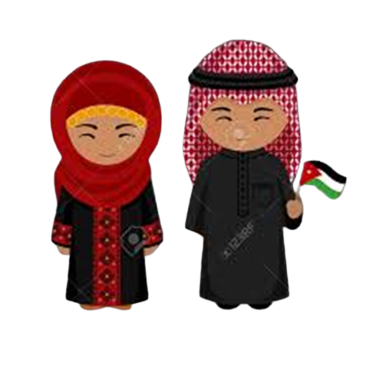
Traditional Clothing in Jordan
By :
Diego
Saif Ayyoub
Talia
Karen
6 C

Slide 2
Traditional Clothing in Jordan
In Jordan the traditional clothing reflect on the cultural and historical traditions in Jordan.
Many Jordanians continue to wear their traditional clothes, especially during special occasions , religious events and cultural celebrations.

Slide 3
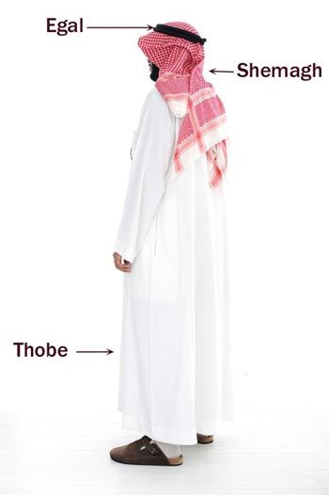
Men Clothes:
The Thobe or Dishdasha is a long white robe worn by Jordanian men.It is made of lightweight cotton fabric suitable for the hot climate.
Typically, the dishdasha is paired with a head covering, called Hatah (a white or checkered scarf) and an Egal (a black cord that holds the hatah in place).
During winter, Jordanians switch to a heavy red and white checkered head covering – the Shemagh or keffiyeh.
Traditionally in Jordanian tribes, if a man’s Agal is not placed straight but rather slanted to the right, it means he is a leader of the tribe or a Sheikh

Slide 4
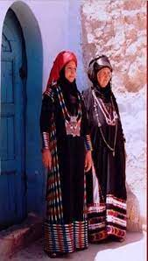
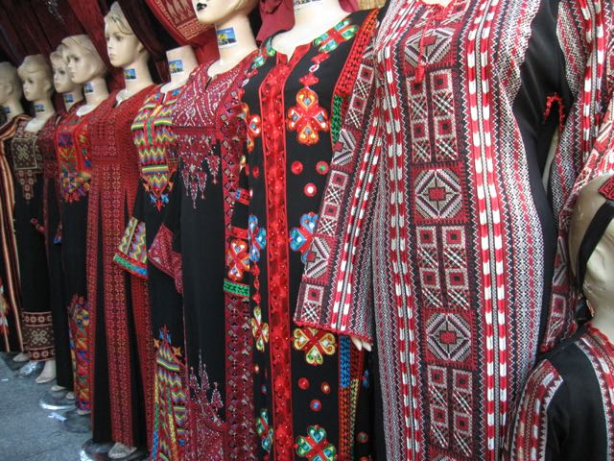
Women’s clothing:
Jordanian women's traditional clothing consists of a Thawb (a dress). On the front of the dress, there is usually a decorative panel made from embroidery or what we call Tatreez. Women frequently wear handcrafted embroidered dresses with red, gold or green accents and a headscarf in the hues of black and red. However, the colors and embroidery style differ in different parts of Jordan.

Slide 5
The embroidery style in Jordan, called al-roqma, differs from that of Palestine. The stitches resemble the numbers seven and eight in the Arabic language.
Most thobes in Jordan were black, and the embroidery colors were the only difference between them. For instance, people in northern governorates traditionally preferred blue, red, yellow, and white embroidery together in the same dress. Additionally, some regions in Jordan, such as the southern governorates, used beads in their embroidery instead of thread.

Slide 6
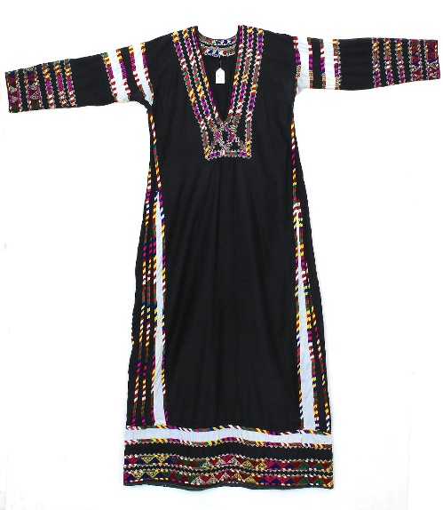
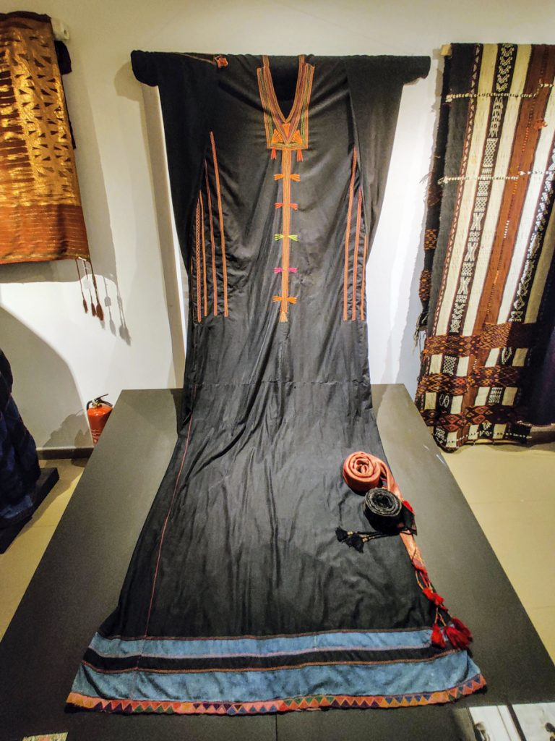
For example, Shirsh is the name for clothing in northern Jordan (in Irbid and Ajloun). They typically have long, tight sleeves and a low, embroidered neckline, and are the same length all around. The sides and hem of the outfit are also elaborate embroidered with lovely motifs.
One unique dress in Jordan, al-khalaga, comes from Al-Salt, one of Jordan’s oldest cities.

Slide 7
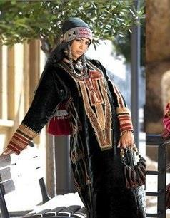
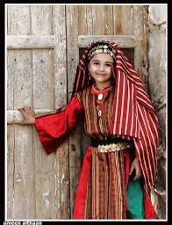
الكرك
معان

Slide 8
Resources:
https://www.amideastedabroad.org/
https://petra.gov.jo/
Thank You

