Slide 1

JORDANIAN
TRADITIONAL FOOD
Student Names:
Hamed Alshelleh
Joyce Imseeh
Victor petro
Tia Alfar
Teacher Name:
Hala Alhmoud
Grade 6-E / CP

Slide 2
INTRODUCTION
Traditional Jordanian cuisine is a rich and diverse culinary heritage, reflecting the country's history, culture, and unique geography. It can be found throughout the country, from the vibrant streets of Amman to the serene deserts of Wadi Rum. It is renowned for delightful dishes like Mansaf, Makmoura, and Sajeyeh, blending the past with the present in a unique way.

Slide 3
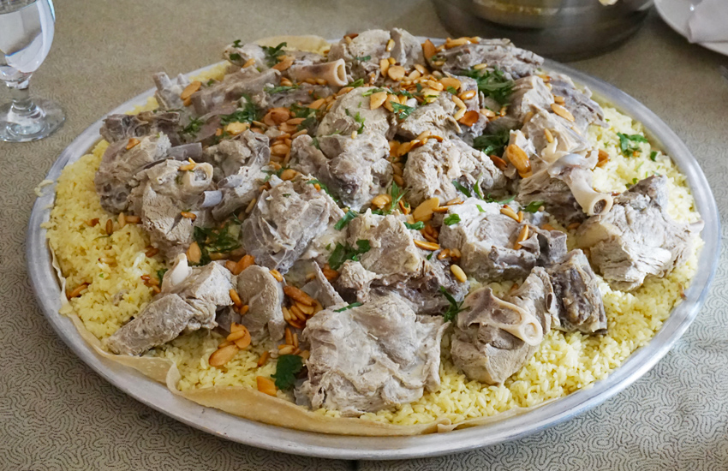
Traditional Jordanian Cuisine
MANSAF
Origin of Mansaf
The history of Jordanian Mansaf is traditionally associated with the city of Karak. Mansaf has a long and rich history in that region. However, it has spread widely throughout Jordan and has become an important part of the national cuisine.

Slide 4
Mansaf Ingredients
Meat, Jameed (dried yogurt), rice, Arabic bread, ghee, almonds, and pine nuts.
How to Eat Mansaf
Mansaf is typically eaten with three fingers of the right hand (the thumb, index finger, and middle finger) or with the whole hand. People often consume Mansaf while standing, and it is preferred to place the left hand behind the back.

Slide 5
Timing for Consuming Mansaf in Jordanian Culture
Mansaf is known in Jordanian culture as a traditional lunch or dinner meal and can be enjoyed at any time of the day, often during significant family gatherings or social events.

Slide 6

JAMEED
Jameed is considerd a foundamental ingredient in the preparation of of mansaf. But what are the best types of Jameed?what is it made from?The best types of Jameed in karak are the ones made from sheep's milk ,although it's also possible to make Jameed from goat's milk.

Slide 7
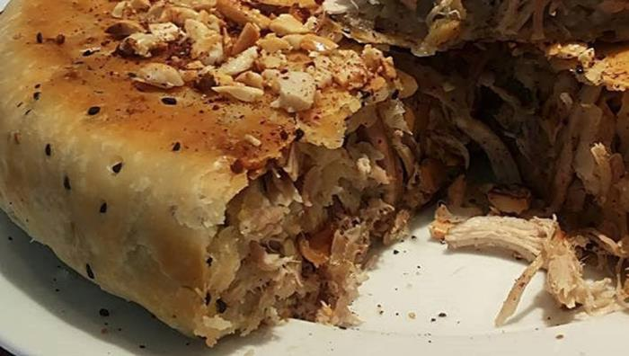
MAKMOURA
Origin of Makmoura
Makmoura is a traditional Jordanian dish among the old, popular, and well-known rural cuisines in the northern regions of Jordan, such as Ramtha, Hawara, and villages north of Irbid.
Makmoura Ingredients
We prepare Makmoura using flour to prepare the dough, meat with minced onions, and olive oil. It is prepared in multiple layers.

Slide 8
TOMATO FRYER (Galayet Bandora)
Origin of Tomato Fryer
Tomato Fryer ( galayet bandora) is a distinctive traditional meal that is easy to Cook. This dish is considerd apart of popular Cuisines in many regions, including the Jordan Valley and tomato fryer is traditionally served in Amman, Al-Salt, Irbid, Al-Karak, and Ma'an, where it enjoys great popularity.

Slide 9
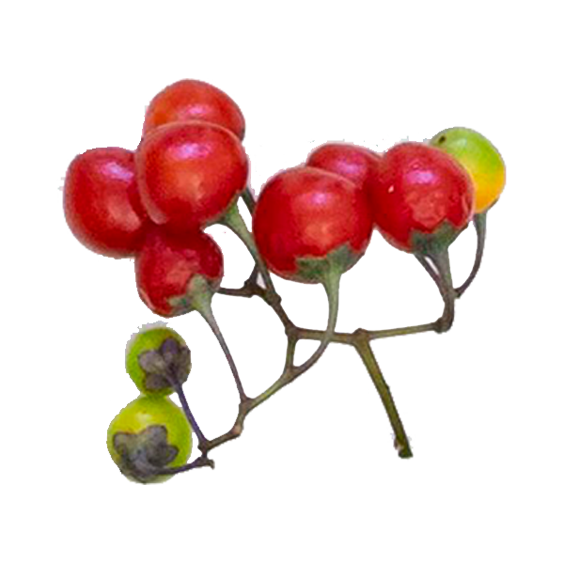



Tomato Frayer Ingredient
Ingredients for tomato fryer typically include tomatoes, olive oil, hot pepper, and optionally, onions and garlic according to personal preferences.

Slide 10
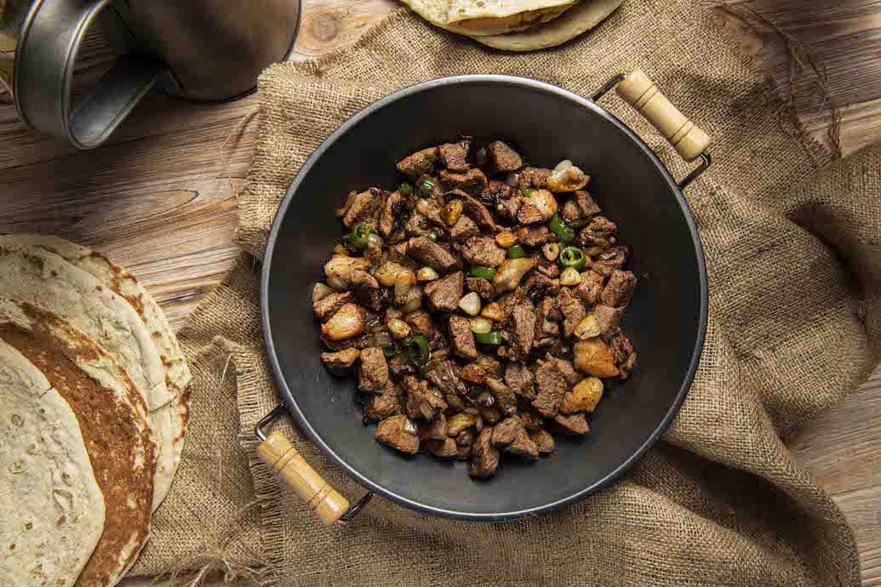
SAJEEYAH
origin of Sajeeyah
The provinces of Irbid, Karak, and Wadi Rum are known in Jordan for making "Sajeeyah." Besides these, Sajeeyah can also be found in other Jordanian provinces like Ma'an, Tafilah, Zarqa, Madaba, and Amman.

Slide 11
Sajeeyah Ingredients
Sajeeyah ingredients include lamb fat, lamb meat, and onions, with optional vegetables like sweet and hot peppers and tomatoes. It is named "Sajeeyah" due to the deep and large pan it is cooked in. Sajeeyah is a favorite dish for outings, holidays, and all occasions.

Slide 12
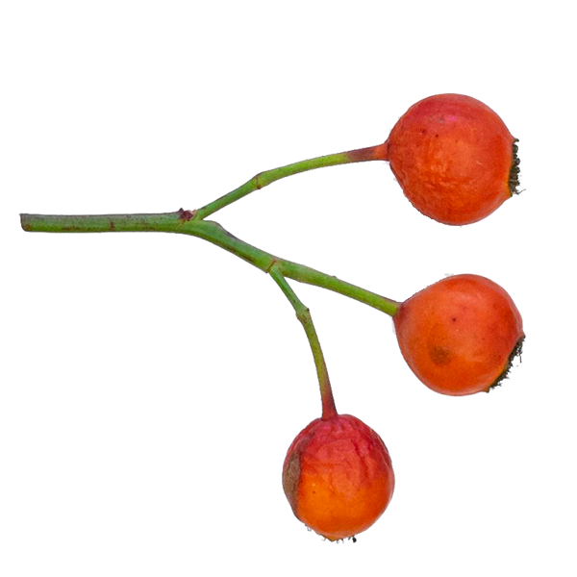

JORDANIAN COFFEE
Origin of Jordanian Coffee
The history of coffee can be traced back to the Bedouins. Jordan's coffee production combines a unique flavor with ancient customs. Jordanian coffee is present in all cities and governorates, from Karak to Amman, and from Jerash to Petra.
Ingredients of Jordanian Coffee
The components of Jordanian coffee include roasted coffee, cardamom, and water, prepared in a dallah to keep it hot.

Slide 13
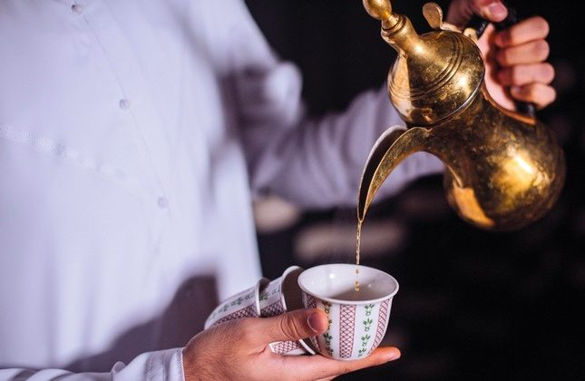
Pouring coffee Traditional in Jordanian Culture
Holding the dallah with the left hand.
Pouring a small quantity of coffee.
Presenting the cup with the right hand.
Serving coffee from right to left in gatherings.
Serving coffee to the eldest first in gatherings.
Not forgetting any guest.
Shaking the cup signal whether you want more or are finished.

Slide 14
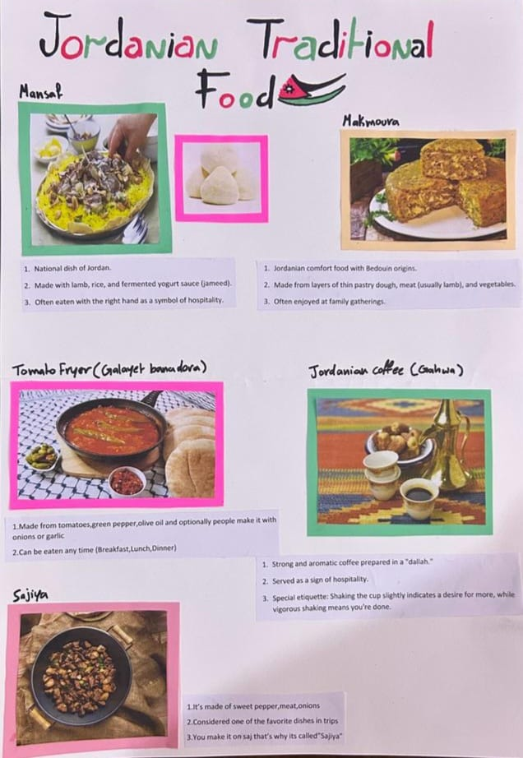
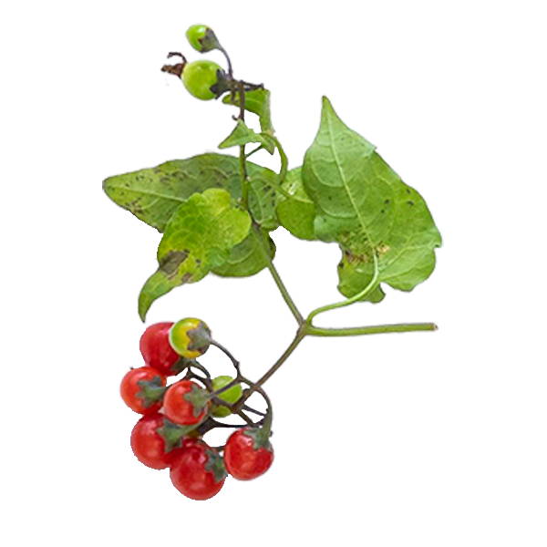
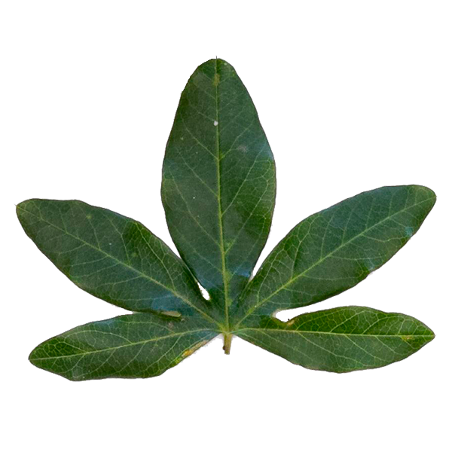
Hamed , Joyce

Slide 15
REFERENCES
Videos:
Jnon.org
3arf.org
archive.org
ich.gov.jo
tabkh.org
https://kohanrishe.net
https://www.youtube.com/watch?v=VjHIhvbPRfs
https://www.youtube.com/watch?v=p2TsPtamTlI
https://www.youtube.com/watch?v=tUtnC0Z7_1w
https://www.youtube.com/watch?v=sbhbTw3QWWk

