Slide 1
The Traditional Food Of Jordan
Made by: Leen Rabadi, Sireen Haddadin, Mohammad Nihad and Henry Habash

Slide 2
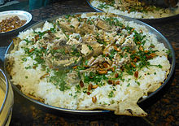
Introduction
Jordan is traditionally full of a long and rich history that has evolved over time.
The most common food in Jordan which is also found in most restaurants is the mansaf. It is a lamb or goat meat dish that is cooked in fermented yoghurt and served with rice or bulgur. There are many variations of mansaf but the main base of the dish which is lamb and yoghurt remains the same.

Slide 3
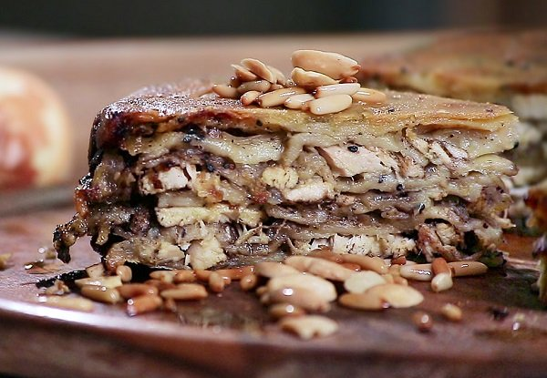
The Traditional Food in The North of Jordan
The makmoura is the most famous and popular traditional food for the north of Jordan like in Irbid. It is often served in occasions and festivals since it adds a beautiful look to the table. The makmoura consists of dough, wheat flour, chicken, onions and olive oil.

Slide 4
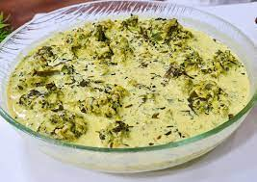
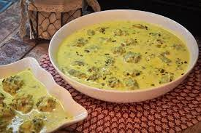
The Traditional Food In the North Of Jordan
There is also jaajeel or sometimes called kaakeel. It is a Jordanian dish par excellence that the people of the North excel in and are creative in preparing.
It consists of wheat flour and eggs, mixed, balled and cooked with milk

Slide 5
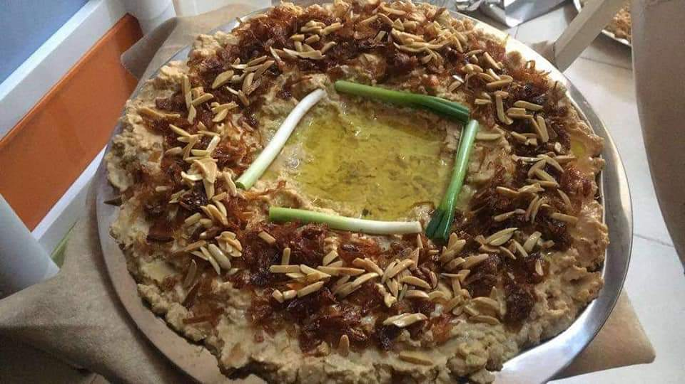
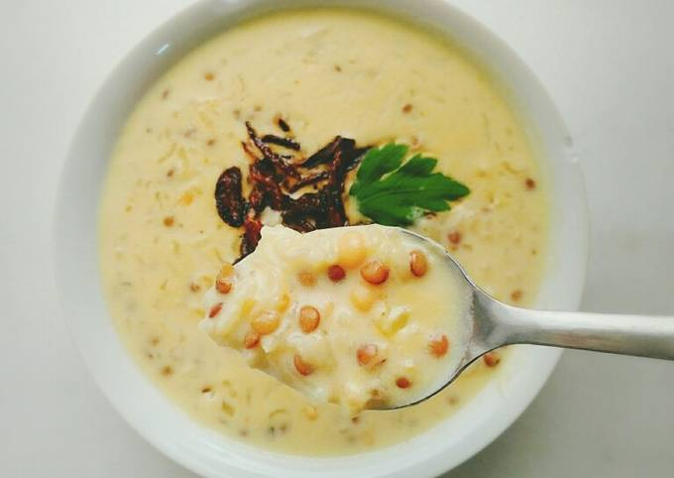
The traditional Food in The South of Jordan
One of the most common and popular traditional food in the south of Jordan as in Karak, Ma’an and in Aqaba is the mojalalah that consists of homemade bread and yoghurt mixed with local homemade margarine.
Other similar traditional food is rashoof which is made out of grinded wheat and lentils mixed with cooked yoghurt.

Slide 6
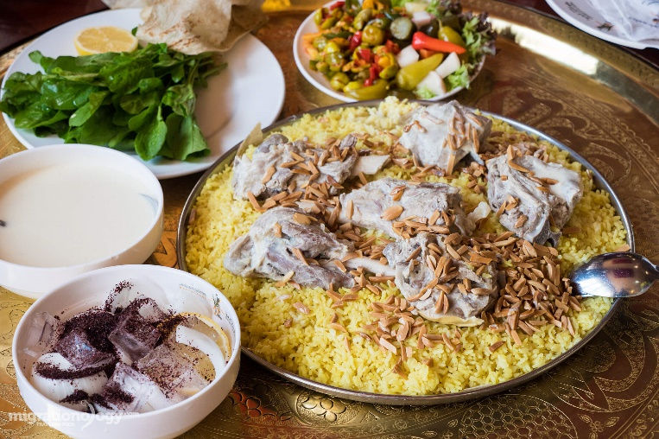
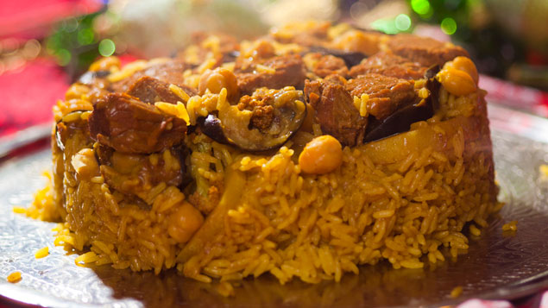
The Traditional Food in the Middle of Jordan
In the middle of Jordan like in Amman and Al salt similarly mansaf is considered the most common traditional food which is cooked and served in the same way as in other parts of Jordan and for the same reasons.
The maqluba is also considered a traditional food in the middle of Jordan. It is made up of eggplants, cauliflower, potatoes , chicken or meat and rice, onions , olive oil, cinnamon, nuts, salt and pepper with spices of maqluba. It usually relates to banquets and different familial events but it can also be made in natural days.

Slide 7
Video:

Slide 8
Recourses / References:
https://www.ammonnews.net/article/44248
https://www.ammonnews.net/article/352686
https://ich.gov.jo/node/55688

